Slide 1
Informed Consent SNS Resident Training Course
Harvey Cushing, M.D.
Osler Professor
Cambridge University

Slide 2
Outline
Historical Perspective
Components of an Informed Consent
Special Considerations
Obtunded or incapacitated patients
Alert but cognitively impaired patients
Pediatric patients
Etc.
Exceptions to the Rule

Slide 3
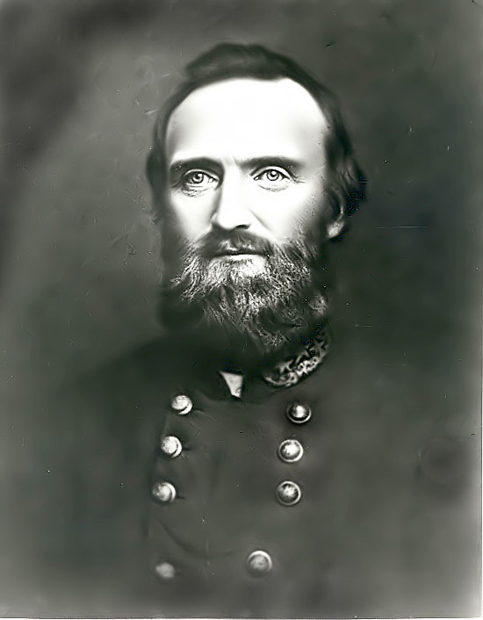
Historical Perspective
The story of Stonewall Jackson’s arm
Natanson v. Kline, 1960
Entry of “informed consent” into the medical lexicon
General Thomas “Stonewall” Jackson
Notes:
A rare insight into mid-nineteenth century surgical practice can be found in the story of Stonewall Jackson’s left arm in 1863. Battle-wounded Jackson was briefed as to the diagnosis (an unsalvagable arm secondary to severity of injury), a statement of the procedure (his arm would require amputation) and a verbal consent was obtained via a face-to-face exchange between him and his surgeon. Surgery proceeded uneventfully but he died 8 days later of pneumonia.
Natanson v. Kline, 1960: Irma Natanson was referred to Dr. Kline for post-op cobalt radiation therapy for treatment of her breast cancer. Following completion of the radiation therapy, Ms. Natanson filed a malpractice suit against Dr. Kline alleging that “they administered the radiation in such a negligent manner that the skin, flesh and muscles beleat her left arm sloughed away and the ribes of her left chest were so burned they became necrotic.” Ms. Natanson went on to claim that Dr. Kline was negligent because he failed to inform her of the risks of the radiation treatment. Following a series of appeals that ultimately reached the Kansas Supreme Court the following decision was issued: “The duty of the physician to disclose, however is limited to those disclosures which a reasonalbe medical professional would made under the same circumstances. How the physican [executes his responsibility] to the patient…is a question of medical judgement.”

Slide 4
Informed Consent
Both a legal requirement and a standard of ethical surgical practice
Promotes a conversation between surgeon and patient that develops the surgeon/patient relationship and may improve the patient's care and the treatment outcome
Information must be presented fairly, clearly, accurately, and compassionately
The surgeon should listen to and understand the patient's feelings and wishes and should answer all questions as accurately a possible

Slide 5
Components to Include
The nature of the illness and the natural consequences of no treatment
The nature of the proposed operation, including estimated risks of mortality and morbidity.
The more common known complications, which should be described and discussed. This discussion should include a description of what to expect during the hospitalization and post hospital recovery.
Alternative forms of treatment, including non-operative techniques.
*Identity of those participating in surgery and their respective roles should be disclosed (including residents, extenders, etc.)

Slide 6
Things to keep in mind…
The discussion must occur in lay language in order to verify understanding of the discussion
The patient must not only have the opportunity to ask questions but must feel as if they have had ample time to ask all their questions
What is important to one person will be irrelevant to someone else, we as surgeons carry the responsibility to identify what would be deemed “important or material” to someone’s decision making
The physician should separately document the discussion that occurred in a timely manner, emphasizing key elements of the discussion
This often proves to be the single strongest piece of evidence in a court of law when cases of malpractice are levied against a physician

Slide 7
Special Considerations
Consent for procedures in the obtunded or incapacitated patient
Legal decision making hierarchy must be respected:
1. Legal Power of Attorney
2. Patient’s spouse
3. Patient’s adult child*
4. Patient’s parent*
5. Patient’s sibling*
6. Patient’s adult grandchild or other adult relative*
7. Close friend of the patient*
8. Legal guardian of the patient’s estate
*Agreement must be reached between members of equal priority

Slide 8
Special Considerations
Consenting the alert but cognitively impaired patient
Include them in the discussion as best they are able to participate but verify consent with a competent guardian

Slide 9
Special Considerations
Considerations for pediatric patients
Patients old enough to express understanding and voice an opinion pertaining to medical treatment must be included in the conversation for informed consent
Assent, or agreement, should be obtained from children who participate in the informed consent conversation although legal consent is obtained from their parents
If no assent is obtained, further discussions should continue including delaying non-emergent interventions until assent can be obtained

Slide 10
Special Considerations
Considerations for pediatric patients
When a minor may consent to his/her own treatment
Active duty military
16 years of age or older, residing apart from their parents and manages their financial affairs regardless of source of support
Diagnosis and treatment of an infectious, contagious or communicable disease that is required to be reported
If unmarried and pregnant, consenting to treatment related to her pregnancy other than abortion
Consenting to examination and treatment for drug addiction
Consenting to counseling for sexual, physical or emotional abuse, suicide prevention or drug addiction

Slide 11
Special Considerations
Considerations for foreign language speaking patients
An approved medical interpreter should be used for all conversations seeking informed consent

Slide 12
Special Considerations
Considerations for when you have trouble obtaining consent for best medical treatment:
It is always a patient’s right to refuse treatment
What to do when this happens in adult patients:
Physician must assure him/herself that risks and benefits have been adequately discussed and patients questions have been answered
If the physician is convinced that the patient is of sound mind and refusing treatment then they should document the details of their conversation as well as stated risks of refusing treatment
If the physician is concerned there are issues pertaining to capacity, interference from misinformed or abusive family members, financial considerations or other factors influencing the patients decision, the case should be discussed with departmental administration, risk management, hospital ethics committee and legal counsel to thoroughly address those concerns

Slide 13
Special Considerations
Considerations for when you have trouble obtaining consent for best medical treatment:
It is always a patient’s right to refuse treatment
What to do when this happens in pediatric patients:
Physician must assure him/herself that risks and benefits have been adequately discussed and that all questions have been answered
If a physician believes treatment is critical for the survival of the patient or if there are concerns regarding abuse or neglect, the case may be discussed with departmental administration, risk management, hospital ethics committee and legal counsel to evaluate options to potentially supersede parental decision-making

Slide 14
Special Considerations
Considerations for Conflict of Interest Disclosures:
Surgeons who receive payments from a medical device manufacturer or distributor, or who have a personal financial interest in such companies must report his or her financial relationship with that company as it pertains to their expertise in evaluating any product
Example - Dr. Jones has been involved in re-designing an implantable cervical cage that is now commercially available by Company X which pays her a consulting fee for her involvement in re-designing this product. Mr. Smith requires a cervical corpectomy for management of cervical spondylosis. If Dr. Jones wants to use this new cage, her financial relationship must be disclosed to Mr. Smith as part of the informed consent process indicating the non-financial benefits of that particular device. If Mr. Smith refuses implantation of that device based solely on Dr. Jones’ financial relationship, an alternative cervical cage must be selected.

Slide 15
Exception to the Rule
Schloendorff v. Society of New York Hospital in 1914: “Every human being of adult years and sound mind has a right to determine what shall be done with his own body…This is true except in cases of emergency where the patient is unconscious and where it is necessary to operate before consent can be obtained.”
Emergent consent is obtained via 2 physicians agreeing that a procedure is deemed life-saving for an unresponsive patient when all reasonable measures to contact next of kin have been exhausted. At that point, both physicians sign the consent form, document necessity for the procedure and what efforts were made to reach next of kin and then proceed with surgical intervention.

