Slide 1
Introduction to Mock RC
Nicholas M Barbaro, MD
Chair, Review Committee for Neurological Surgery
Program Director Annual Meeting
SNS May 19, 2018

Slide 2
Topics
Review Committee Members
Strategic Plan/Conflict-Duality of Interest
Annual Program Review Overview and Data
Accreditation Process
Demonstration of 5 program reviews
2 annual program reviews
2 increase requests
1 site request

Slide 3
Review Committee Membership: Current
Nicholas M Barbaro, MD, Chair
Griffith R Harsh IV, MD, Vice Chair
Sepideh Amin-Hanjani, MD
M Sean Grady, MD
Nickalus Kahn, MD, Resident Member
Robert Harbaugh, MD
Karin Muraszko, MD
Harry Rosenbluth MBA (Public Member)
Gregory Smith, DO

Slide 4
New Member Effective 7/1/2018
Christopher I Shaffrey MD
University of Virginia Medical Center

Slide 5
Strategic Plan (reviewed at every meeting)
Mission
We improve health care and population health by assessing and advancing the quality of resident physicians’ education through accreditation.
Vision
We imagine a world characterized by:
A structured approach to evaluating the competency of all residents and fellows,
Motivated physician role models leading all GME programs,
High quality, supervised, humanistic clinical educational experience, with customized formative feedback,
Clinical learning environments characterized by excellence in clinical care, safety, and professionalism,
Residents and fellows achieving specialty specific proficiency prior to graduation,
Residents and fellows are prepared to be Virtuous Physicians who place the needs and well-being of patients first.
© 2018 Accreditation Council for Graduate Medical Education (ACGME)

Slide 6
Strategic Plan (reviewed at every meeting)
ACGME Values
Honesty and Integrity
Excellence and Innovation
Accountability and Transparency
Fairness and Equity
Stewardship and Service
Engagement of Stakeholders
Leadership and Collaboration
Strategic Priorities
Foster innovation and improvement in the learning environment
Increase the accreditation emphasis on educational outcomes
Increase efficiency and reduce burden in accreditation
Improve communication and collaboration with key external stakeholders
© 2018 Accreditation Council for Graduate Medical Education (ACGME)

Slide 7
CoI/DoI Policy(reviewed at every meeting)
Purpose
Protect the integrity of accreditation/recognition as a peer-review process
Protect Committee members from censure
Protect the integrity of the ACGME
Definitions
Financial interest
Conflict or apparent conflict of interest
Duality or apparent duality of interest
Examples
Automatic same-state recusal
Prohibits members from accreditation-related consulting/advising
Fiduciary duty is to the ACGME
Only the chair/executive director can speak on behalf of the RC
© 2018 Accreditation Council for Graduate Medical Education (ACGME)

Slide 8
Accreditation System Overview
Annual Program Review by Review Committee (January)
May include Progress Report request
Annual Data Submission
(Fall)
© 2018 Accreditation Council for Graduate Medical Education (ACGME)

Slide 9
Accreditation System Overview
Annual Program Review by Review Committee (January)
Annual Data Submission
(Fall)
Site Visit or Clarifying Info Requested
May include Progress Report request
Program Review by Review Committee (April)
© 2018 Accreditation Council for Graduate Medical Education (ACGME)

Slide 10
Annual Program Review
Takes place at January RRC meeting
All programs on either review or consent agenda
Programs on review agenda:
Status of AOW or Probation; applications; complaints
Current citations resulting from previous annual review
Potential citation(s) [below threshold level: case log, board scores, scholarly activity, resident survey]
Interim requests
© 2018 Accreditation Council for Graduate Medical Education (ACGME)

Slide 11
Annual Program Review (Follow-up)
Takes place at April RRC meeting
Programs on review agenda:
Site visit/clarifying information requested at January RRC meeting
Applications
Complaints
Interim requests
© 2018 Accreditation Council for Graduate Medical Education (ACGME)

Slide 12
Annual Program Review: Data Elements
Annual ADS Update
Program Changes – Participating site/sponsor
Program Attrition – Program director/core faculty members/residents
Case Logs
Surveys
Resident
Faculty
Scholarly Activity – Faculty members and residents
Major changes and responses to citations
© 2018 Accreditation Council for Graduate Medical Education (ACGME)

Slide 13
Annual Program Review: Data Elements
Milestone data NOT used for the annual program reviews
Board Scores
Omission of Data
© 2018 Accreditation Council for Graduate Medical Education (ACGME)

Slide 14
Reviewer Materials compiled by ADS for each program following Fall Annual ADS Update

Slide 15
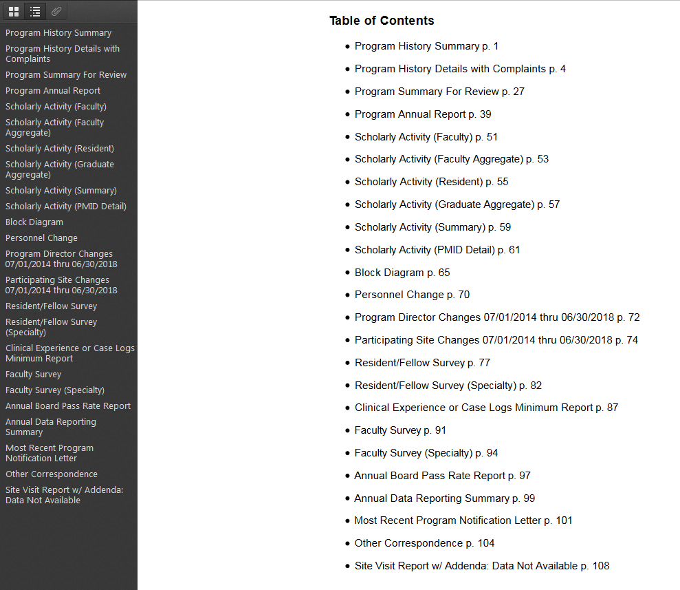

Slide 16
Accreditation Process: Before the RRC Meeting
Staff sets review agenda (full surveys and interim requests received by agenda closing date)
Reviewer receives ADS email notification
Reviewer downloads materials to computer desktop
Reviewer completes reviewer template
Reviewer uploads completed reviewer template to ADS by announced due date
Assign RC member reviewers; program files available on ADS
© 2018 Accreditation Council for Graduate Medical Education (ACGME)

Slide 17
Accreditation Process: Before the RRC Meeting
Jennifer retrieves completed reviews from ADS, prepares reviewer books, uploads reviewer books to ADS
Member-specific reviewer books (programs with conflicts/dualities removed)
Business agenda book prepared by Pam and Susan; uploaded to ADS
© 2018 Accreditation Council for Graduate Medical Education (ACGME)

Slide 18
Accreditation Process: During the RRC Meeting
RRC members leave the room as appropriate for each program discussion
Primary reviewer presents:
program background
previous citations/responses to citations/recommendation
new citation recommendations
accreditation and other recommendations
Secondary reviewer summarizes areas of reviewer agreement; focuses on areas of difference
All committee members in the room discuss and decide final outcome: record vote
© 2018 Accreditation Council for Graduate Medical Education (ACGME)

Slide 19
Accreditation Process: After the RRC Meeting
Jennifer enters decisions into ADS; generates email to each program
Pam prepares Letters of Notification (LON)
Chair/vice chair review and approve all LONs
Jennifer enters citations into ADS
Final review by Pam
LONs released and programs notified by email
© 2018 Accreditation Council for Graduate Medical Education (ACGME)

