Slide 1
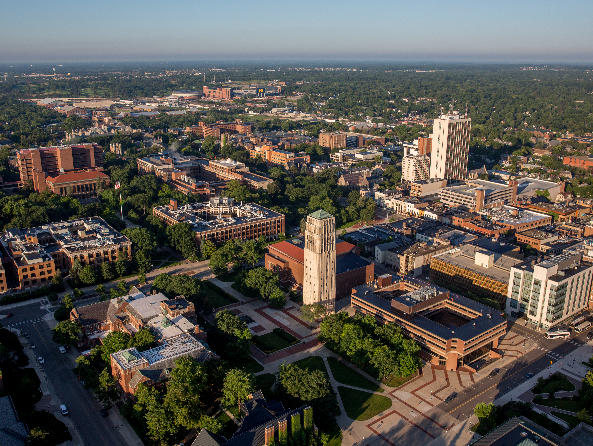
Focused MK and PC Milestones for Residency and Fellowship
Oren Sagher, MD

Slide 2
Shifting Milestones Structure
Milestones 1.0
Parcellation of neurosurgical knowledge and practice
Codifying important knowledge items and practical skills
Subspecialty-specific
Considered “biopsy” of neurosurgical corpus
First attempt at codifying progress in neurosurgical learning
But
Unwieldy – difficult to separate MK from PC
Widely open to interpretation
Difficult to operationalize
Did not account for changes in neurosurgical knowledge and technique

Slide 3
Milestones 2.0 Objectives
Address shortcomings of v 1.0
Improve and refine language around each skill evaluated
Adopt similar language and structure to each discipline’s milestones
Remove all specific knowledge items from MK
Move specific techniques to Appendix in order to account for technological changes
Improve Milestone structure
Re-form MK to follow Bloom’s Taxonomy of learning
Create robust, reproducible PC milestone progression
Align Level 5 with Fellowship/CAST

Slide 4
Milestones 1.0 – Medical Knowledge Criticisms
Difficult to separate from PC
Reflect specific knowledge points rather than depth of understanding
Specific knowledge points better suited for Primary ABNS Exam
Did not reflect transition from memorization of facts, to application of concepts, to knowledge creation.

Slide 5
Milestones 2.0 - Medical Knowledge A new paradigm
Level 5
Bloom’s Taxonomy
Level 1

Slide 6
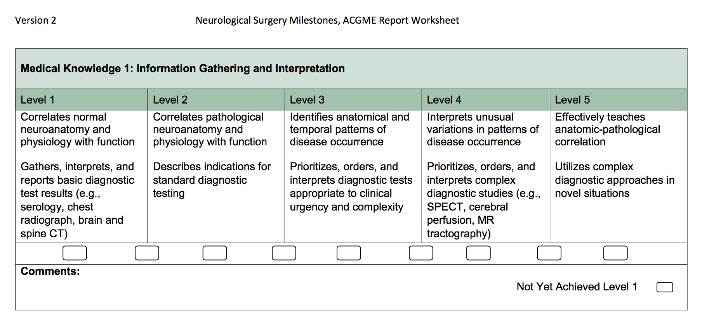
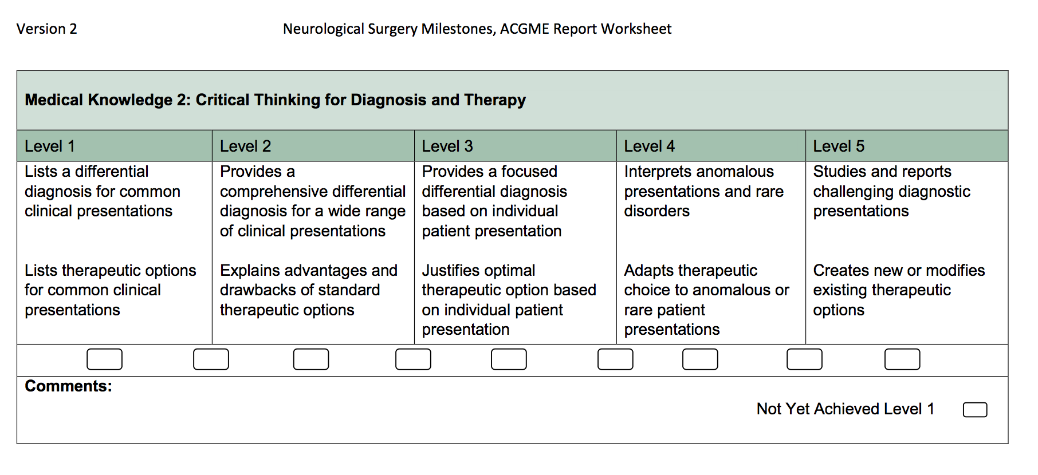
Remember/
Understand
Apply
Analyze
Evaluate
Create

Slide 7
New Patient Care Structure
Move specific procedures to Appendix as exemplars
Create structure of skill learning across each discipline
Better reflect progression of learning
Improve stability of Milestones

Slide 8
Appendix Structure
Division of procedures into “Routine”, “Complex” and “Advanced”
Attempted symmetry across each row
Routine, Complex procedures – during residency
Advanced procedures – domain of fellowship/advanced subspecialty training
Appendix to be modifiable without changing Milestone structure

Slide 9
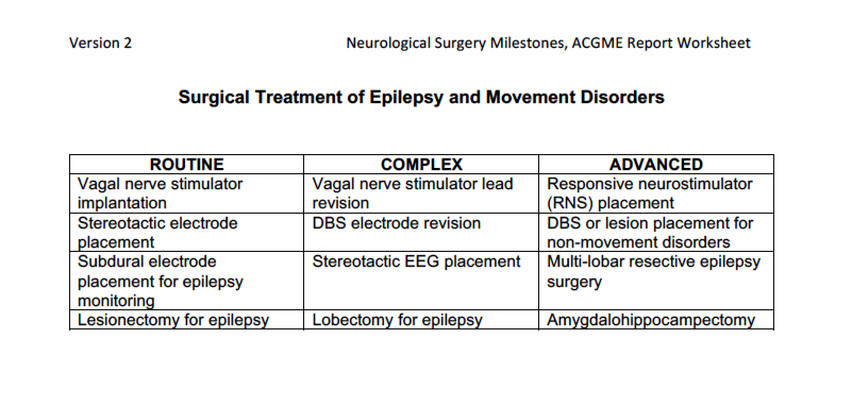
Electrode placement
Stereotaxy
Invasive monitoring
Resective surgery
Complexity

Slide 10
PC Milestone Structure
Levels 1-4: Residency
Level 5: Fellowship
Standardized division at each milestone level
Diagnosis/Preop Management
Treatment
Complication Management
Documents natural progression of operative training

Slide 11
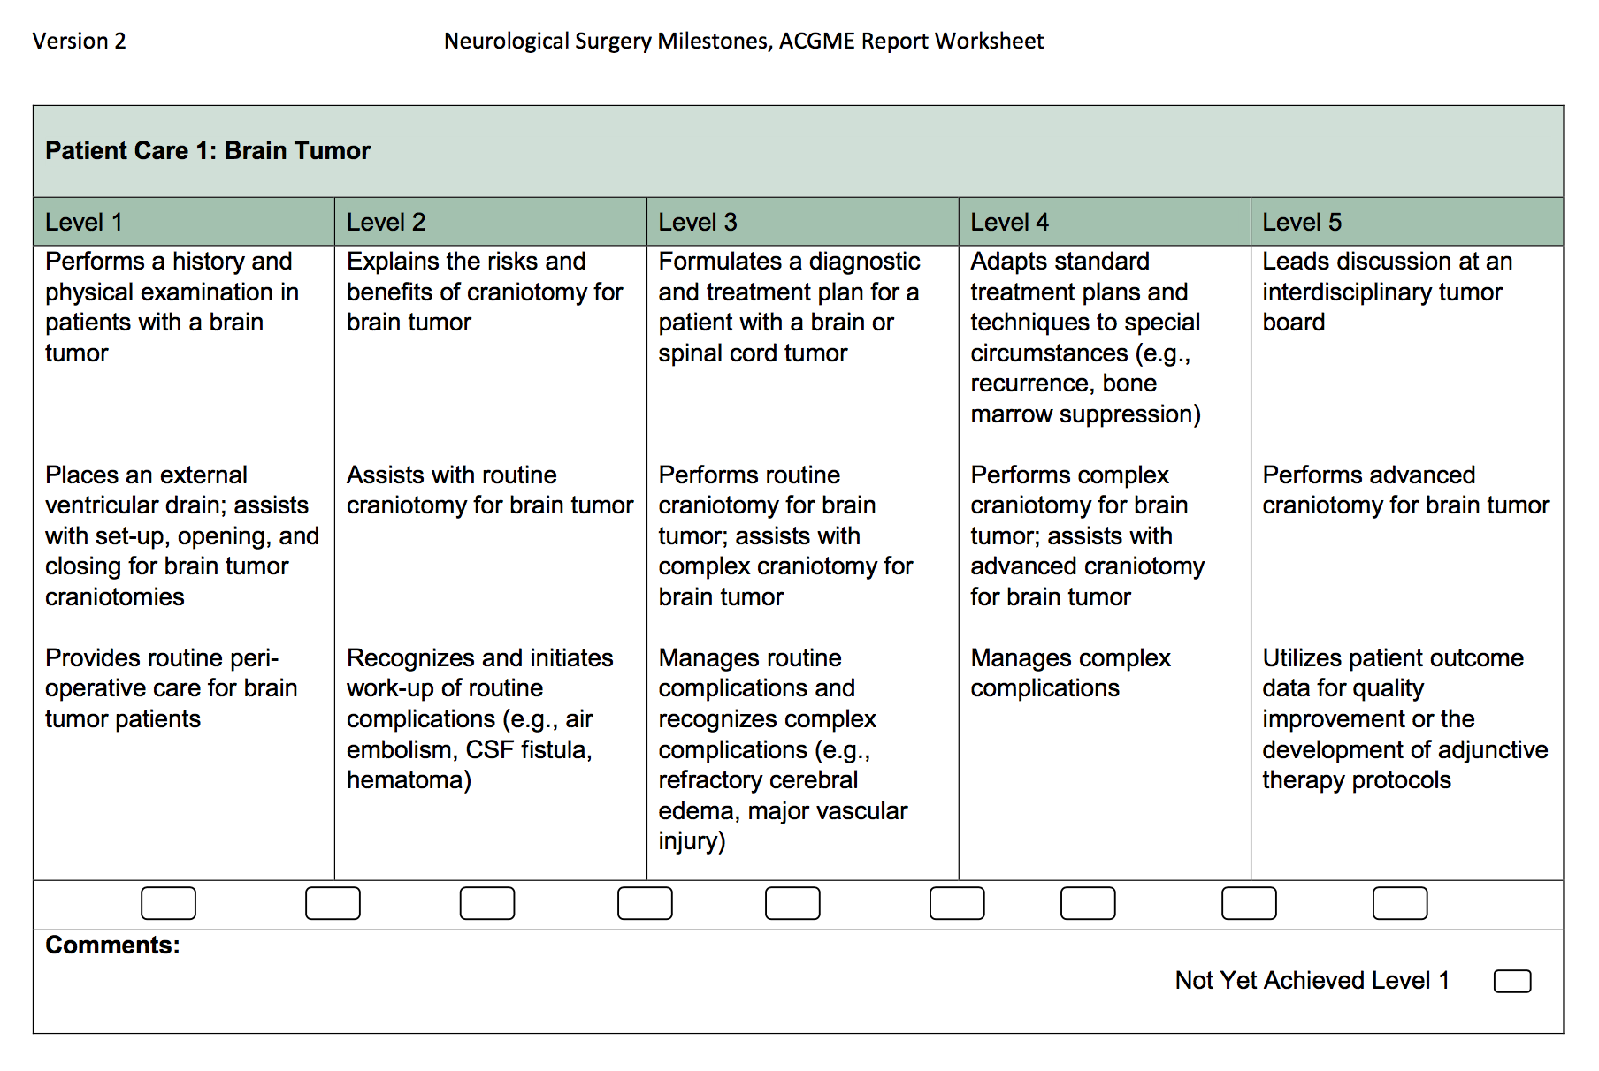
Residency
Fellowship

Slide 12
PC Milestone Structure
Levels 1-4: Residency
Level 5: Fellowship
Standardized division at each milestone level
Diagnosis/Preop Management
Treatment
Complication Management
Documents natural progression of operative training

Slide 13
Diagnosis
Treatment
Complications

Slide 14
PC Milestone Structure
Levels 1-4: Residency
Level 5: Fellowship
Standardized division at each milestone level
Diagnosis/Preop Management
Treatment
Complication Management
Documents natural progression of operative training

Slide 15
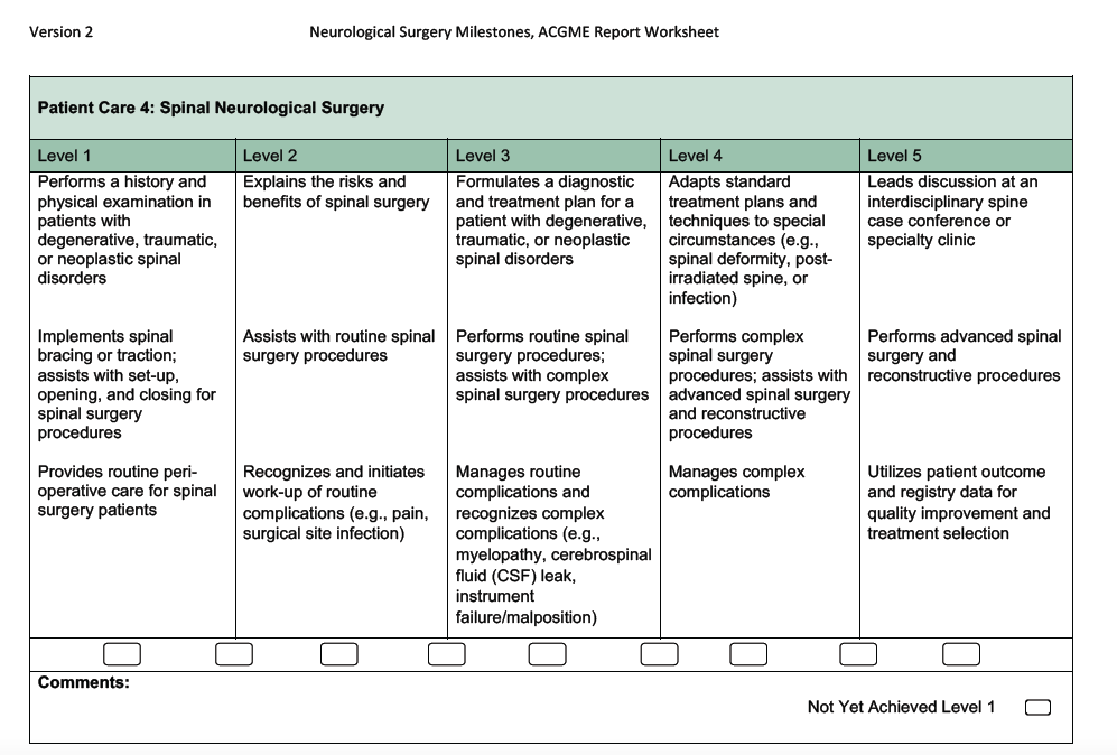
Assist on routine procedures
Perform routine, assist complex
Perform advanced
Minor procedures
Perform complex

Slide 16
Milestones 2.0 Issues
Structural overhaul requiring re-tool on Portal
Current residents evaluated under both versions
MK complete revamp => Cannot document progress from v 1.0
PC milestones v1.0 to v2.0 - unknown correlation
Future resident progression more straightforward

Slide 17
Our Vision
Showing OHSU how it’s done

