Slide 1
Introduction to Neurosurgery
Brian L. Hoh, MD¹ and Gregory J. Zipfel, MD²
¹University of Florida, ²Washington University

Slide 2
Disclosures
No commercial interests
Acknowledgements
Katie Orrico, AANS/CNS Washington Committee

Slide 3
Definition of Neurosurgery

Slide 4
Neurosurgery
Constitutes a medical discipline and surgical specialty that provides care for adult and pediatric patients in the treatment of pain or pathological processes that may modify the function or activity of the central nervous system (e.g. brain, hypophysis, and spinal cord), the peripheral nervous system (e.g. cranial, spinal, and peripheral nerves), the autonomic nervous system, the supporting structures of these systems (e.g. meninges, skull & skull base, and vertebral column), and their vascular supply (e.g. intracranial, extracranial, and spinal vasculature).
Treatment encompasses both non-operative management (e.g. prevention, diagnosis – including image interpretation – and treatments such as, but not limited to neurocritical intensive care and rehabilitation) and operative management with its associated image use and interpretation (e.g. endovascular surgery, functional and restorative surgery, stereotactic radiosurgery, and spinal fusion – including its instrumentation).
American Board of Neurological Surgery, Definition of Neurological Surgery

Slide 5
History of Neurosurgery

Slide 6
History of Neurosurgery
Evidence suggests that the first trepanations may have occurred up to 10,000 years ago
460-370 BC Hippocrates describes types of trauma in which trepanation may be performed
129-200 AD Galen describes trepanation for hydrocephalus

Slide 7
History of Neurosurgery
Pierre Paul Broca localizes and drains brain abscess 1876 in Paris
Sir William Macewan excises meningioma in 1879, performs laminectomy in 1883

Slide 8
History of Neurosurgery
1918 Walter Dandy develops pneumoencephalography
1927 Egas Moniz performs cerebral angiography
1971 Godfrey Hounsfield & Allan Cormack develop CT scan; won Nobel Prize in 1972

Slide 9
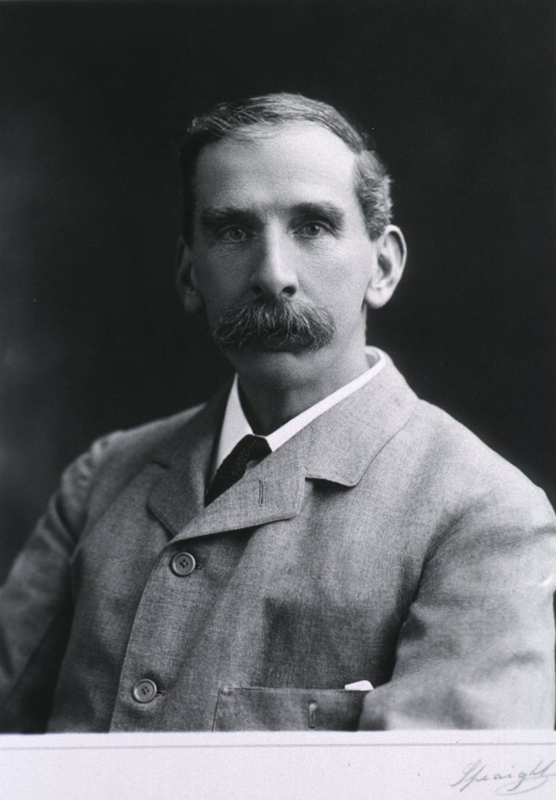
History of Neurosurgery
Sir Victor Horsley (1857-1916)
Intraoperative cortical stimulation to localize epileptic foci
Bone wax
Transcranial approach to pituitary
Ligation of carotid artery to treat aneurysm
Intracranial division of trigeminal nerve root to treat trigeminal neuralgia
Horsley-Clarke stereotactic frame

Slide 10
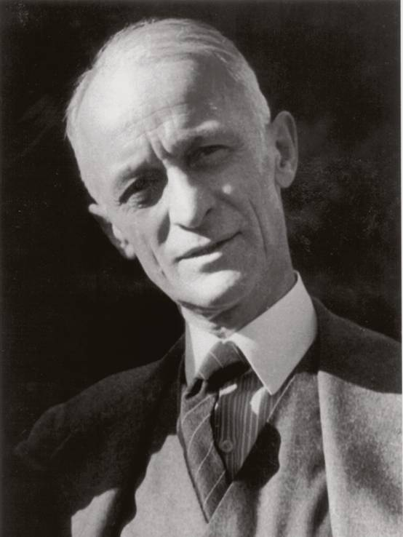
History of Neurosurgery
Harvey Cushing (1869-1939)
Developed anesthesia record
Cushing response to intracranial hypertension
With Bovie developed electrocautery
Function of the pituitary gland – Cushing’s disease
Reduced mortality from neurosurgical operations from 80-90% down to 10%
Father of American Neurosurgery

Slide 11
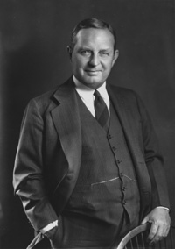
History of Neurosurgery
Walter Dandy (1886-1946)
Trained under Cushing
Described CSF physiology and hydrocephalus
Developed pneumoencephalography
Dandy-Walker malformation/syndrome
First described clipping of cerebral aneurysm 1938

Slide 12
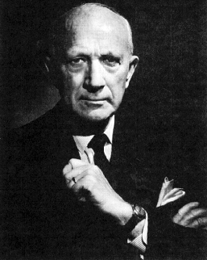
History of Neurosurgery
Wilder Penfield (1891-1976)
Modernized epilepsy surgery
Research utilizing intraoperative electrical cortical stimulation
Published first homunculus
Penfield’s syndrome

Slide 13
Neurosurgery Practice Demographics

Slide 14
Neurosurgeons in US
Approximately 3800 practicing neurosurgeons in the US

Slide 15
Demographic Profiles

Slide 16
Demographic Profiles

Slide 17
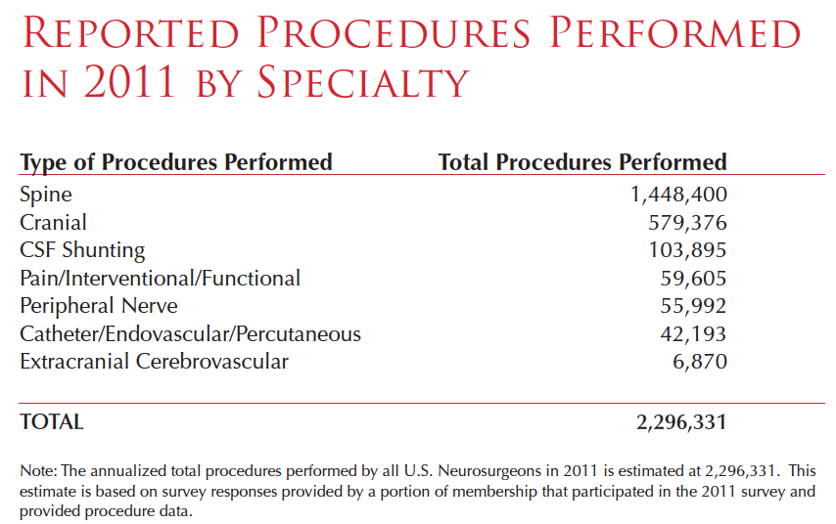

Slide 18
Maldistribution of Surgeons
25% of the U.S. population lives in county w/out a neurosurgeon
50% percent of the
U.S. population lives in counties w/ 15.5% of neurosurgeons
Source: American College of Surgeons Health Policy Research Institute

Slide 19
Number of Neurosurgeons by Age
800
718
666 667
700
600 | 531
500
400
487
359
300
182
200
161
100
0
34‐39
40‐44
45‐49
50‐54 55‐59
Age Range
60‐64
65‐69
70‐74
44% of practicing neurosurgeons over the age of 55
Source: American Board of Neurological Surgery

Slide 20
Neurosurgical Workforce Shortages
Only 83% of neurosurgeons take emergency call 24/7/365
178 board certified pediatric neurosurgeons
42% will retire within the next decade
Only 6 enter workforce each year, falling short of demand
305 vacant neurosurgery positions in the U.S. in 2011
192 generalists, spine‐focused neurosurgeons, or unidentified
113 subspecialists, including neurovascular, endovascular, pediatric
Sources: Neurosurgery Statement to IOM ‐‐ Ensuring an Adequate Neurosurgical Workforce American Board of Neurological Surgery

Slide 21
Neurosurgery Compensation
 | Mean | Median | 90th percentile
Overall | $812,079 | $670,100 | $ 1,417,038
Private practice | $924,426 | $759,662 | $1,707,635
Academic | $675,521 | $569,529 | $927,093
Sources :NERVES 2014 report based on 2013 data

Slide 22
Neurosurgery Malpractice Insurance
 | Mean | Median | 90th percentile
Overall | $50,723 | $42,290 | $ 89,672
Sources :NERVES 2014 report based on 2013 data

Slide 23
Neurosurgery Residency Match Data
Year | PGY 1 Applicants | Positions Offered | Positions Filled | Percent Filled
2009 | 317 | 191 | 191 | 100.0
2010 | 309 | 191 | 188 | 98.4
2011 | 283 | 195 | 192 | 98.5
2012 | 318 | 196 | 194 | 99.0
2013 | 314 | 204 | 203 | 99.5
2014 | 335 | 206 | 206 | 100.0
Source: National Residency Matching Program

Slide 24
Neurosurgical Subspecialties
Spine
Peripheral Nerve Surgery
Vascular Neurosurgery (open and endovascular)
Neuro-Oncology
Neuroendocrinology
Skull Base Neurosurgery
Pediatrics
Functional Neurosurgery
Neurocritical Care

Slide 25
Residency Training:
Year 1: Internship year: May include some rotations outside neurosurgery like ICU, trauma surgery, neurology.
Year 2: Junior resident: Learning the basics of neurosurgical assessment, patient management, and surgical procedures
Year 3: Senior resident: Learning more advanced degrees of patient care and surgical procedures
Year 4/5/6: There are frequently some permutation of pediatric neurosurgery, neurological electives, research (3mons to 2 years), and directing some services at a Chief Resident level of management
Year 7: Chief Resident: Learning how to direct a large neurosurgical service, transition toward being able to independently do the routine neurosurgical procedures

Slide 26
The Spectrum of Neurosurgery Residencies
Residencies vary in size with some programs matching 1 resident a year up to 4 residents per year
Residencies vary in regard to the cities in which they reside: Some are in large metropolitan centers with many large academic centers while others are in relatively smaller cities
Residencies vary in regard to the degree of research time that is incorporated into the curriculum however research is a part of all residency programs
With more than 105 programs, there are a wide range of “personalities” of residencies

Slide 27
Conclusions
Neurosurgery is a rewarding and intellectually stimulating career
Opportunity to profoundly affect the lives of patients, often times to save lives
Multiple subspecialties with diverse diseases and different types of procedures, or general neurosurgeon who can have a broad practice
Current and future shortage of neurosurgeons so need for more neurosurgeons

