Slide 1
Washington update
Katie Orrico, Director
AANS/CNS Washington Office
Society of Neurological Surgeons
June 2013

Slide 2
Your Government at Work
Scandals

Slide 3
The Federal Budget
Preventing the “fiscal cliff”
Permanent Tax rates for most Americans
Cuts for gamma knife radiosurgery (-$300m)
Budget sequestration on Mar. 1
Cuts continue each yr. for 10 yrs. unless Congress acts
2% Medicare physician pay cut began on 4/1/13
2% Medicare hospital cuts, including GME
Other cuts in 2013:
NIH = $1.6b
CDC = $323m
FDA = $206m
Debt ceiling showdown?

Slide 4
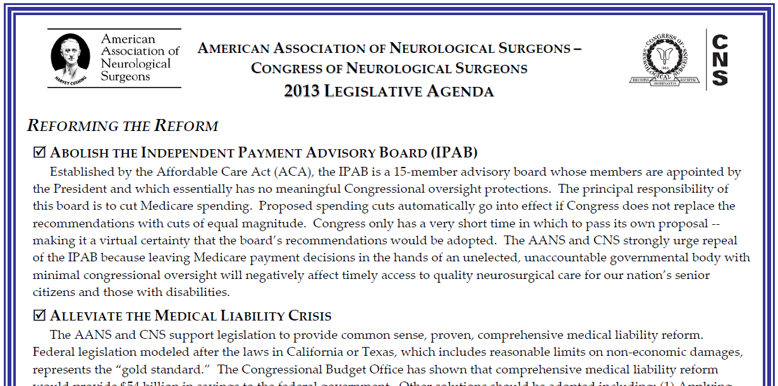
2013 Legislative Agenda

Slide 5
2013 Legislative Agenda
Reforming the Reform
Repeal Independent Payment Advisory Board (IPAB)
Medical Liability Reform
Support Medical Innovation, including repeal of medical device excise tax
Expand Support for Graduate Medical Education
Funding for Trauma and Emergency Care Program
Modernizing Medicare
Moving Medicare to a Defined Contribution System
Repeal SGR, Allow Private Contracting
Restructure and Streamline Quality Improvement Programs

Slide 6
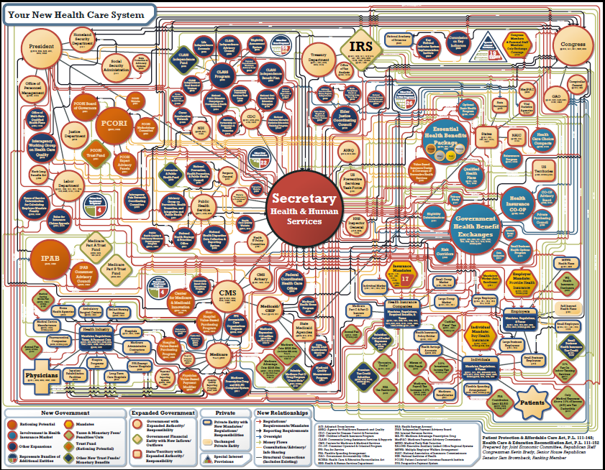

Slide 7
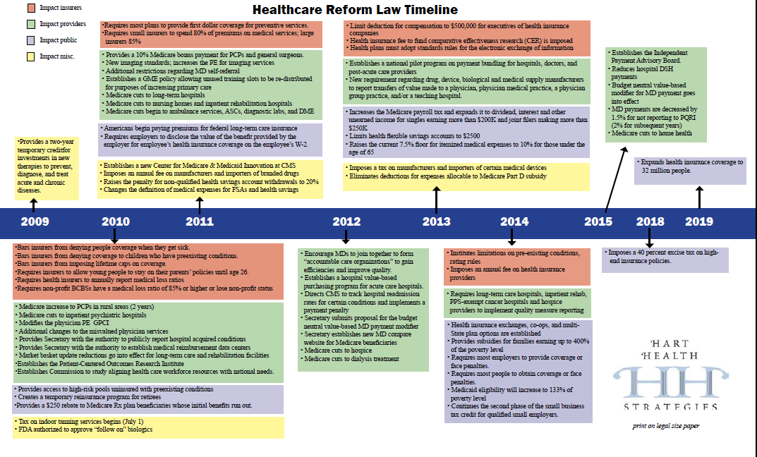
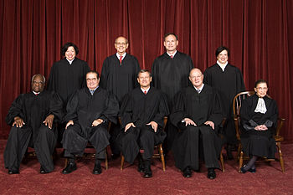
Moving Forward w/Implementation

Slide 8
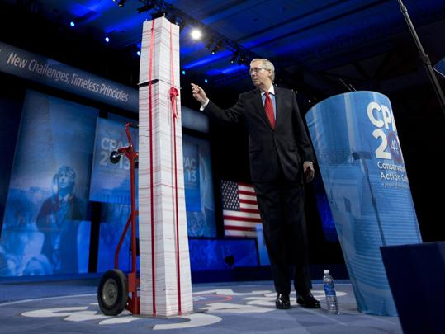
7-feet of regulations — over 20,000 pages and growing!

Slide 9
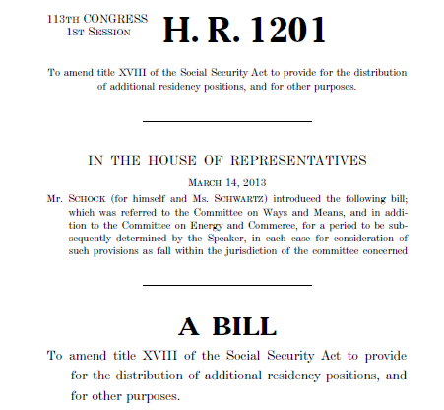
Graduate Medical Education

Slide 10
IOM Study Overview
Institute of Medicine Review will:
assess current regulation, financing, content, governance, and organization of U.S. GME; and
recommend how to modify GME to produce a physician workforce for a 21st century U.S. health care system
Study Timeline
Start Date: June 2012
Public meetings held in Sept & Dec (Ralph Dacey testified)
Draft report Summer 2013 (available for peer review)
Final Report Fall 2013

Slide 11
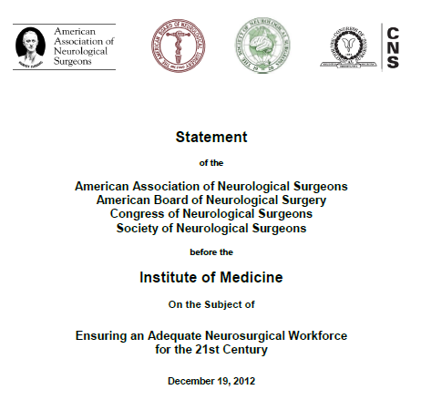
Neurosurgery’s Recommendations
Need more primary care and specialists
Expand GME funding to fully cover all years of training
Eliminate GME funding caps
All-payer fund for GME
Maintain funding for children’s hospital GME
Keep ACGME in charge

Slide 12
GAO Report
Requested by Sens. Tom Coburn (R-OK), Michael Enzi (R-WY) and Richard Burr (R-NC)
Workforce Report Objectives:
Recent supply trends, including info on training and demographics
Projections of future supply and factors affecting projections
How provisions in ACA may affect future workforce needs

Slide 13
GAO Report
GME Funding Review:
Complete list of federally funded GME and loan forgiveness programs
Evaluation of return on investment and possible duplication
Description of all programs available in Spring 2013
Neurosurgery requested opportunity to meet with GAO
Coordinating meeting w/other surgical groups in near future

Slide 14
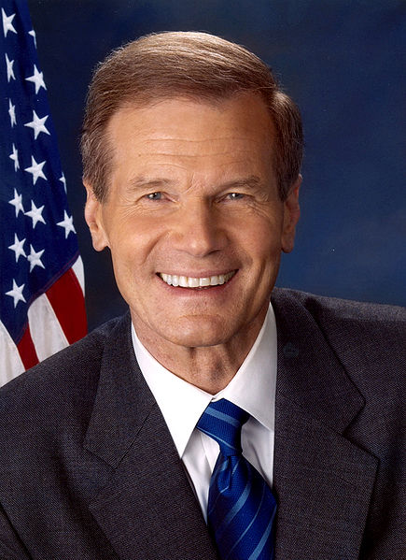
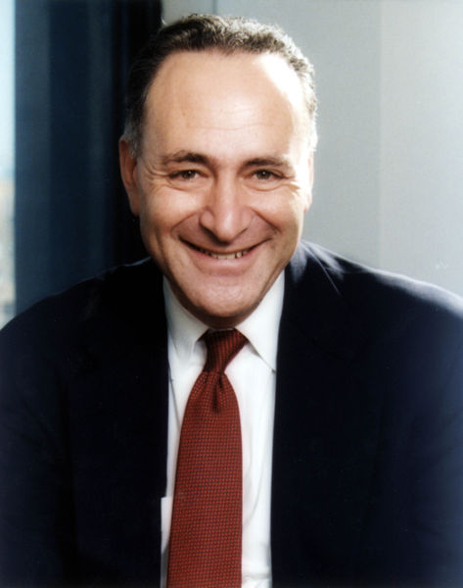
GME Legislation
S. 577: Resident Physician Shortage Reduction Act of 2013
7 cosponsors
Medicare funding for additional 15,000 slots – 3,000 per year
1/3 for a “cap-relief pool”; 2/3 for “priority pool”
50% of new go to primary care; 50% workforce shortage specialties
Nat’l Health Care Workforce Commission to study MD workforce
Bill Nelson
(D-FL)
Charles Schumer (D-NY)
Harry Reid (D-NV)
Notes:
The Resident Physician Shortage Act of 2011 (S. 1627)
Summary
• Introduced by Senators Bill Nelson (D-FL), Charles Schumer (D-NY), and Senate Majority Leader Harry Reid (D-NV)
• Increases by 15,000 the number of Medicare direct graduate medical education (DGME) and indirect medical education (IME) slots.
• Requires National Health Care Workforce Commission to submit a report to Congress by January 1, 2014 identifying physician shortage specialties.
• Requires Government Accountability Office study on strategies for increasing health professional workforce diversity.
Distribution Methodology for Additional Slots
• Increases the number of residency slots nationally by 3,000 each year between 2013-17 (total 15,000).
• At least 1,500 slots each year must be used for a shortage specialty residency program as identified in the National Health Care Workforce Commission’s report.
• Prior to report, directs the HHS to define shortage specialties as identified by the December 2008 HRSA report on the physician workforce.
• A hospital may not receive more than 75 slots in the aggregate between 2013-17, unless CMS determines there are remaining slots available for distribution.
• In determining which hospitals will receive slots, CMS required to consider the likelihood of a teaching hospital’s filling the positions and would prioritize teaching hospitals in the following
manner:
o Hospitals in states with new medical schools or new branch campuses;
o Hospitals that have exceeded their resident cap at the time of enactment of the legislation;
o Hospitals that emphasize training in community health center or community-based settings or in hospital outpatient departments;
o Hospitals eligible for electronic health record (EHR) incentive payments, and;
o All other hospitals.
Requirements Associated with Additional Slots
• Hospitals receiving additional slots must ensure that:
o At least 50% of the additional slots are used for a shortage specialty residency program;
o The total number of slots is not reduced prior to the increase; and
o The ratio of residents in a shortage specialty program is not decreased prior to the increase.
Reimbursement Level for Additional Slots
• Under S. 1627, new slots would be reimbursed at the hospital’s otherwise applicable per resident amounts for GME purposes and using the usual adjustment factor for IME reimbursement
purposes.

Slide 15
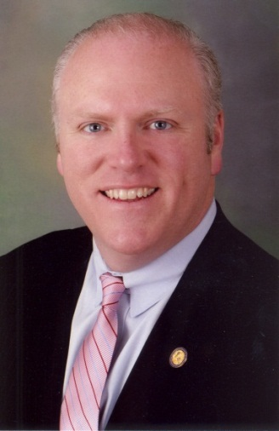
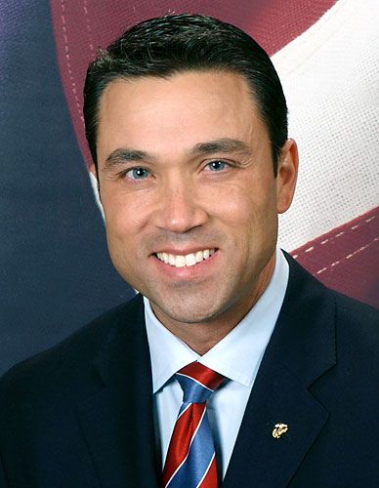
GME Legislation
H.R. 1180: Resident Physician Shortage Reduction Act of 2013
33 cosponsors
Medicare funding for additional 15,000 slots – 3,000 per year
1/3 for a “cap-relief pool”; 2/3 for “priority pool”
50% of new go to primary care; 50% workforce shortage specialties
Nat’l Health Care Workforce Commission to study MD workforce
Joseph Crowley
(D-NY)
Michael Grimm
(R-NY)
Notes:
The Resident Physician Shortage Act of 2011 (S. 1627)
Summary
• Introduced by Senators Bill Nelson (D-FL), Charles Schumer (D-NY), and Senate Majority Leader Harry Reid (D-NV)
• Increases by 15,000 the number of Medicare direct graduate medical education (DGME) and indirect medical education (IME) slots.
• Requires National Health Care Workforce Commission to submit a report to Congress by January 1, 2014 identifying physician shortage specialties.
• Requires Government Accountability Office study on strategies for increasing health professional workforce diversity.
Distribution Methodology for Additional Slots
• Increases the number of residency slots nationally by 3,000 each year between 2013-17 (total 15,000).
• At least 1,500 slots each year must be used for a shortage specialty residency program as identified in the National Health Care Workforce Commission’s report.
• Prior to report, directs the HHS to define shortage specialties as identified by the December 2008 HRSA report on the physician workforce.
• A hospital may not receive more than 75 slots in the aggregate between 2013-17, unless CMS determines there are remaining slots available for distribution.
• In determining which hospitals will receive slots, CMS required to consider the likelihood of a teaching hospital’s filling the positions and would prioritize teaching hospitals in the following
manner:
o Hospitals in states with new medical schools or new branch campuses;
o Hospitals that have exceeded their resident cap at the time of enactment of the legislation;
o Hospitals that emphasize training in community health center or community-based settings or in hospital outpatient departments;
o Hospitals eligible for electronic health record (EHR) incentive payments, and;
o All other hospitals.
Requirements Associated with Additional Slots
• Hospitals receiving additional slots must ensure that:
o At least 50% of the additional slots are used for a shortage specialty residency program;
o The total number of slots is not reduced prior to the increase; and
o The ratio of residents in a shortage specialty program is not decreased prior to the increase.
Reimbursement Level for Additional Slots
• Under S. 1627, new slots would be reimbursed at the hospital’s otherwise applicable per resident amounts for GME purposes and using the usual adjustment factor for IME reimbursement
purposes.

Slide 16
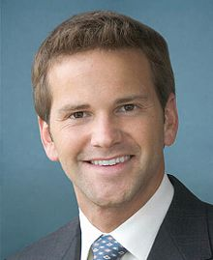
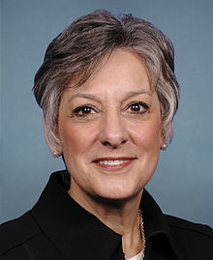
GME Legislation
H.R. 1201: Training Tomorrow’s Doctors Today Act
30 cosponsors
Medicare funding for additional 15,000 slots – 3,000 per year
1/3 for a “cap-relief pool”; 2/3 for “priority pool”
50% of new go to primary care; 50% workforce shortage specialties
2% IME penalty unless comply w/ ACGME approved measures
GAO study on shortage specialties; HHS reports on GME payments
Aaron Schock
(R-IL)
Allyson Schwartz
(D-PA)
Notes:
The Resident Physician Shortage Act of 2011 (S. 1627)
Summary
• Introduced by Senators Bill Nelson (D-FL), Charles Schumer (D-NY), and Senate Majority Leader Harry Reid (D-NV)
• Increases by 15,000 the number of Medicare direct graduate medical education (DGME) and indirect medical education (IME) slots.
• Requires National Health Care Workforce Commission to submit a report to Congress by January 1, 2014 identifying physician shortage specialties.
• Requires Government Accountability Office study on strategies for increasing health professional workforce diversity.
Distribution Methodology for Additional Slots
• Increases the number of residency slots nationally by 3,000 each year between 2013-17 (total 15,000).
• At least 1,500 slots each year must be used for a shortage specialty residency program as identified in the National Health Care Workforce Commission’s report.
• Prior to report, directs the HHS to define shortage specialties as identified by the December 2008 HRSA report on the physician workforce.
• A hospital may not receive more than 75 slots in the aggregate between 2013-17, unless CMS determines there are remaining slots available for distribution.
• In determining which hospitals will receive slots, CMS required to consider the likelihood of a teaching hospital’s filling the positions and would prioritize teaching hospitals in the following
manner:
o Hospitals in states with new medical schools or new branch campuses;
o Hospitals that have exceeded their resident cap at the time of enactment of the legislation;
o Hospitals that emphasize training in community health center or community-based settings or in hospital outpatient departments;
o Hospitals eligible for electronic health record (EHR) incentive payments, and;
o All other hospitals.
Requirements Associated with Additional Slots
• Hospitals receiving additional slots must ensure that:
o At least 50% of the additional slots are used for a shortage specialty residency program;
o The total number of slots is not reduced prior to the increase; and
o The ratio of residents in a shortage specialty program is not decreased prior to the increase.
Reimbursement Level for Additional Slots
• Under S. 1627, new slots would be reimbursed at the hospital’s otherwise applicable per resident amounts for GME purposes and using the usual adjustment factor for IME reimbursement
purposes.

Slide 17
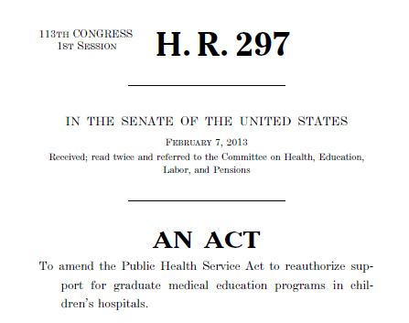
Children’s Hospital GME Support Reauthorization Act: H.R. 297
Bipartisan bill: Rep. Joe Pitts (R-PA) and Frank Pallone (D-NJ)
Authorizes $330 m/yr for FY 13-FY 17 (for 55 hospitals)
Passed House of Representatives on Feb 4, 2013
 | Yeas | Nays | NV
Republican | 171 | 49 | 11
Democrat | 181 | 1 | 18
Total | 352 | 50 | 29

Slide 19
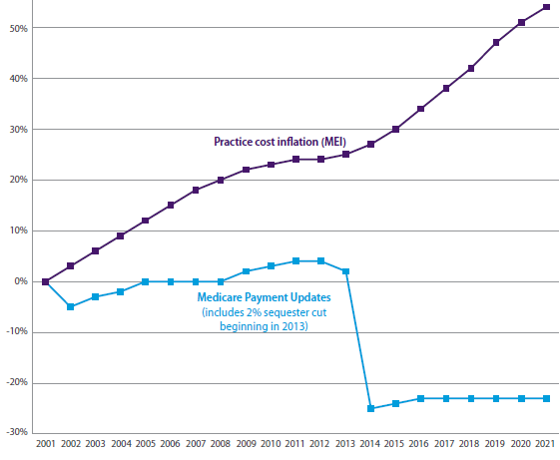
Medicare’s UnSustainable Growth Rate
Congress continues w/short-term “patches” to fix Medicare’s sustainable growth rate (SGR)
27% pay cut on Jan. 1, 2014 (w/sequester)
Cost of Repeal = $139.1 billion
($100 less than previous estimate!)

Slide 20
Be careful what you ask for…
SGR Fix

Slide 21
Options for SGR Reform
Phase I
Phase II
Repeal SGR: New FFS program based on quality & efficiency of care
MDs receive base payment: 10-15% less than top rate
Phase III
Payments based on both quality and efficiency measures
Fixed payment rates for set period of time (2-5 years).
Par MDs have menu of QI options (e.g. reporting to clinical data registry) to earn more $
Nonpar MDs receive base payment rate
Physicians can opt out of FFS system and participate in alternative payment systems, such as ACOs

Slide 22
The Quality Penalties are Coming! The Quality Penalties are Coming!
2015
BUT CMS started the clock in 2013!

Slide 23
Total Cuts (worst case scenario)
 | Deficit Reduction Sequester | PQRS | e-Rx | EHR | Value Based Payment Modifier
2013 | -2 |  | -1.5
2014 | -2 |  | -2
2015 | -2 | -1.5 |  | -1 | -1
2016 | -2 | -2 |  | -2 | ?
2017 | -2 | -2 |  | -3 | ?
2018 | -2 | -2 |  | -3 | ?
2019 | -2 | -2 |  | -4 | ?
2020 | -2 | -2 |  | -5 | ?
2021 | -2 | -2 |  | -5 | ?
Add potential SGR & IPAB cuts and TOTAL = >80%!

Slide 24
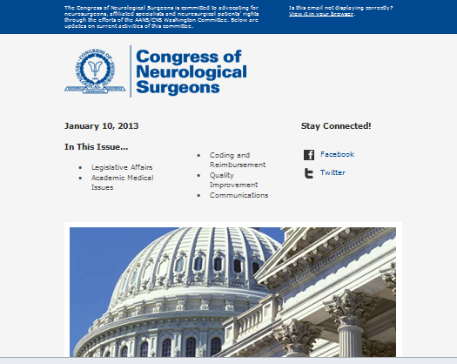

Slide 25
Thank you!

