Slide 1

“Path to Physician Leadership "
Bhagwan Satiani MD, MBA, FACHE, FACS
Professor of Clinical Surgery,
Division of Vascular Diseases & Surgery, Department of Surgery,
Wexner Medical Center
The Ohio State University
2019 Annual Society of Neurological Surgeons Meeting
Conflicts of interest related to this session: None

Slide 2

Objectives
Explore our path to formation of the Faculty Leadership Institute
Lessons learnt after seven years of program.

Slide 3

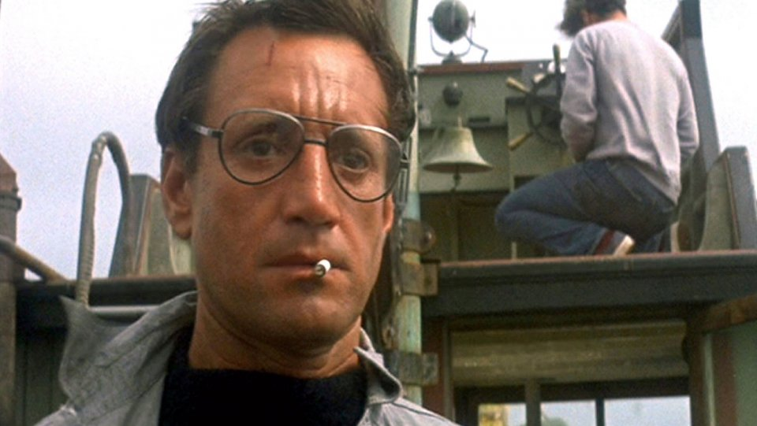
Richard Dreyfuss (Matt Hooper): I'm not going to waste my time arguing with a man who's lining up to be a hot lunch.
That's a twenty footer!
Robert Shaw (Quint): Twenty-five. Three tons of him.
Roy Scheider (Brody): We're gonna need a bigger boat.
Jaws 1975

Slide 4
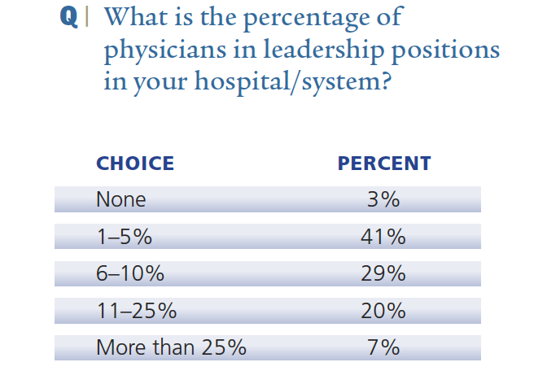
The 2014 American Hospital Association
Environmental Scan, 66% of health system CEOs report that physicians constitute only about 10% of their senior leadership teams.
44%
73%
http://www.healthleadersmedia.com/pdf/survey_project/2010/Physician_pages_2010.pdf

Slide 5
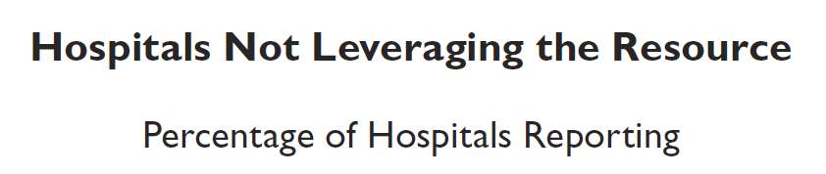
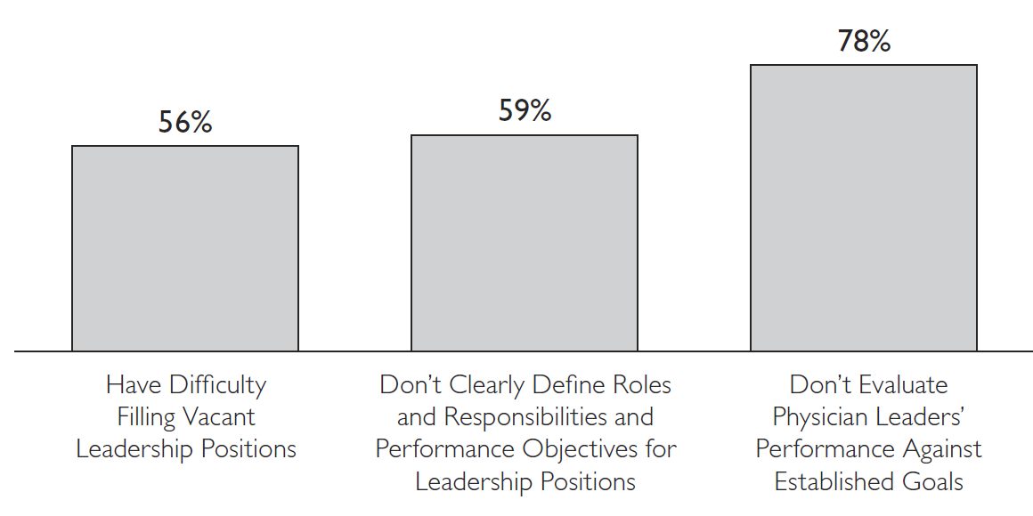


Slide 6
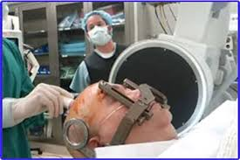

respect
trust

Slide 7
Respect but lack of trust
Emotional intelligence/self awareness
Listening skills
Teamwork & collaboration
Financial knowledge
Problem solving/decision making skills

Slide 8
Mission Statement
To develop physicians so they are equals at the healthcare table

Slide 9
The Faculty Leadership Institute
Faculty Advancement Mentoring & Engagement (FAME)
MANAGING CHANGE
Notes:
We are here to provide you with an update to the Faculty Leadership Institute that will launch next month.
As you may recall, the purpose of the program is designed to enhance the leadership skills & capabilities among faculty here at the OSUWMC & NWC in order to be better positioned to “Create the Future Now.”

Slide 10
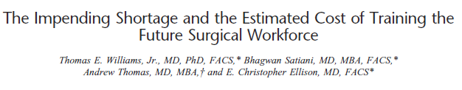
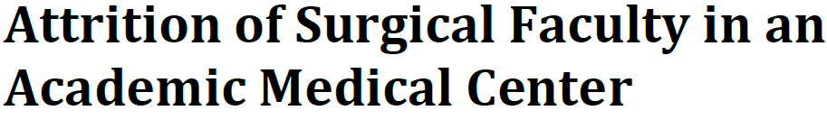
Expected Outcomes for Program
Strengthened leadership skills to be applied in current and future work
Better continuity of leadership; enhanced ability to identify faculty for committee work and leadership roles
A greater sense of “One Medical Center”
Strengthened engagement
Higher retention of faculty
And ultimately, enhanced quality of care
Strengthened leadership skills to be applied in current and future work
Better continuity of leadership; enhanced ability to identify faculty for committee work and leadership roles
A greater sense of “One Medical Center”
Strengthened engagement
Higher retention of faculty
And ultimately, enhanced quality of care
Notes:
A greater sense of “One Medical Center”; interactions with faculty leaders across departments
Strengthened engagement; recognizing our excellent performers through this special development opportunity
Higher retention of faculty
And ultimately, enhanced quality of care

Slide 11


Academic Activity
Leaders Must Walk a Tightrope of Transparency
Essandoh MK, Salani R, Mendel E, Brod H, Satiani B
J Amer Assoc Physician Leadership 2017
Physician Leadership Programs: Challenges and Potential Solutions
Stephen C. Koesters, MD, Bryan Martin, DO and Bhagwan Satiani, MD, FACHE
PREPARING PHYSICIANS FOR LEADERSHIP POSITIONS IN ACADEMIC MEDICINE.
Physician Leadership Journal. 2016 Mar-Apr;3(2):58-61.
Satiani B.

Slide 12
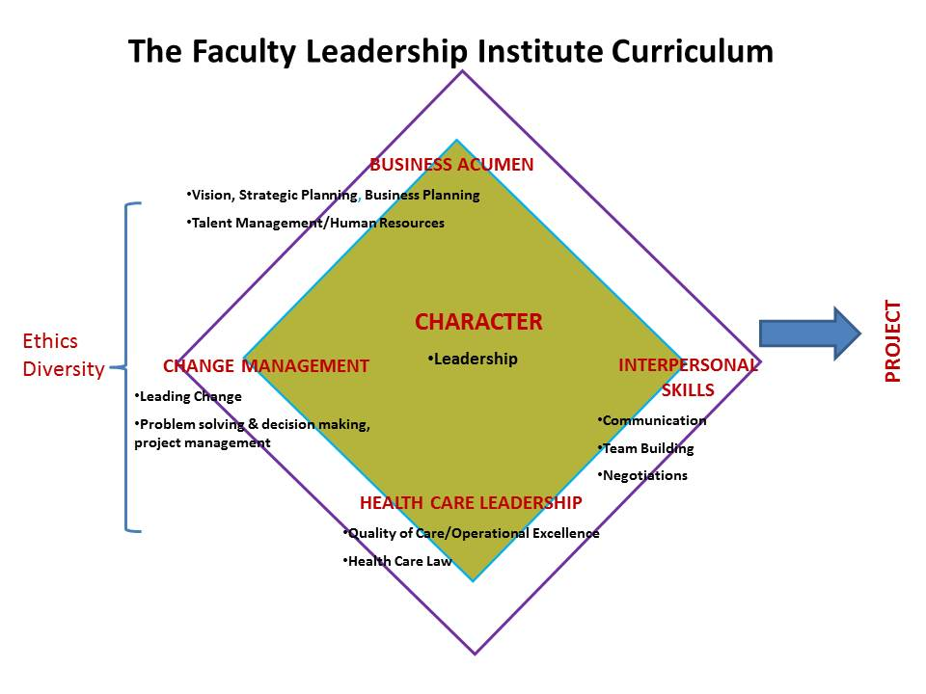

Slide 13

167 faculty – mostly physicians, few PhD, other health sciences
6 classes to date
Graduates (n=139)
40% of grads have been promoted to associate prof
39% of grads have been promoted to professor
15% left OSU and of those, 46% left for a significant leadership role: division director, VP of research, etc.
70% currently have an OSU leadership role. These range from associate program director to division director and vice chair.

Slide 14


Slide 15

Roadblocks
Budget
Not a priority: Need more clinicians (WRVUs) [not leaders]
Possibly impediment to academic promotion for younger faculty
P&T criteria may not set any rewards for such work.
Linda H. Pololi, MBBS, Arthur T. Evans, MD, MPH, Janet T. Civian, EdD, Brian K. Gibbs, PhD, Lisa D. Coplit, MD, Linda H. Gillum, PhD, and Robert T. Brennan. Faculty Vitality—Surviving the Challenges Facing Academic Health Centers: A National Survey of Medical Faculty. Acad Med. 2015 Feb 16.

Slide 16
Challenges: Lessons Learned from our experience
Participants
The time commitment must be shared ahead of time and attendance emphasized
Loved the diverse group and getting to know colleagues
Knowledge/skills appreciated
No good day/time
Capstone Projects: Difficult for teams to meet
Appreciation of relationships with other leaders

Slide 17





Challenges: Lessons Learned from our experience
Directors View

Slide 18



Participant Self- Reported Knowledge 2013-2014
Leading
Change
Problem
Solving
Negotiations
Quality
Safety
Leadership
Teamwork
Business
Acumen
Human
Resources
Healthcare
Law
Communications

Slide 19


Challenges based upon our experiences
Organization
Senior leadership buy-in and active participation
Physician leaders with time and experience to teach and mentor
Frustration of graduates
Demonstration of ROI
Available paths for trainees

Slide 20

Final Thoughts
Not for everyone
Invest in training/ mentorship
Predicted significant increase in physician leaders taking charge of health systems
Health System Leadership: Change “Respect skills, but lack trust yet”
Adapt & be ready to change

Slide 21
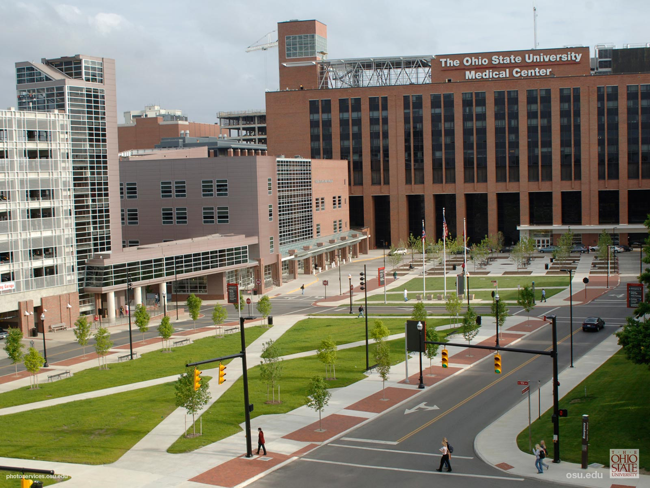
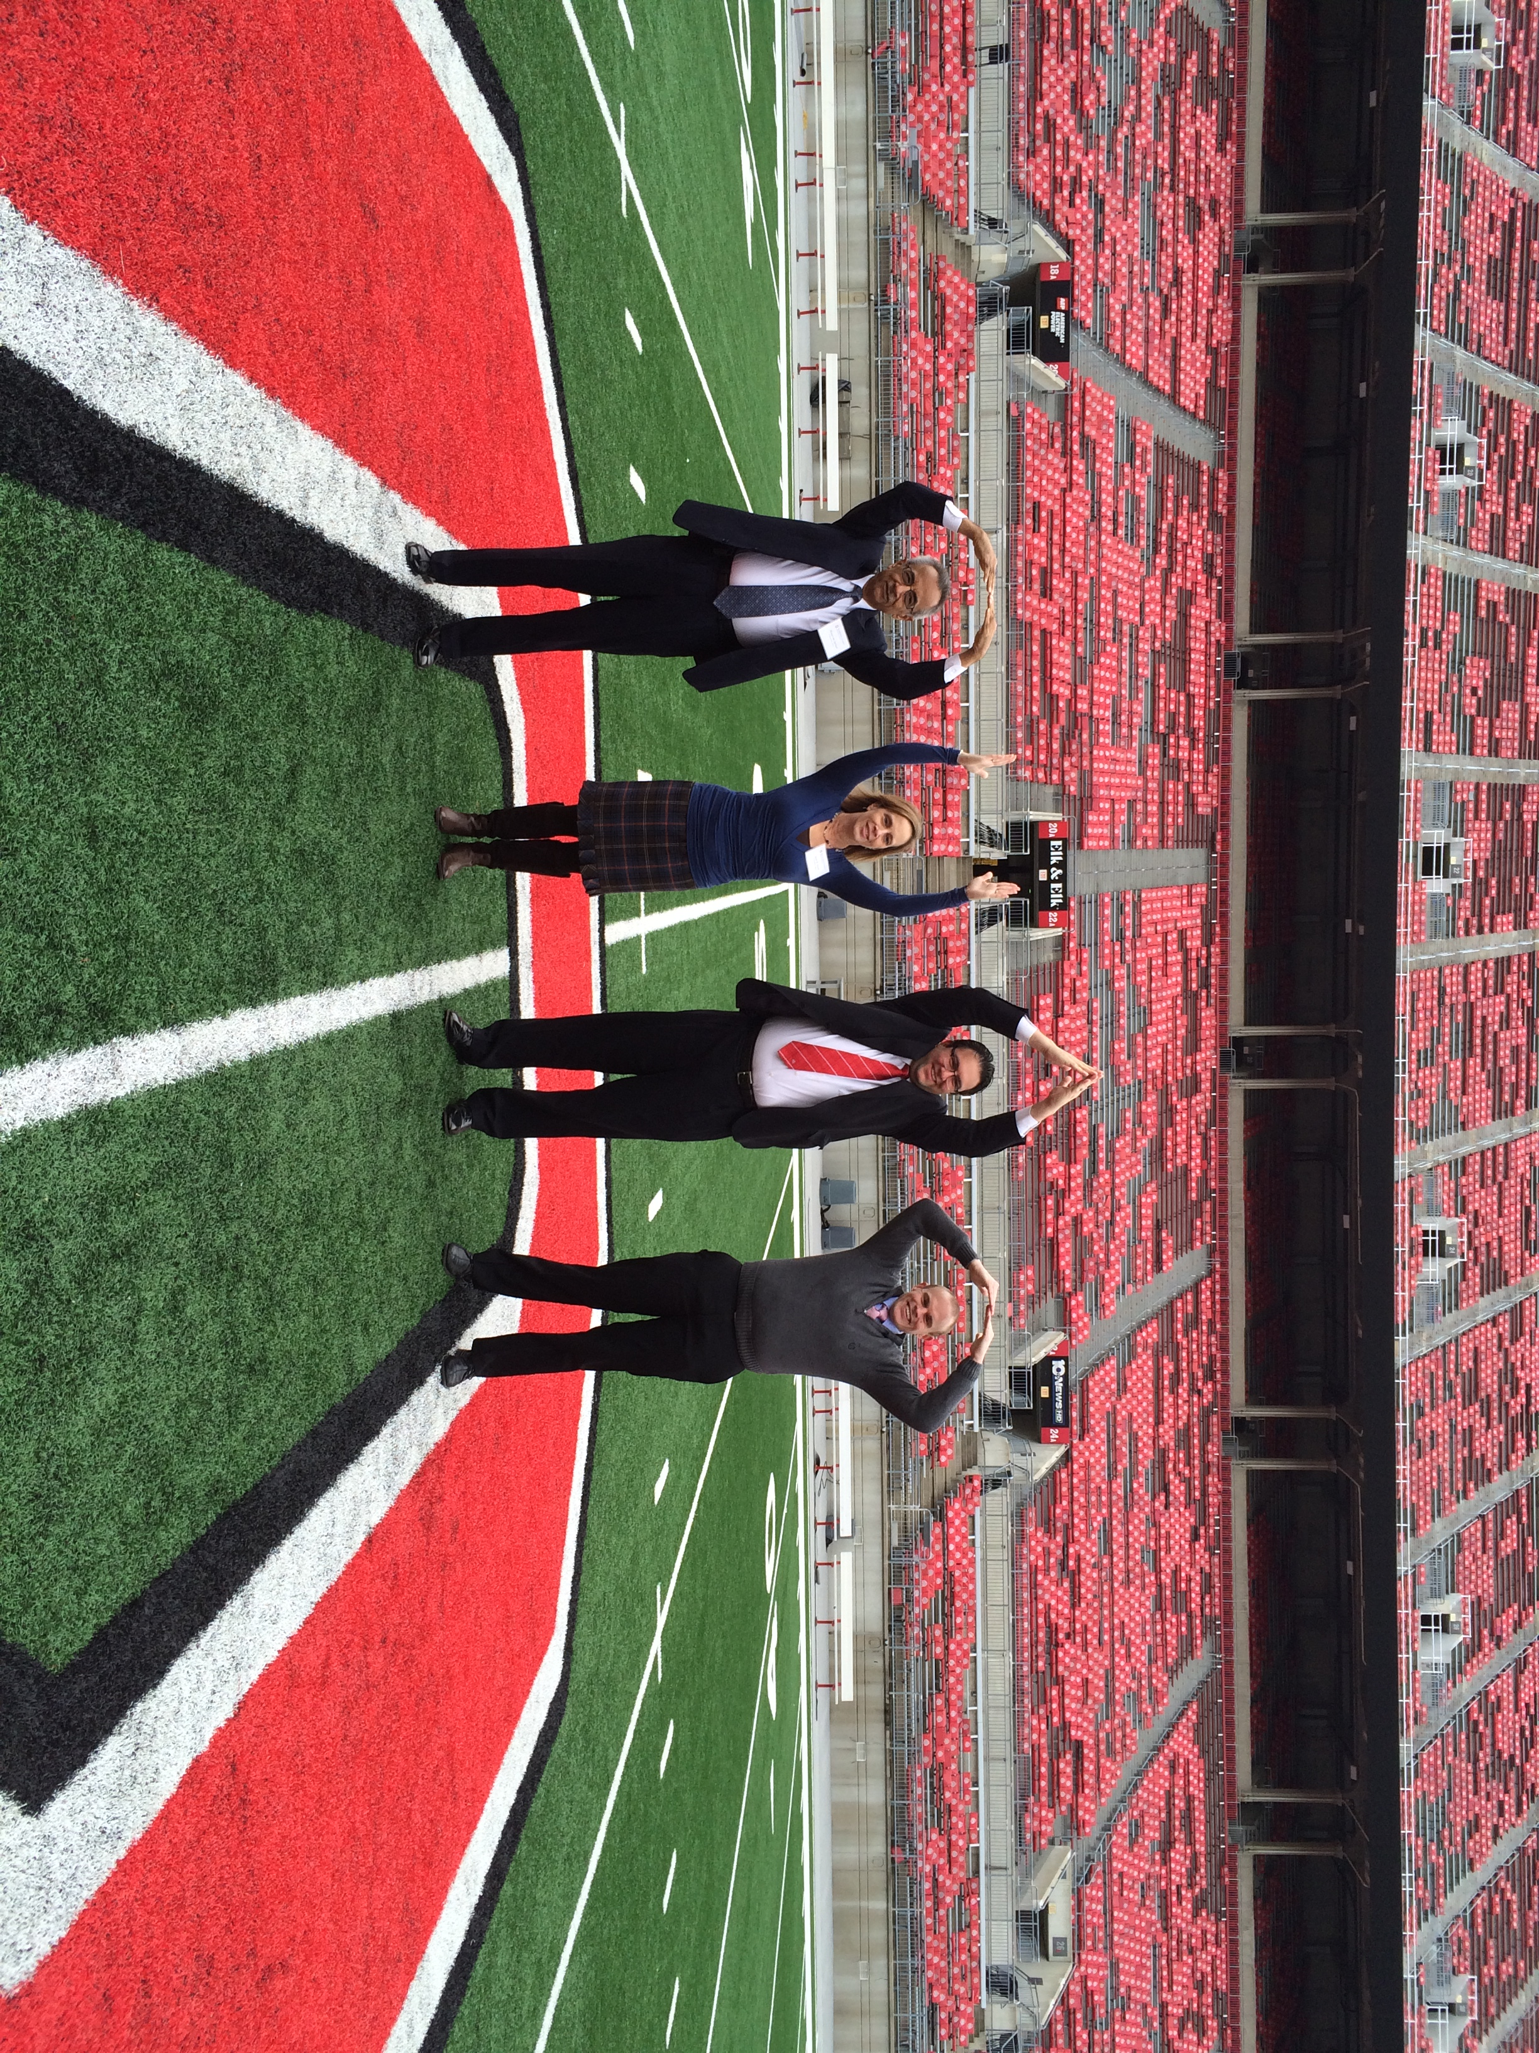
Thank You

Slide 22
Four cohorts (2013 – 2017), 119 participants (66 males and 53 females) completed the program representing 22 departments.
Assistant Professor (53%), Associate Professor (38%), Full Professor (9%).

