Slide 1

Cerebral Vascular Anatomy

Slide 2
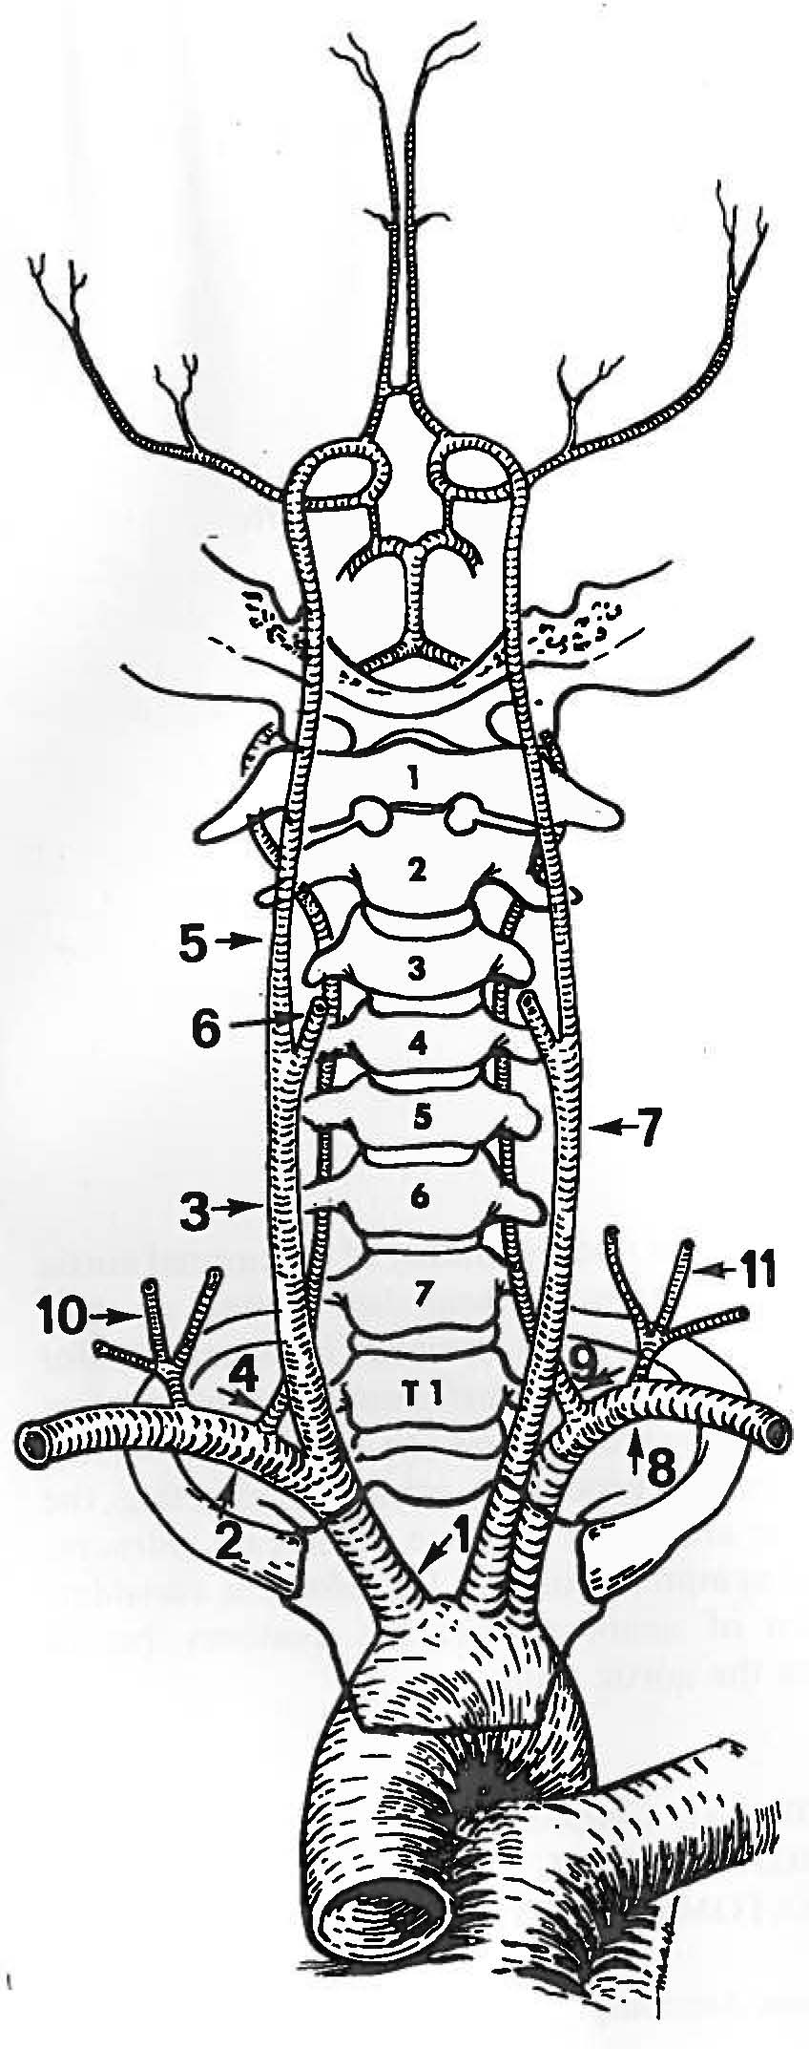
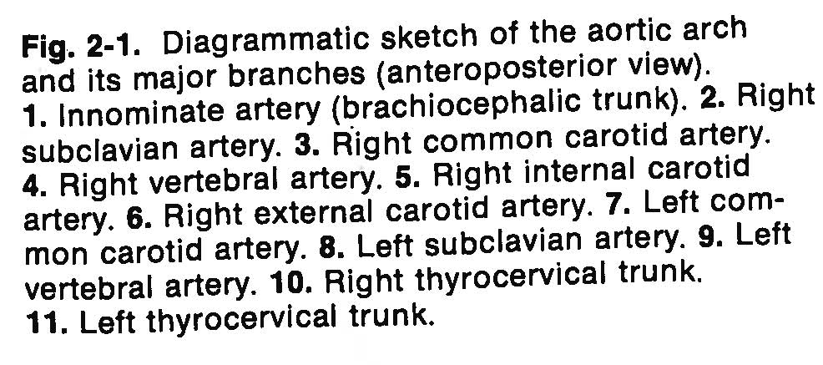
Aortic arch and branches

Slide 3
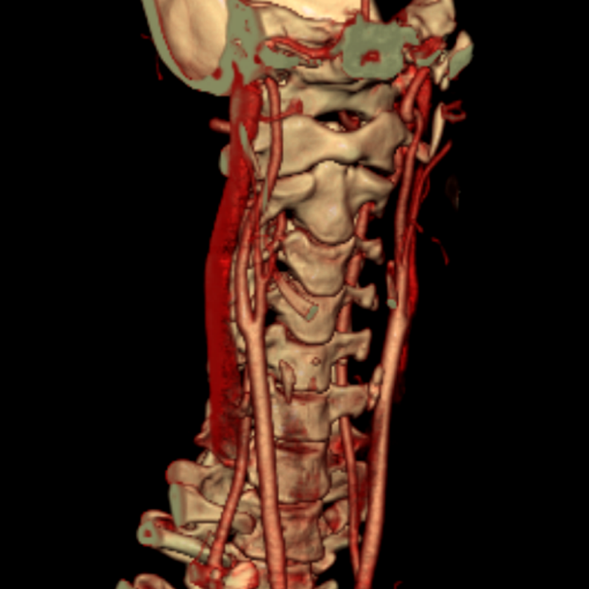
CTA of Carotid

Slide 4
Aortic Arch Normal Variants
Origin of Vertebral Artery
Right common or Internal Carotid Artery
Directly from Aortic Arch
From Subclavian Distal to Thyrocervical Trunk

Slide 5
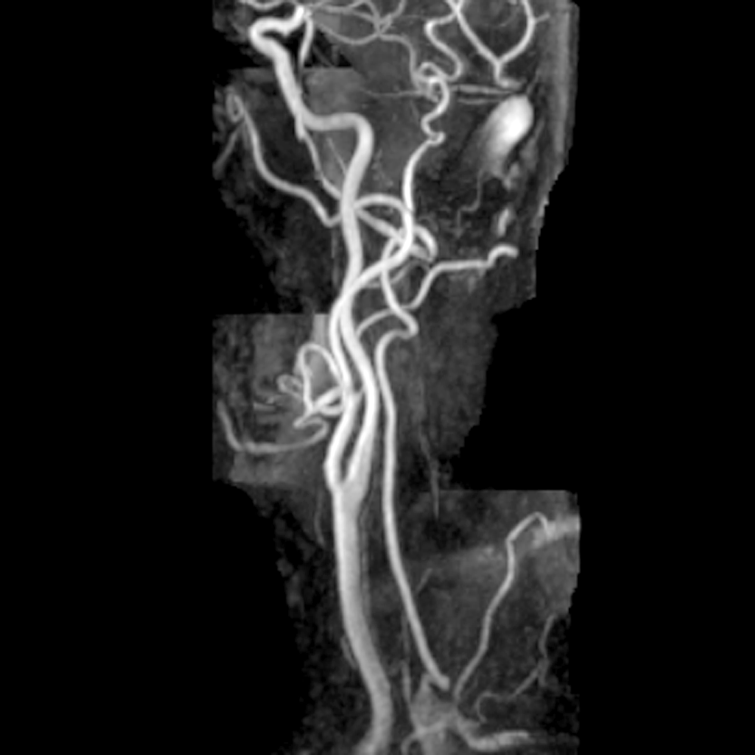
MRA: External/Common Carotid

Slide 6
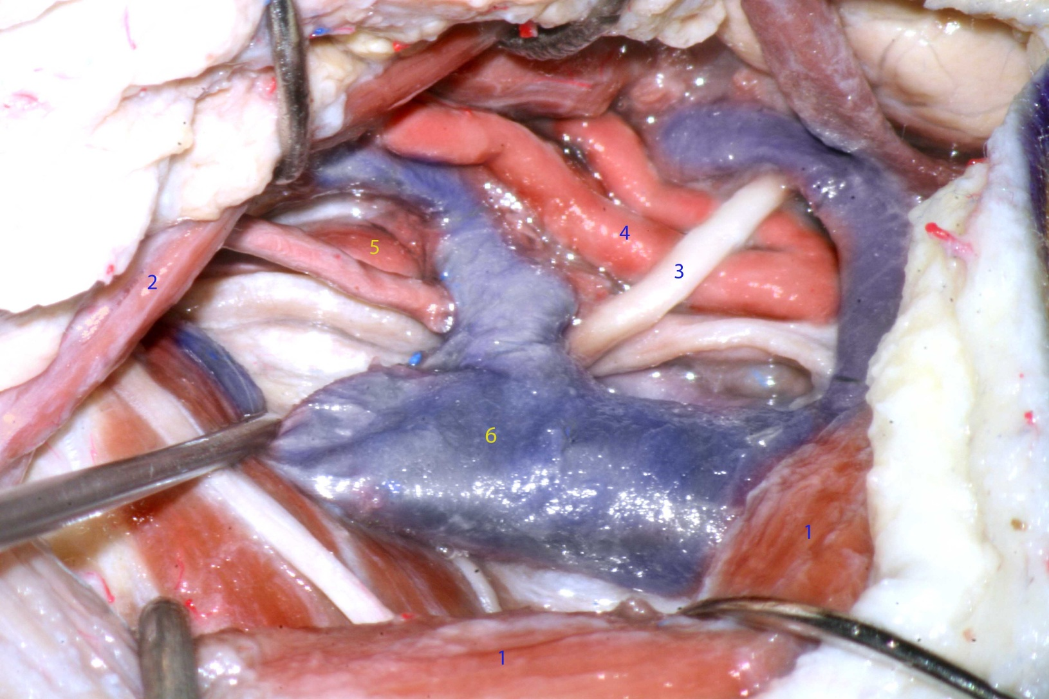
The carotid sheath is sharply opened from the region of the carotid artery bifurcation to the angle of the mandible and the nervous structures are sequentially identified: 1-sternocleidomastoid muscle, 2- posterior belly of digastric muscle, 3- hypoglossal n., 4- external carotid artery, 5- internal carotid artery, 6- internal jugular vein.

Slide 7
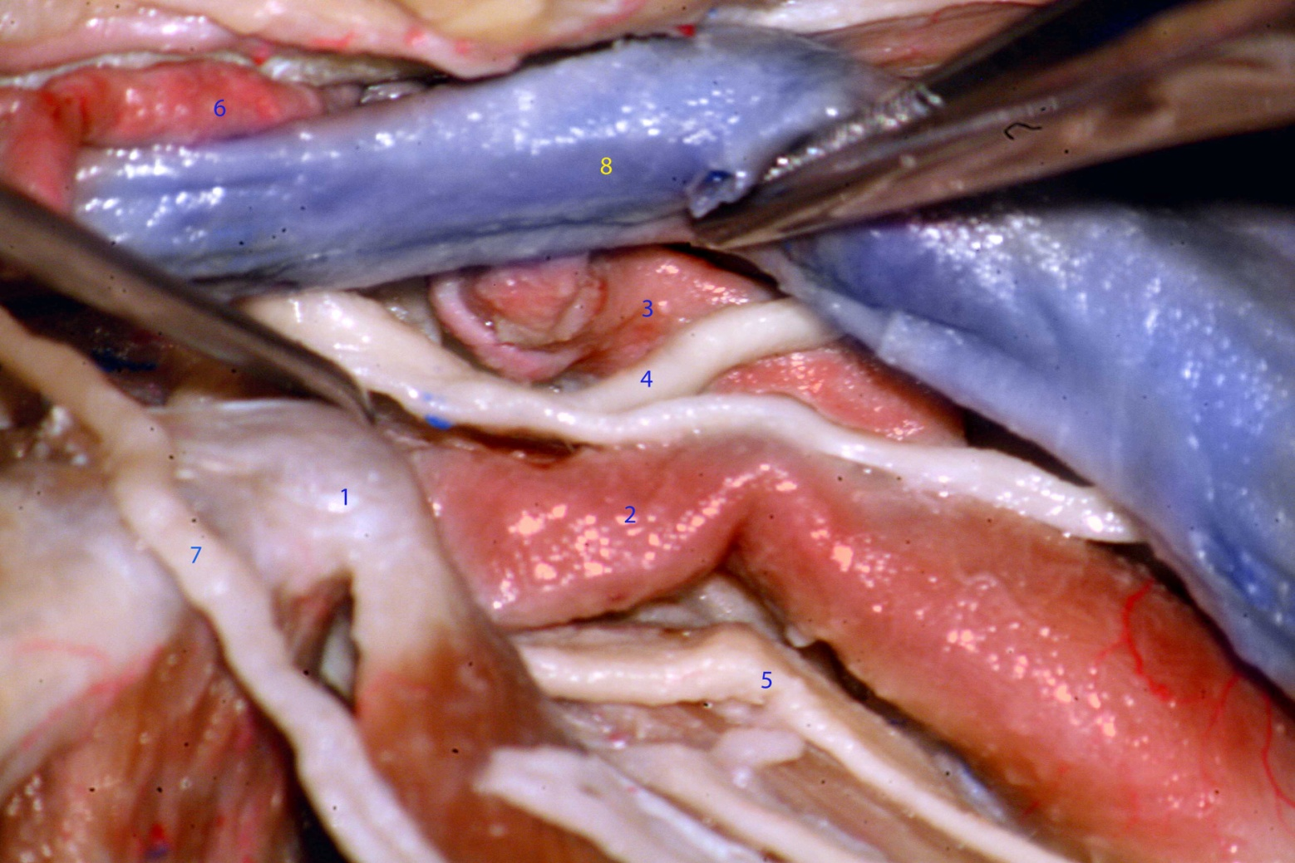
The internal jugular vein has been retracted anteriorly and the carotid bifurcation visualized. 1- transverse process of C1, 2- internal carotid artery, 3- external carotid artery, 4- hypoglossal n., 5- vagus n., 6- occipital artery, 7- spinal accessory n., 8- internal jugular vein.

Slide 8
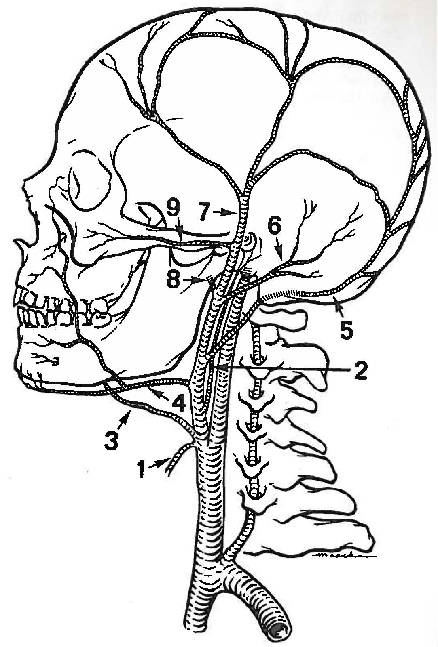
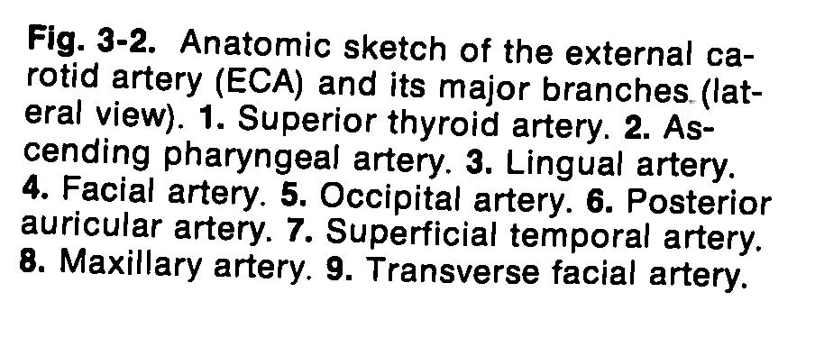
External carotid artery

Slide 9
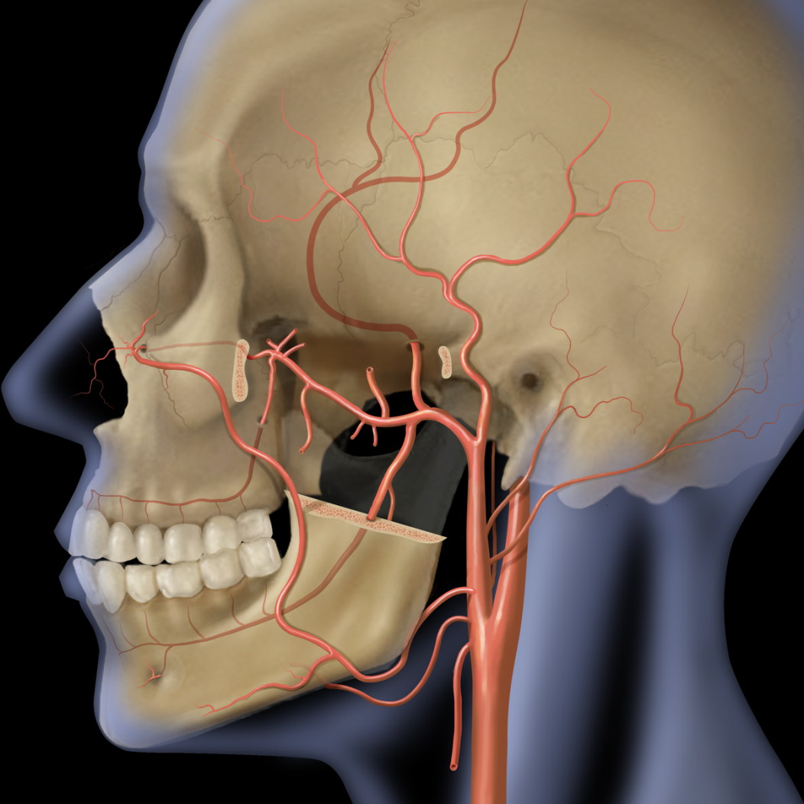
Figure of External Carotid Artery

Slide 10
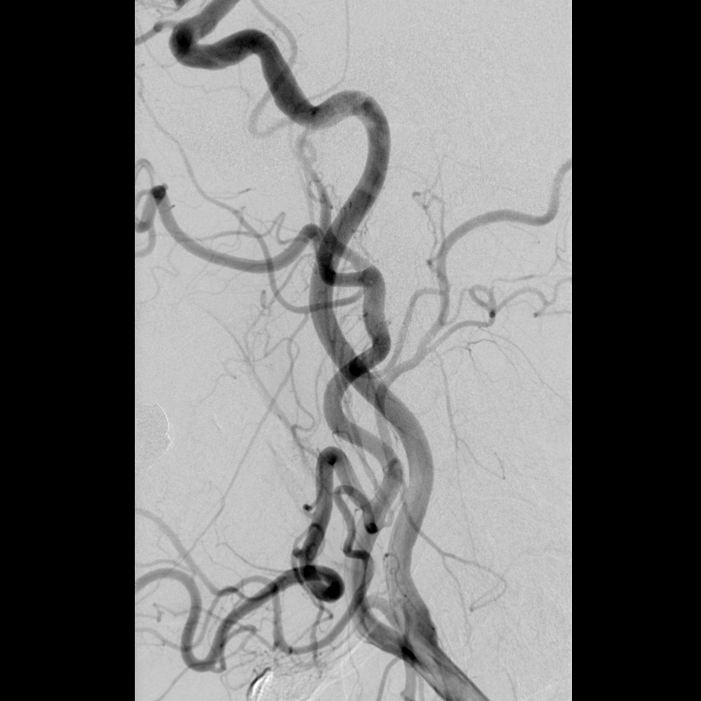
Angiogram: External Carotid Lateral View

Slide 11
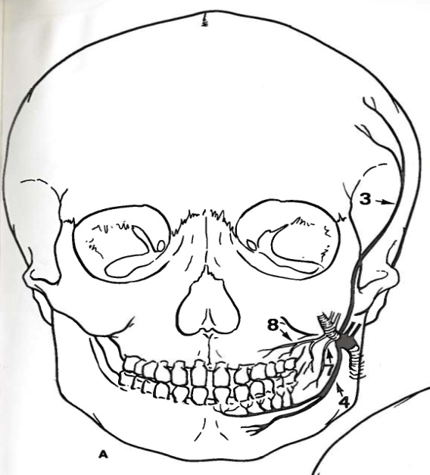
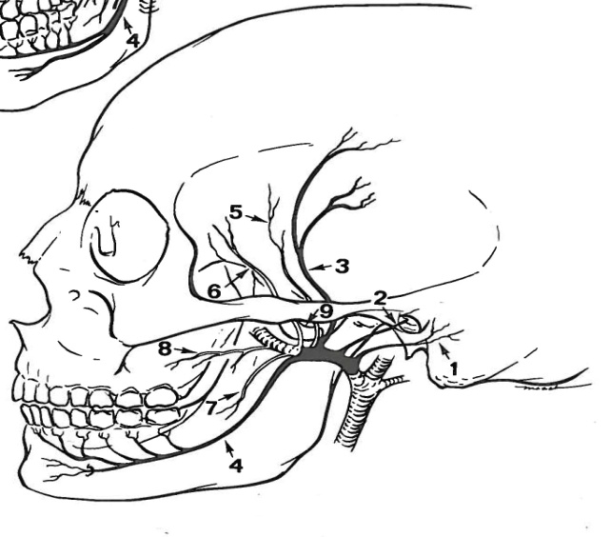
External Carotid Artery
Branches of the Maxillary Artery
Fig. 3-3 Anatomic sketch of the first and second portions of the maxillary artery. The first, or mandibular portion, is indicated by solid lines and the second, or pterygoid portion, is indicated by open lines. A. Anteroposterior view. B. Lateral view. 1. Deep aricular artery. 2. Anterior tympanic artery. 3. Middle meningeal artery. 4. Inferior alveolar artery. 5. Posterior deep temporal artery. 6. Anterior deep temporal artery. 7. Masseteric artery. 8. Bucinator Artery. 9. Accessory meningeal artery.

Slide 12
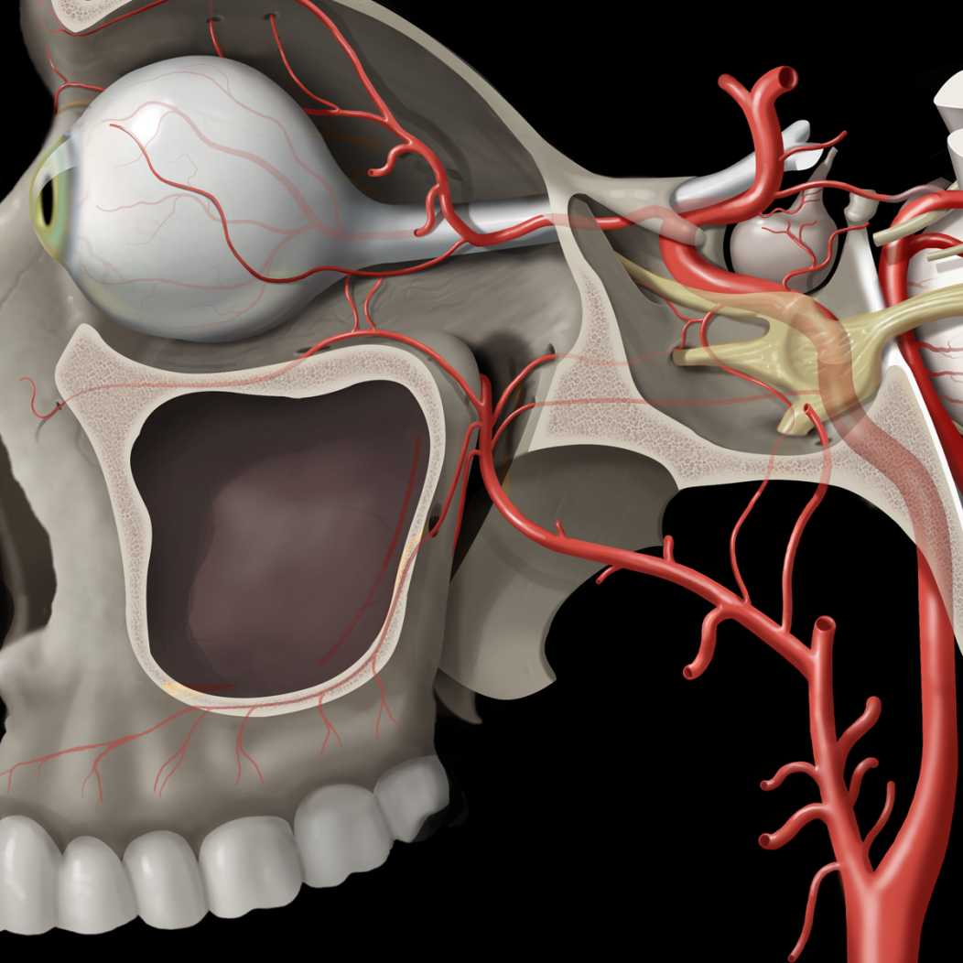
Figure of Maxillary Artery

Slide 13
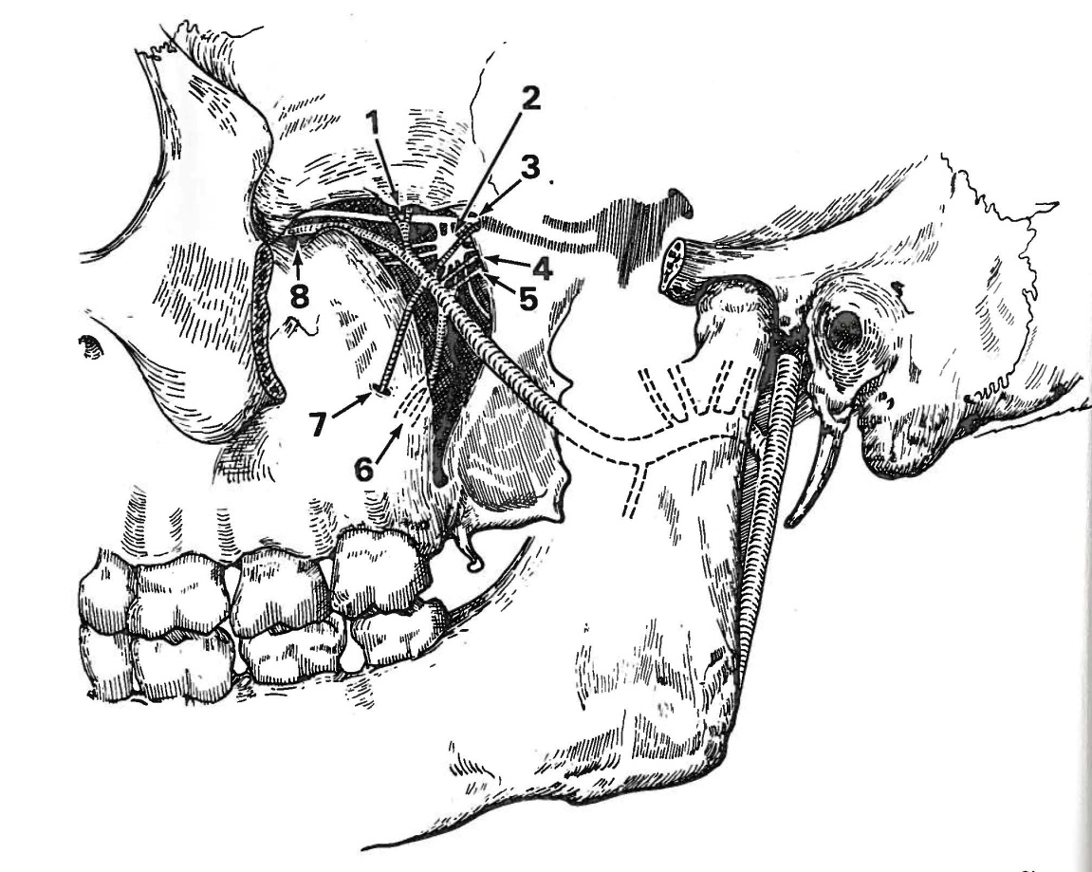
External Carotid Artery
Branches of Distal Maxillary Artery
Fig. 3-4. Diagrammatic sketch of the distal maxillary artery as it braches within the pterygopalatine fossa. 1. Sphenopalatine artery. 2. Sphenopalatine ganglion. 3. Maxillary nerve (V2) and the artery of the foramen rotundum. 4. Vidian artery. 5. Pharyngeal artery. 6. Descending palatine artery. 7. Posterior superior alveolar artery. 8. Infraorbital artery.

Slide 14
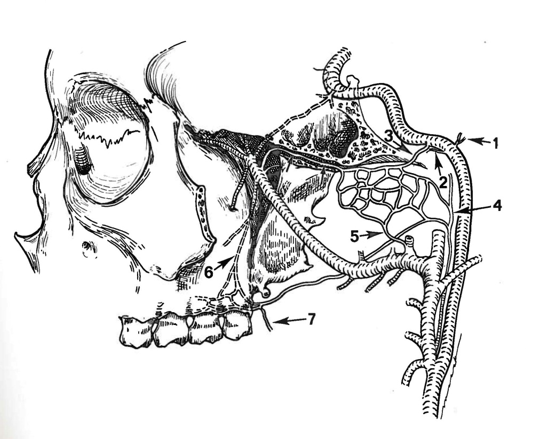
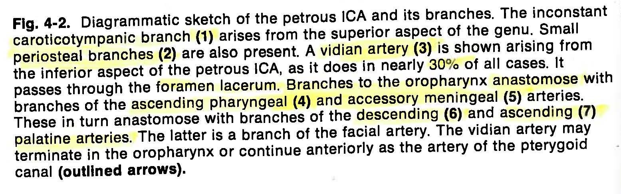
Internal Carotid Artery
Cervical and Distal Component

Slide 15
Internal Carotid Artery
Cervical and Petrous Component
Anomalous Branches
  Inferior and Ascending Pharyngeal
  Vidian
  Occipital
  Pro-atlantal Intersegmental anastomosis with the vertebral
  Hypoglossal anastomosis with the Basilar

Slide 16
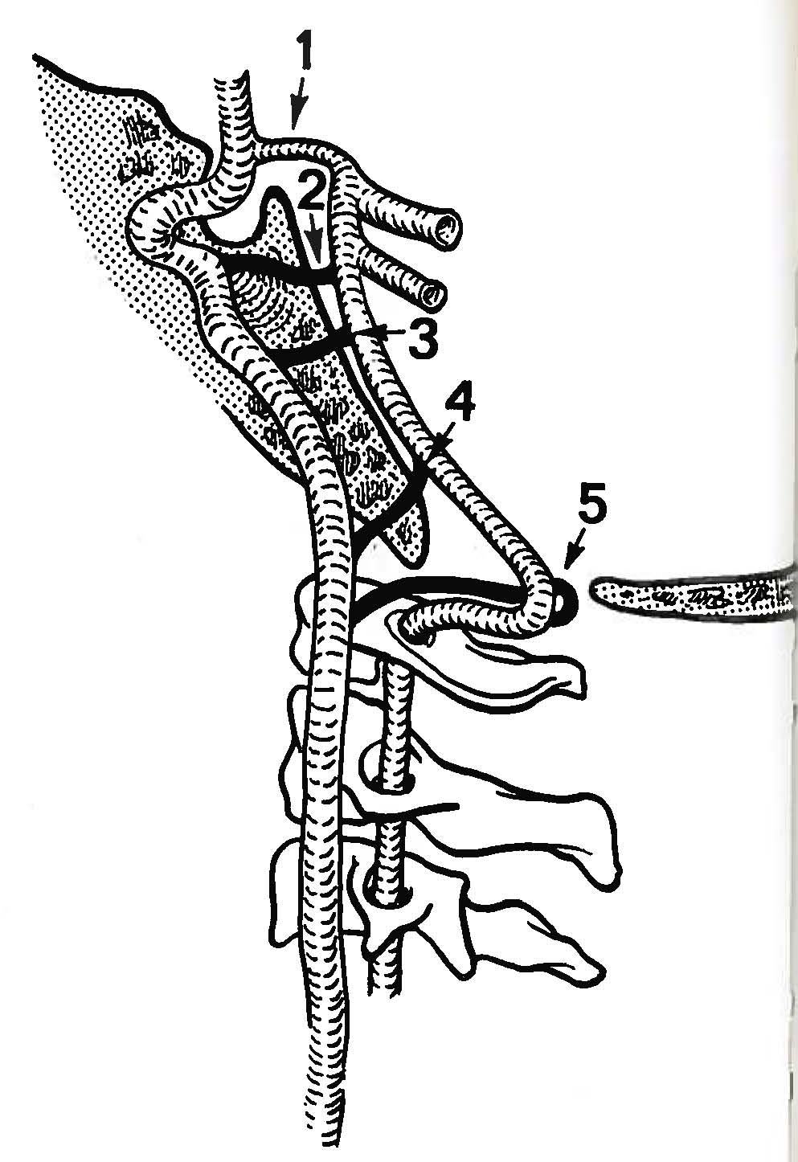
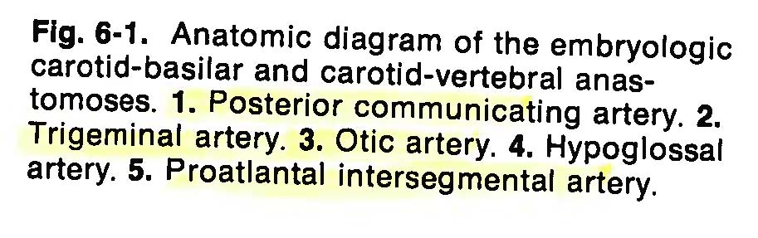
Internal carotid artery
Embryologic Anomalies

Slide 17
Internal Carotid Artery
Segments
C1- Cervical Segment: Bifurcation to Carotid Canal
C2 & C3- Petrous & Lacerum Segments: Commonly called the Petrous Segment
Branches: Caroticotympanic Art Vertical- Genu- Horozontal Components
Vedian Art Foramen Lacerum to Petrolingual Ligament
C4- Cavernous Segment: Petrolingual Ligament to Proximal Dural Ring
Branches: Meningohypophyseal Trunk
Inferolateral Trunk
Capsular Artery of McConnell
C5- Clinoidal Segment: Proximal to Distal Dural Ring
Branches: 20% Ophthlamic Artery
C6- Ophthalmic Segment: Distal Dural Ring to Posterior Communicating Artery
Branches: Superior Hypophyseal Artery
Ophthalmic Artery
C7- Communicating Segment: Posterior Communicating Artery to Bifurcation
Branches: Posterior Communicating Artery
Anterior Choroidal Artery

Slide 18
Internal Carotid Artery
Internal Carotid Artery
Extradural Vascular Supply
Caroticotympanic Art: Tympanic Cavity
Vidian Art: Posterior Superior Nasopharynx
Meningohypophyseal Trunk: Tentorial Artery of Bernasconi and Cassinari
Dorsal Meningeal Artery
Inferior Hypophyseal Artery
Inferolateral Trunk: Cranial Nerves and Dura of Cavernous Sinus
McConnell’s Capsular Art: Floor of the Sella Turcica

Slide 19
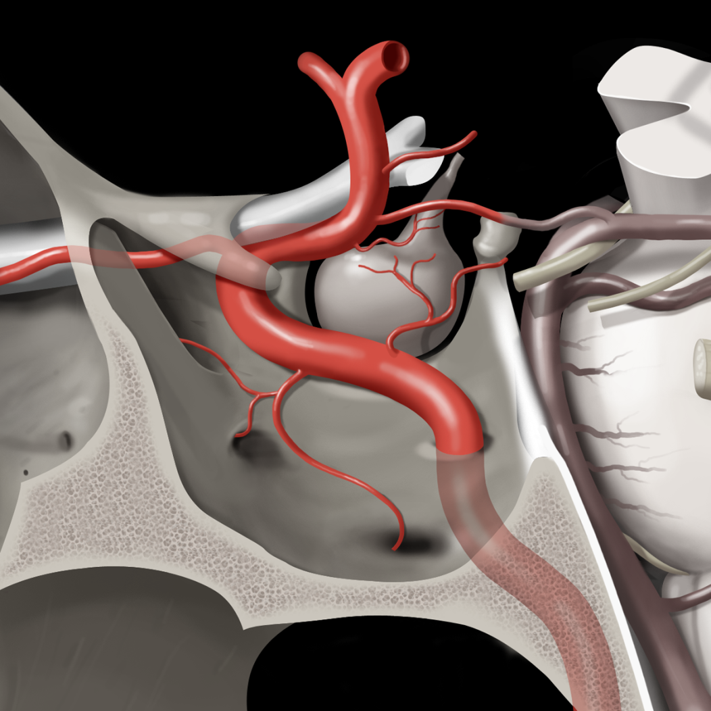
Figure of Cavernous Carotid

Slide 20
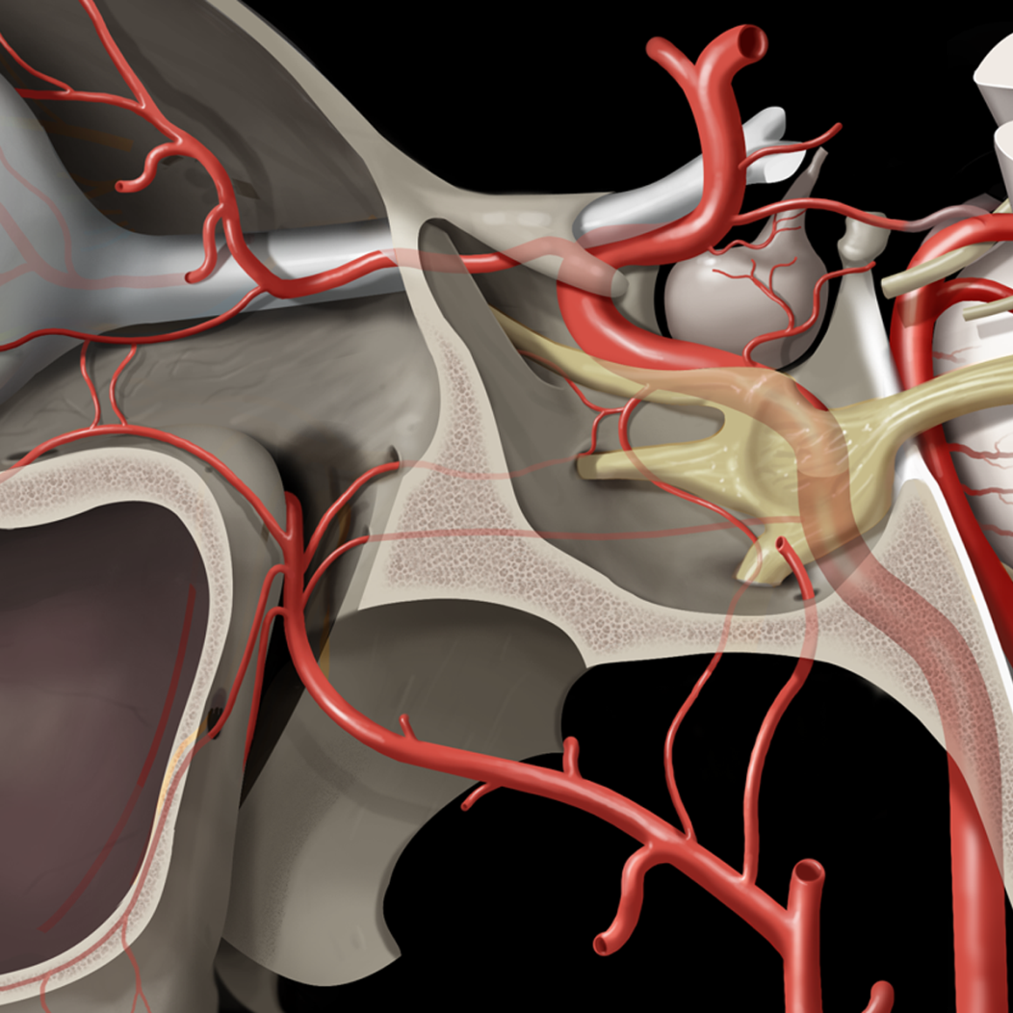
Figure of Cavernous Carotid

Slide 21
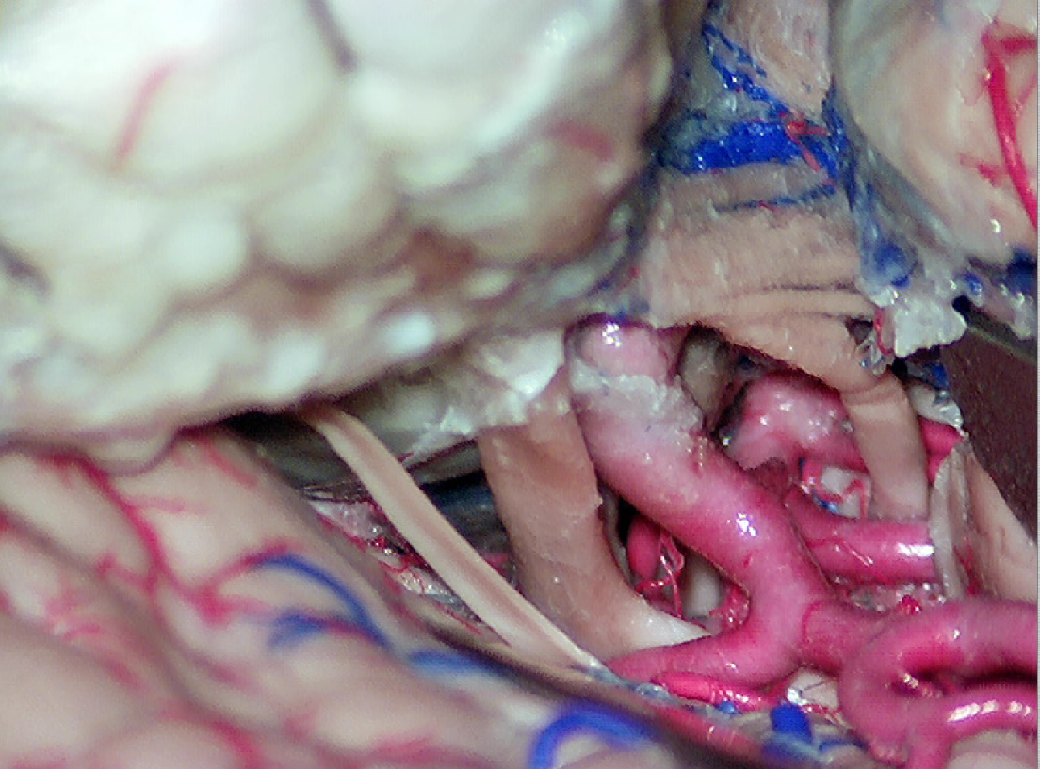
Right pterional window: right supraclinoid carotid artery, right carotid bifurcation, right MCA, right ICA, right I, II, III, IV, V1 CNs, right SCA, right P1 and P2, basilar tip and right PcomA are visible

Slide 22
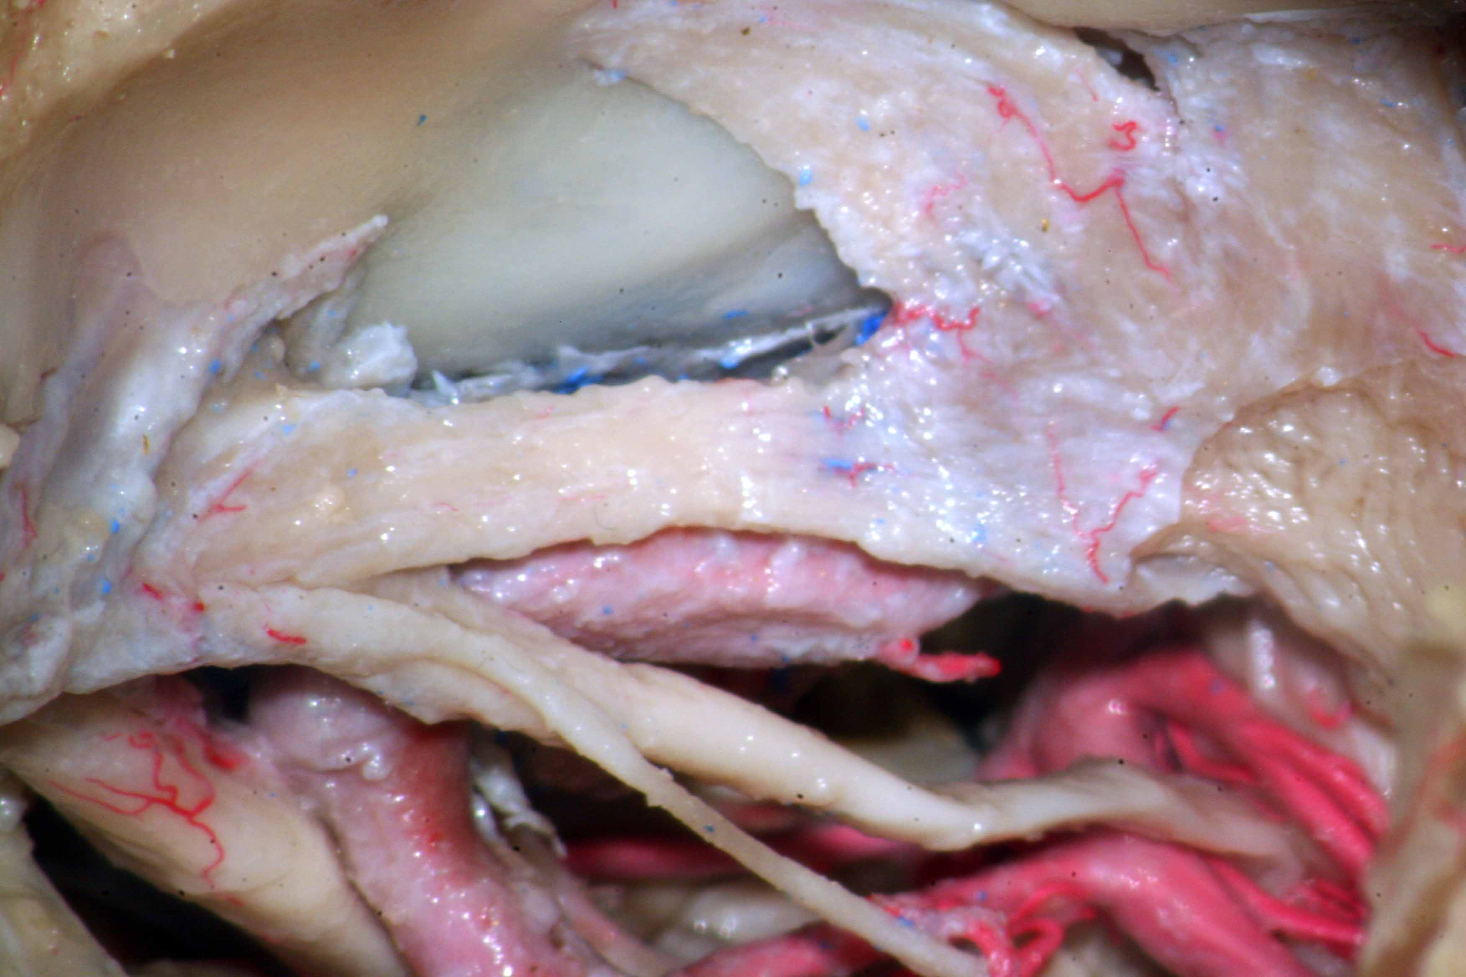
Right orbito-Zygomatic trans-cavernous window: basilar tip , right SCA, both P1, right P2, both PcomA, right II, III, IV, V1, V2 CNs, intracavernous carotid artery, meningo-hypophyseal trunk, gasserian ganglion are visible

Slide 23
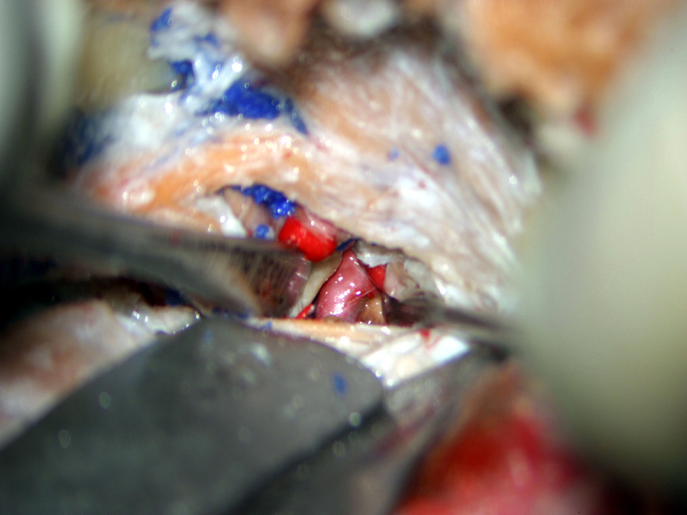
Right orbito-Zygomatic trans-cavernous window: view of mid-portion of the basilar artery through Parkinson’s triangle

Slide 24
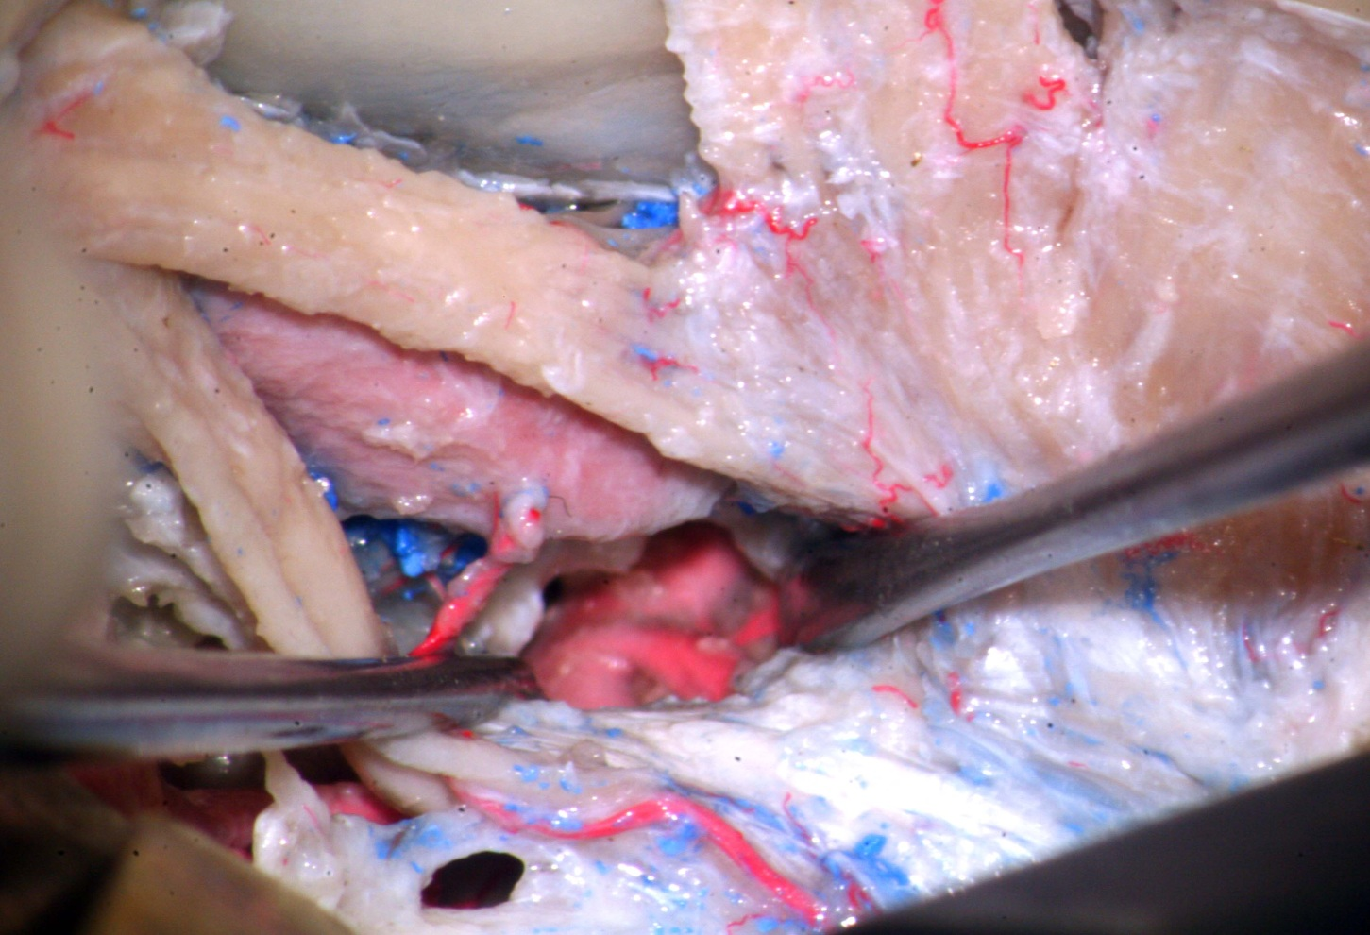
Right orbito-Zygomatic trans-cavernous window: view of mid-portion of the basilar artery through Parkinson’s triangle

Slide 25
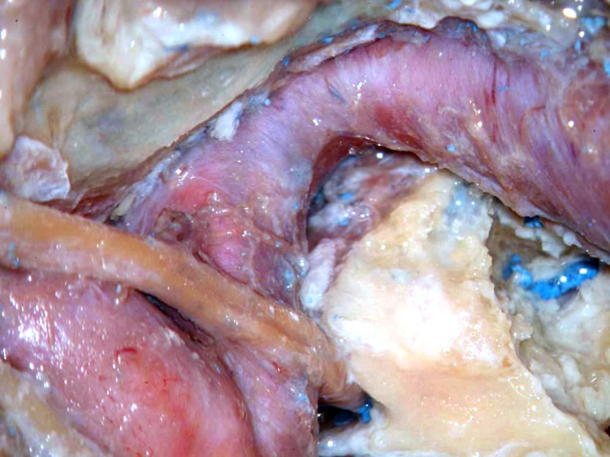
The lateral wall of the cavernous sinus has been removed: View of the intrapetrous and intracavernous carotid artery and foramen lacerum, right VI CN and Dorello’s canal

Slide 26
Internal carotid artery
Intradural Vascular Supply Around Circle of Willis
Superior Hypophyseal Artery: Hypophyseal Stalk and Anterior Lobe
Optic Chas
Ophthalmic Artery: Globe and Orbital Contents
Posterior Communicating Art: Anterior Thalamoperferators
Tuber Cinereum, Subthalamic Nucleus
Ventral and Periventricular Thalamic Nuclei
Mammillary Bodies, Posterior Hypothalamus
Posterior Chiasm, Cerebral Peduncles
Posterior limb of Internal Capsule
Anterior Choroidal Artery: Posterior limb of Internal Capsule
Lentiform Nuclei (Basal Ganglia)
Optic Radiations
Amygdala
Choroid Plexus
Recurrent Artery of Heubner: Basal Ganglia – Globus Pallidus/Caudate
14% off A1 Internal Capsule- Anterior Limb
78% off A2 Hypothalamus
Anterior Communicating Artery: Optic Chiasm, Lamina Terminal
Perforators Hypothalmus, Parolfactory Area
Cingulate Gyrus, Corpus Callosum

Slide 27
Branches: Clinoidal Segment of Internal Carotid

Slide 28
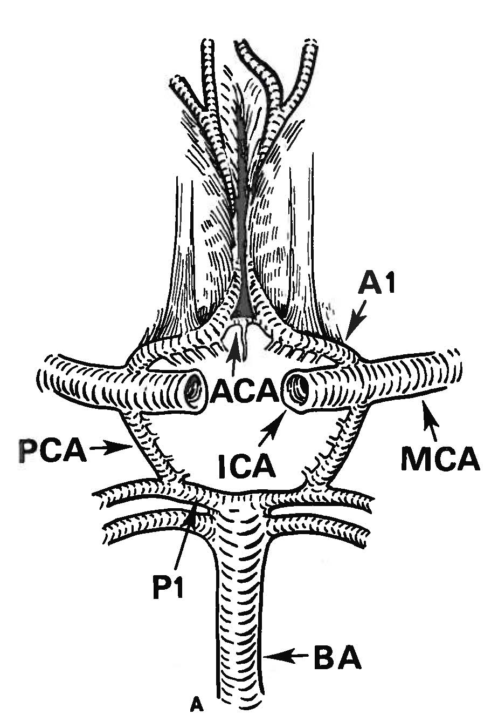
Internal Carotid Artery
Circle of Willis- Classic View
Fig. 6-2. Anatomic diagram of the circle of Willis. (A) “Classic” circle of Willis. No component is hypoplastic or absent. This balanced configuration is present in only 18% of all cases.
Seen in 18% of Patients

Slide 29
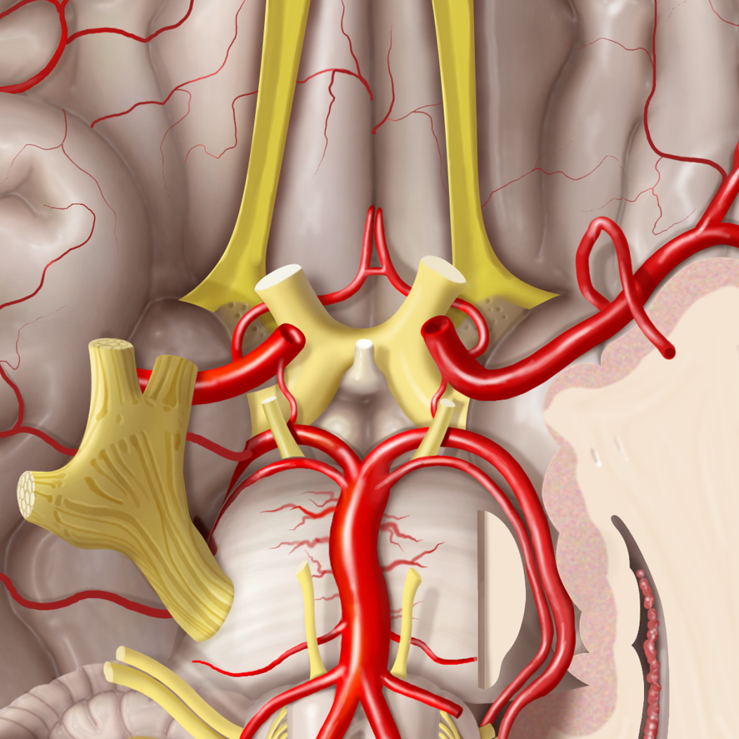
Circle of Willis: Inferior View

Slide 30
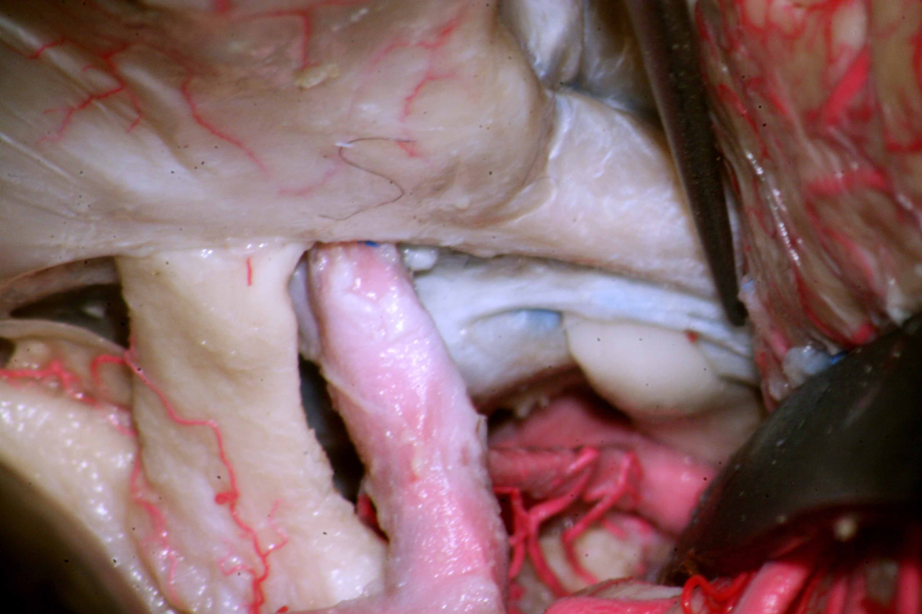
Right Pterional window: Supraclinoid carotid artery, anterior clinoid process, posterior clinoid process, optic chiasm, right II and III CNs, right PcomA, right P1 and P2 and basilar tip are visible

Slide 31
Right pterional window: right supraclinoid carotid artery, right carotid bifurcation, right MCA, right ICA, right I, II, III, IV, V1 CNs, right SCA, right P1 and P2, basilar tip and right PcomA are visible

Slide 32
Internal Carotid Artery
Variants in Circle of Willis
Hypoplasia of one or both Posterior Communicating Arteries 22%
Absent or Hypoplastic A1 Segment 25%
Hypoplastic P1 Segment with Fetal Origin of Posterior Cerebral Artery 15%
Duplicated Anterior Communicating Artery 9%

Slide 33
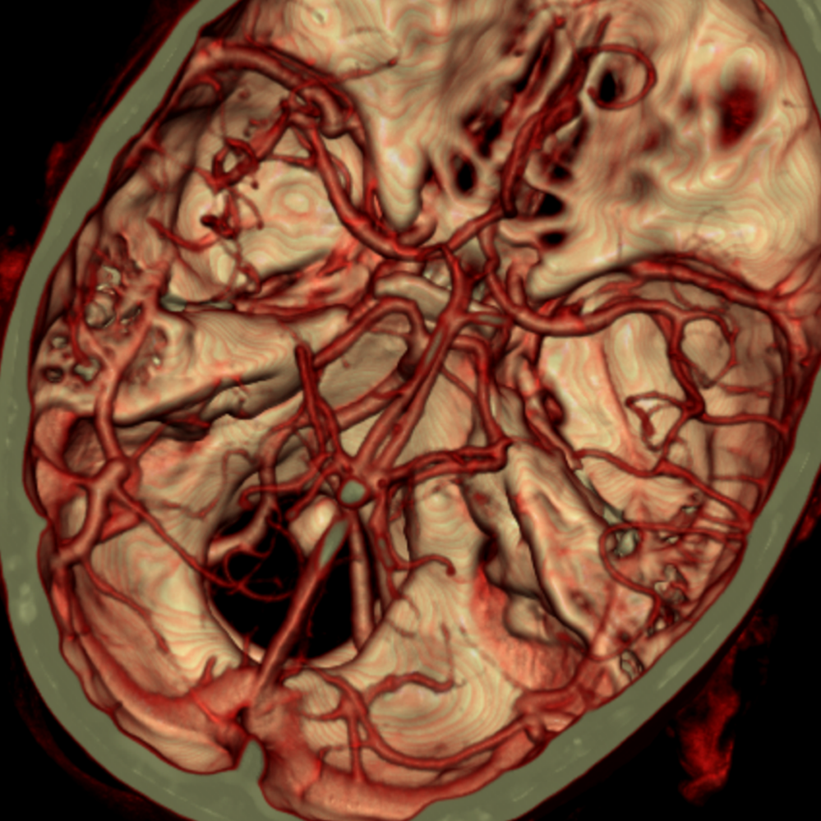
CTA of Circle of Willis

Slide 34
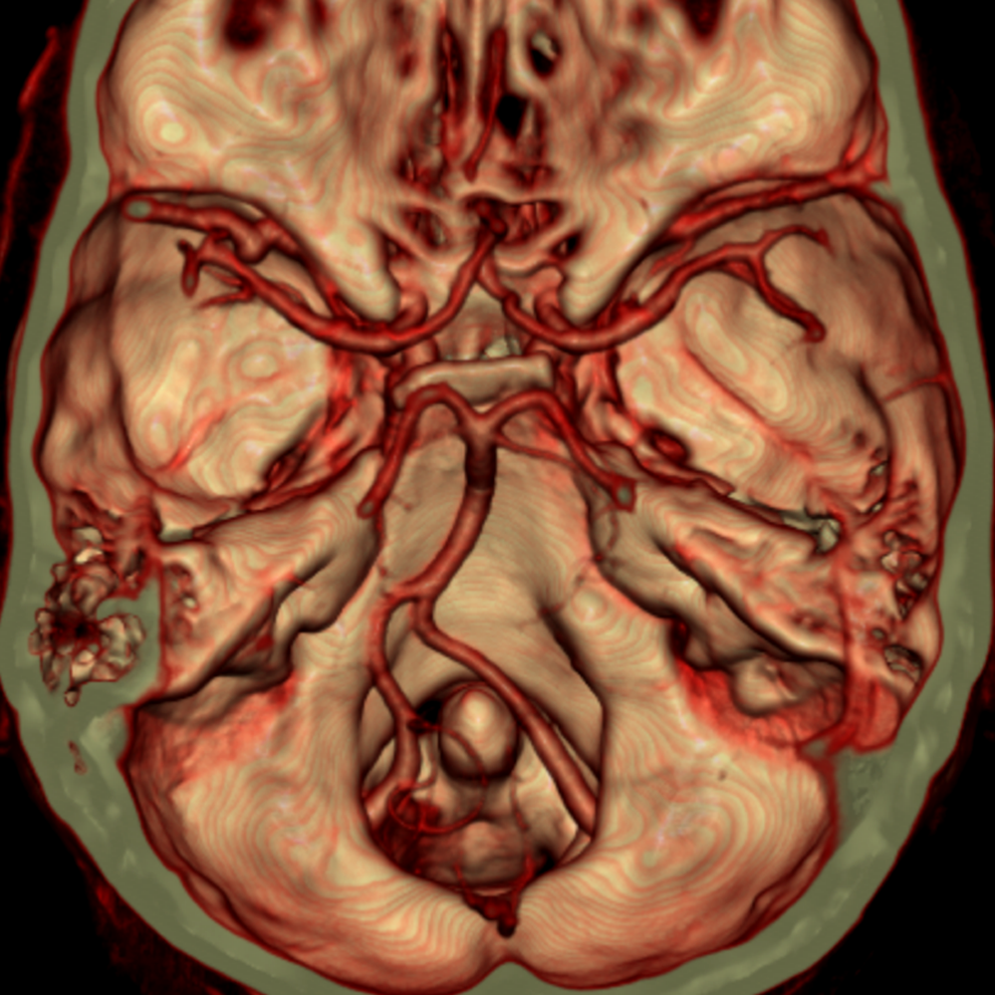
CTA of Circle of Willis

Slide 35
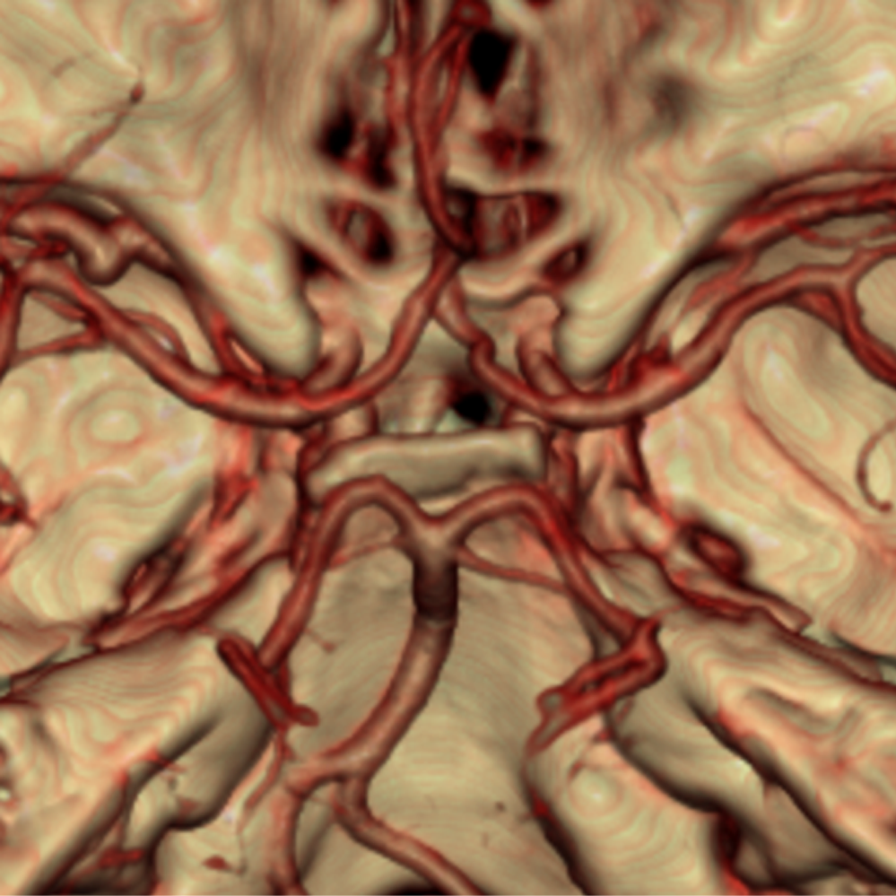
CTA of Circle of Willis

Slide 36
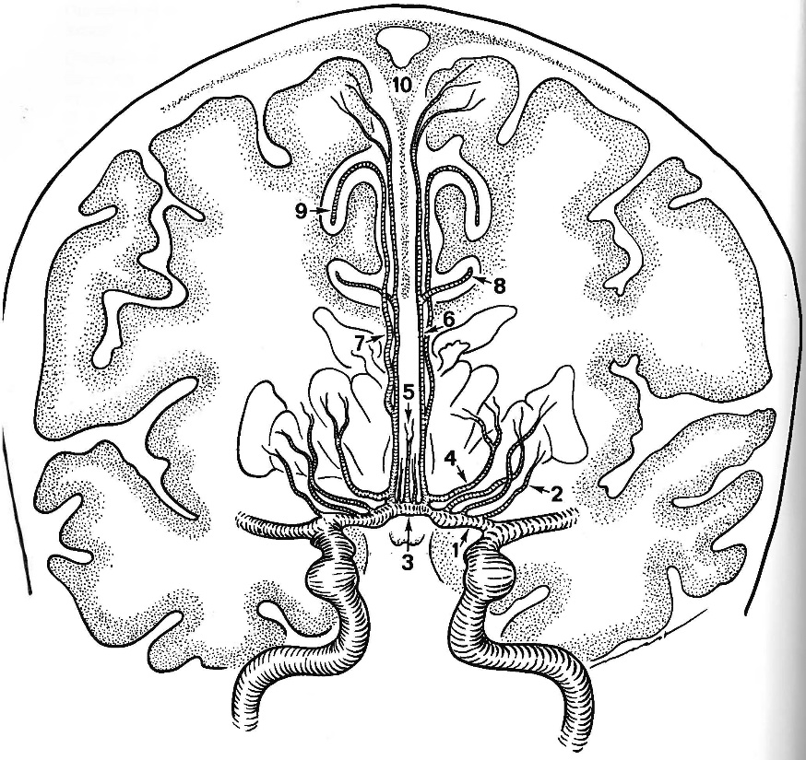
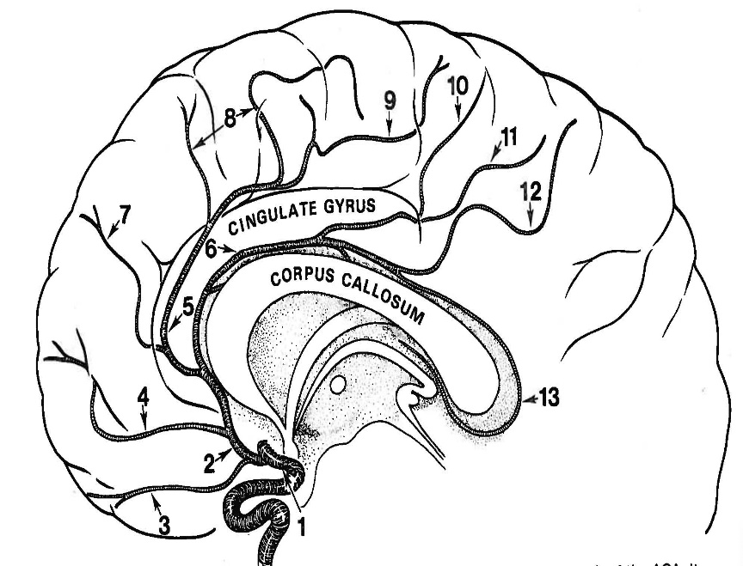
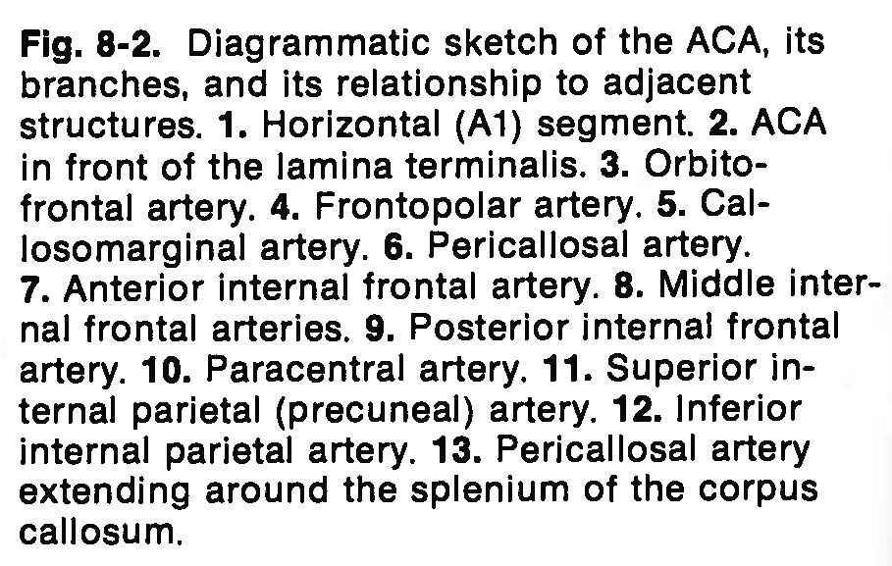
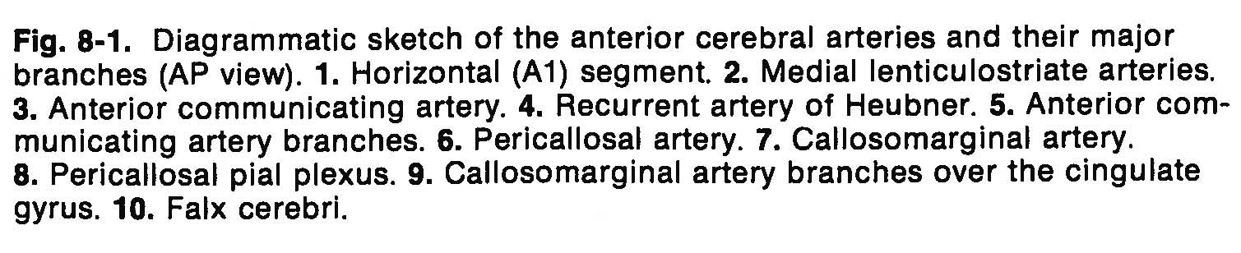
Internal Carotid Artery
Anterior Cerebral Artery

Slide 37
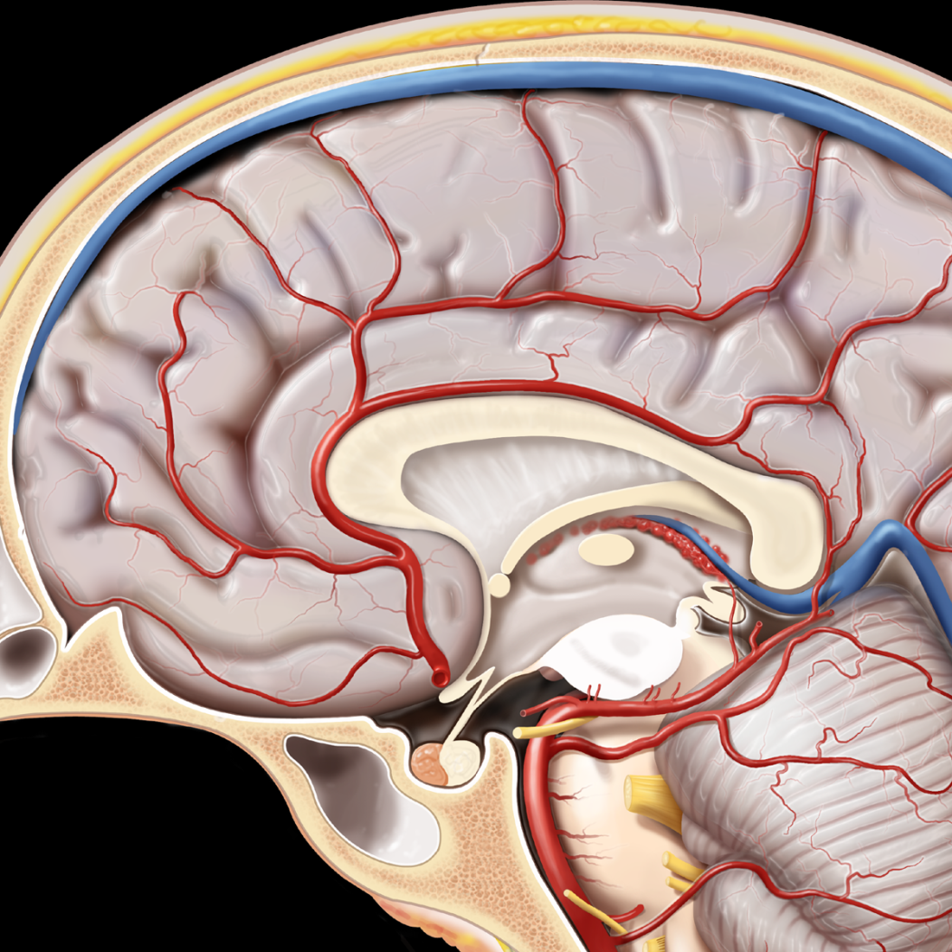
Medial View Anterior Cerebral Artery

Slide 38
Anterior Cerebral Artery
Medial Lenticulostriate Vessels (A1)
Anterior Perforated Substance Dorsal Optic Chiasm
Subfrontal Area Anterior Commisur
Septum Pellucidum Hypothalamus
Para-olfactory Areas

Slide 39
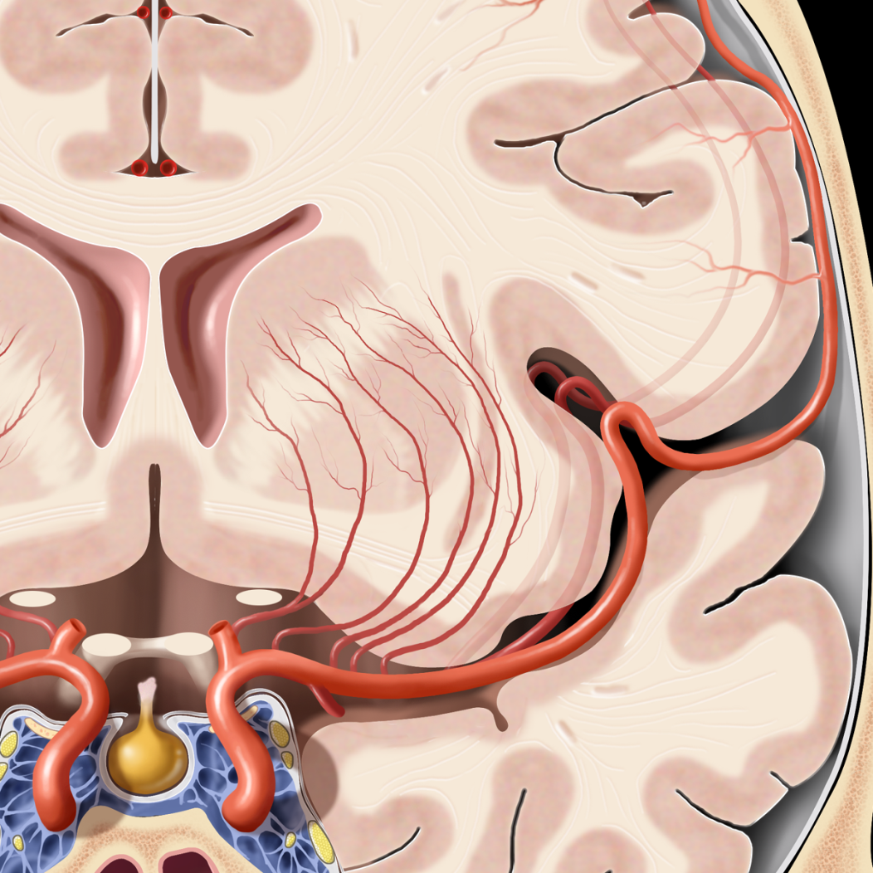
Medial and Lateral
Lenticulostriate Vessels

Slide 40
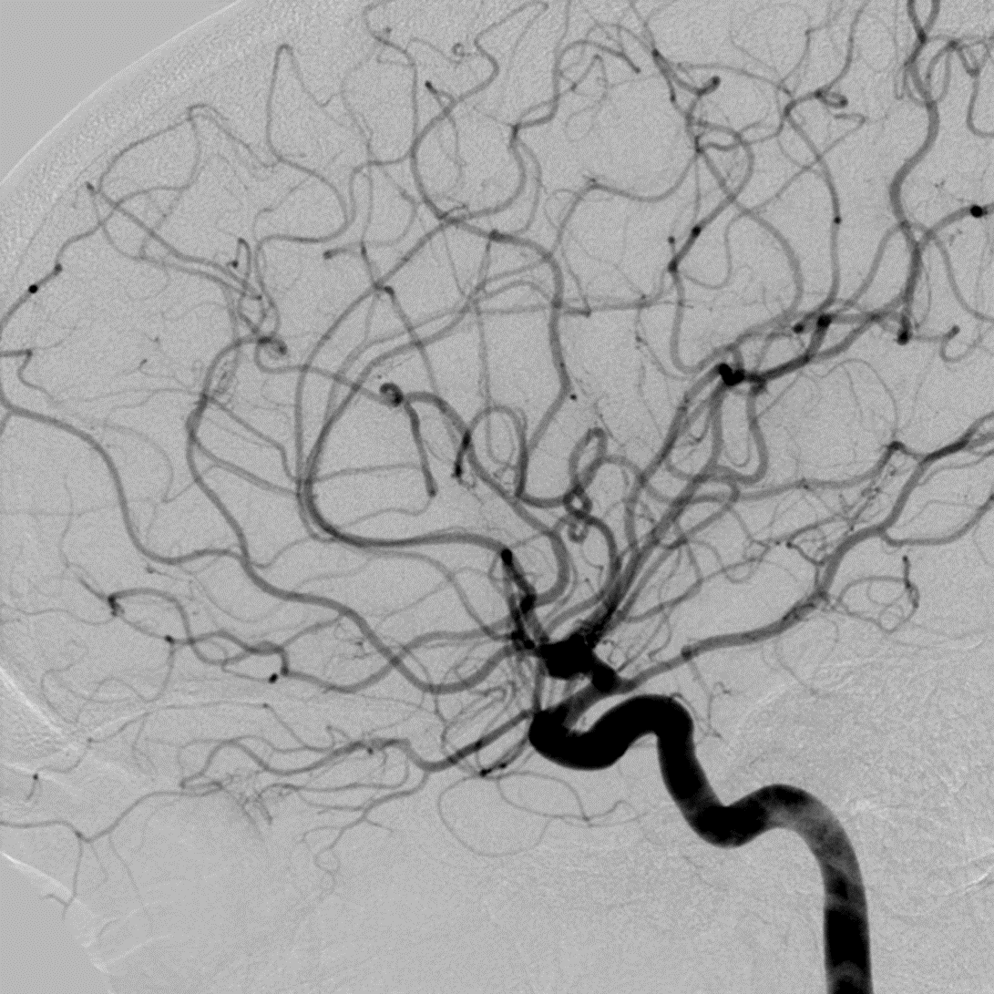
Lateral Angiogram: Internal
Carotid Artery

Slide 41
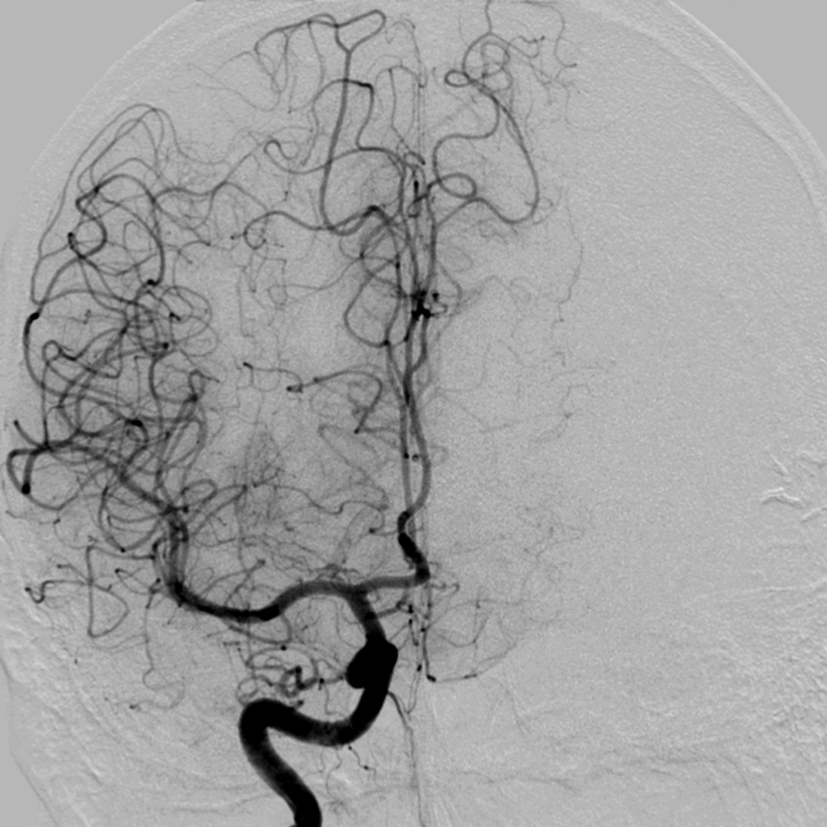
AP Angiogram Internal Carotid Artery

Slide 42
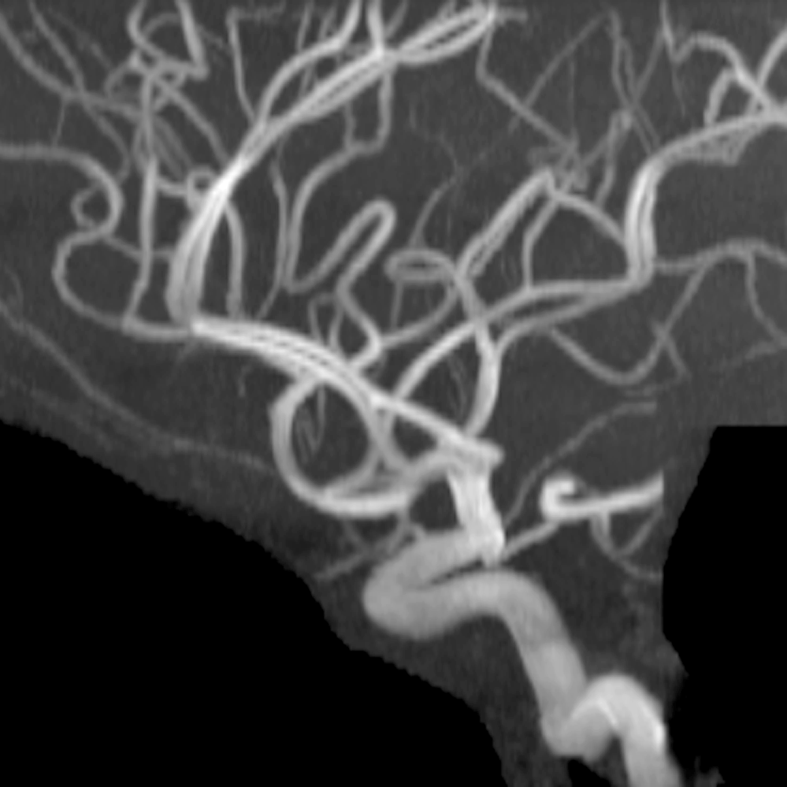
Lateral MRA: Internal Carotid Artery

Slide 43
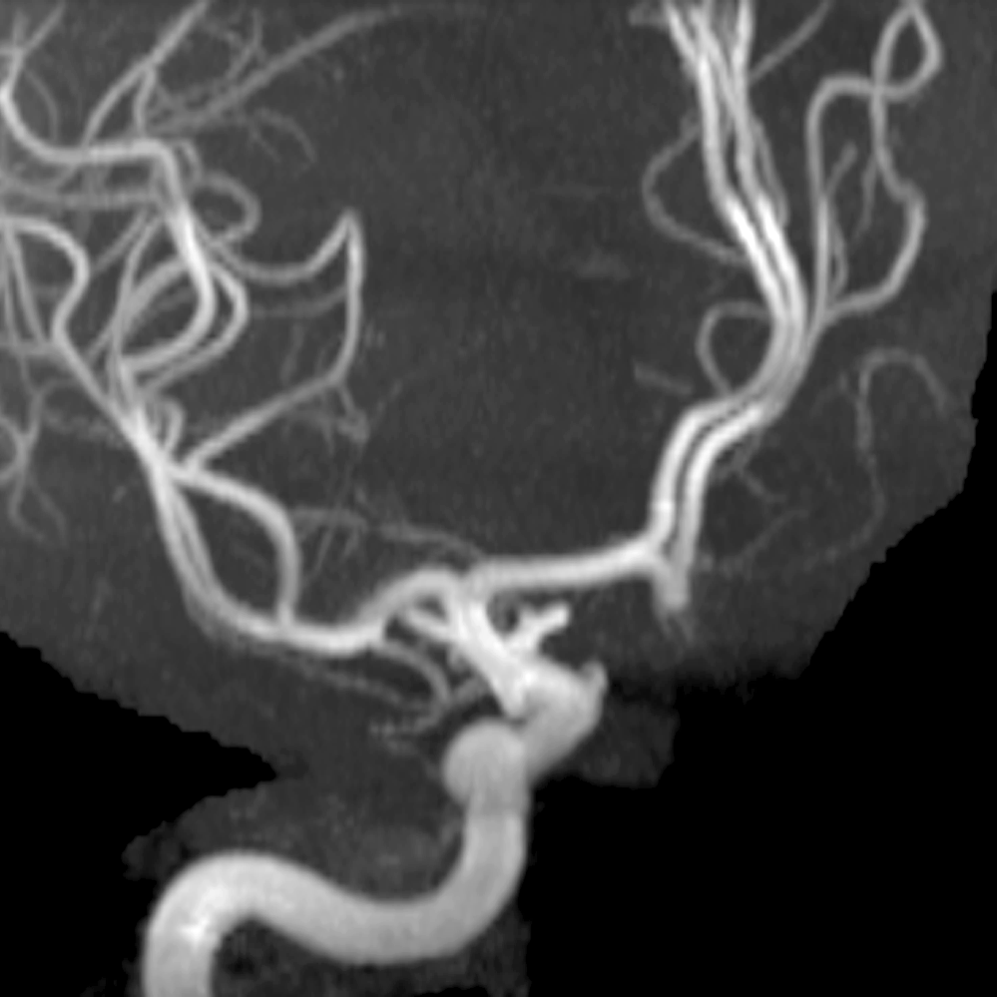
AP MRA Internal Carotid Artery

Slide 44
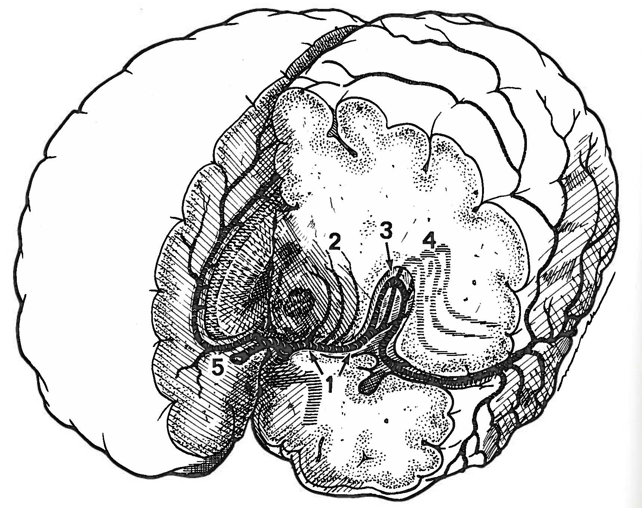
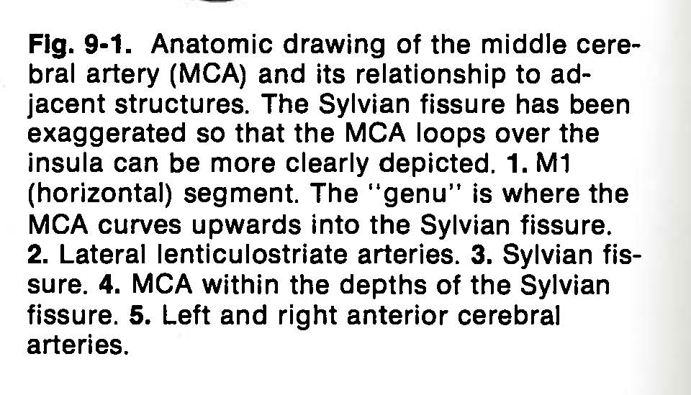
Internal Carotid Artery
Middle Cerebral Artery

Slide 45
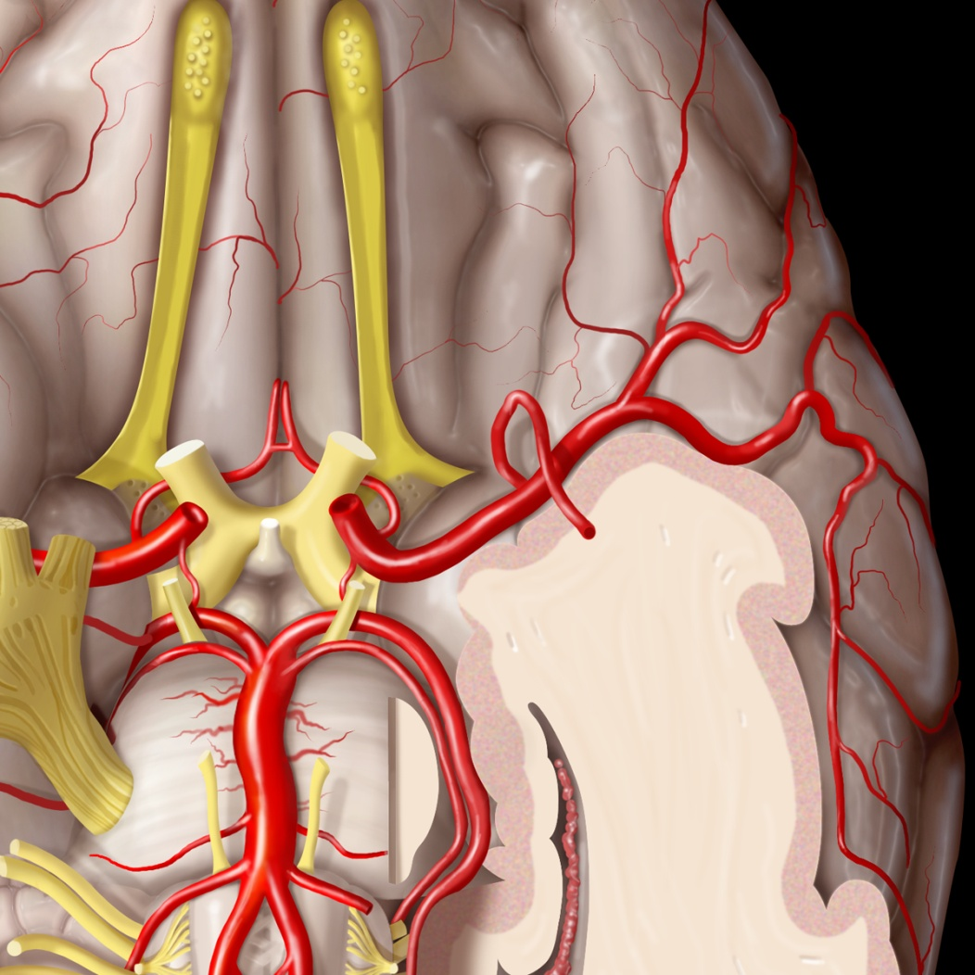
Middle Cerebral Artery: Inferior View

Slide 46
Middle Cerebral Artery
Lateral Lenticulostriate Vessels
Basil Ganglia
Internal Capsule
Caudate Nucleus

Slide 47
Lateral Lenticulostraiate Vessels

Slide 48
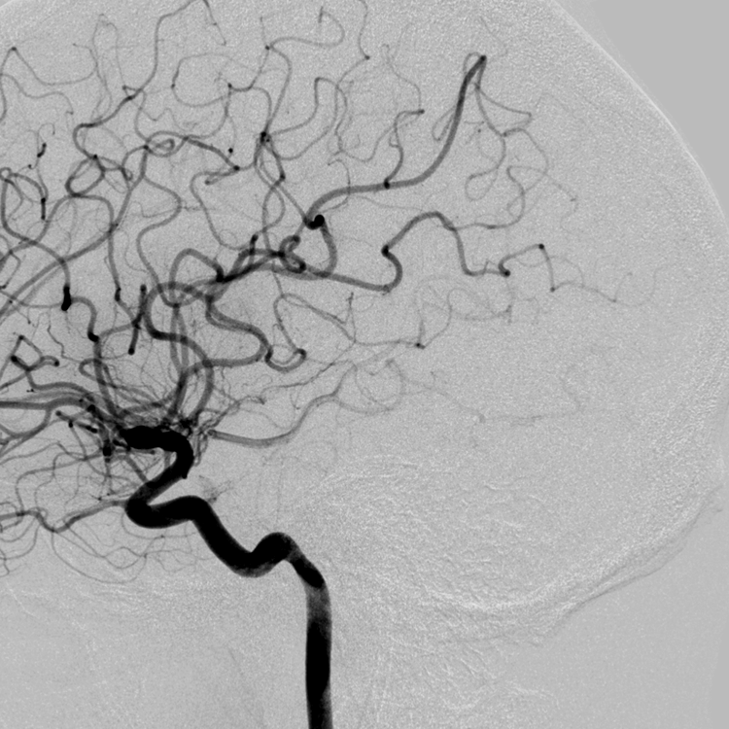
Lateral Angiogram Middle Cerebral Artery

Slide 49
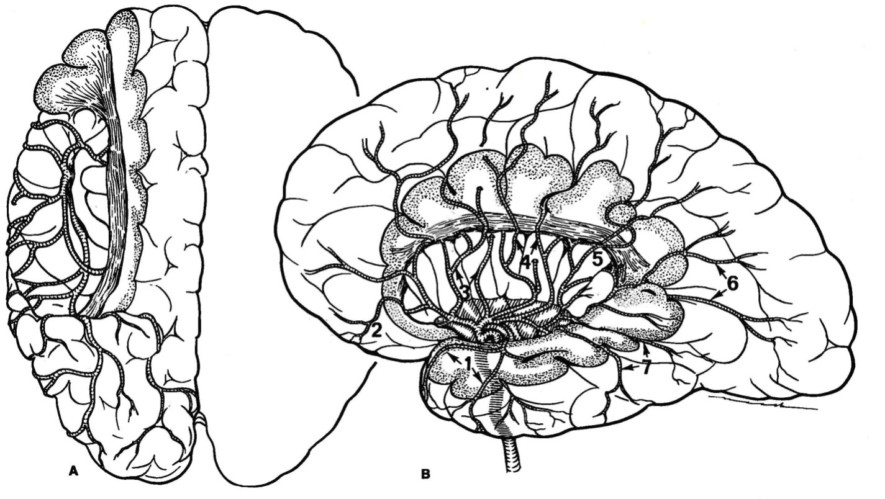
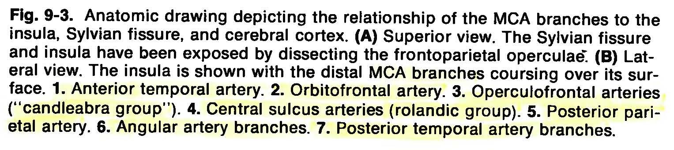
Middle Cerebral Artery

Slide 50
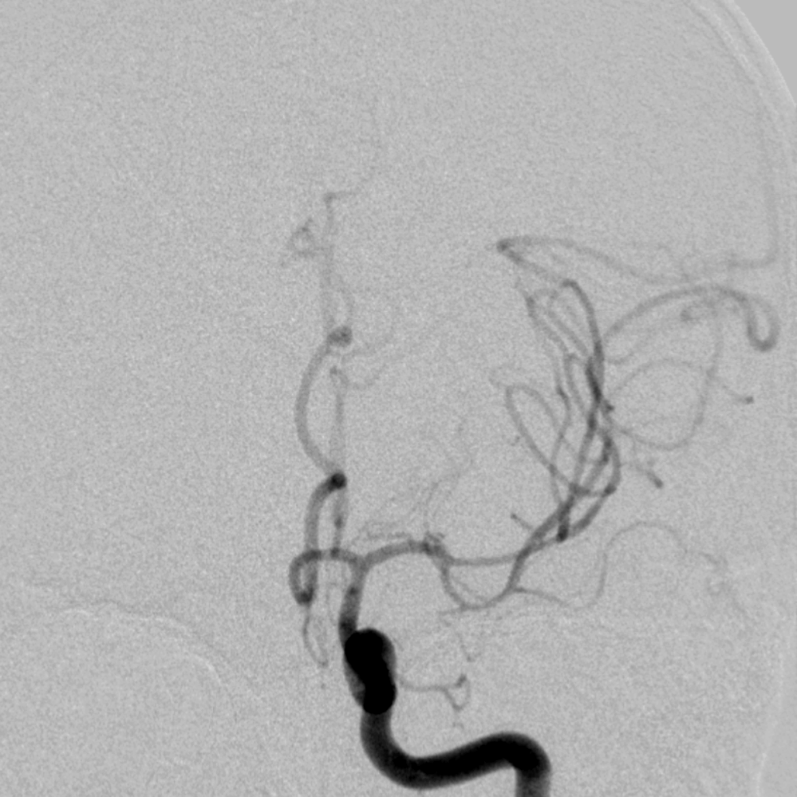
AP Angiogram Middle Cerebral Artery

Slide 51
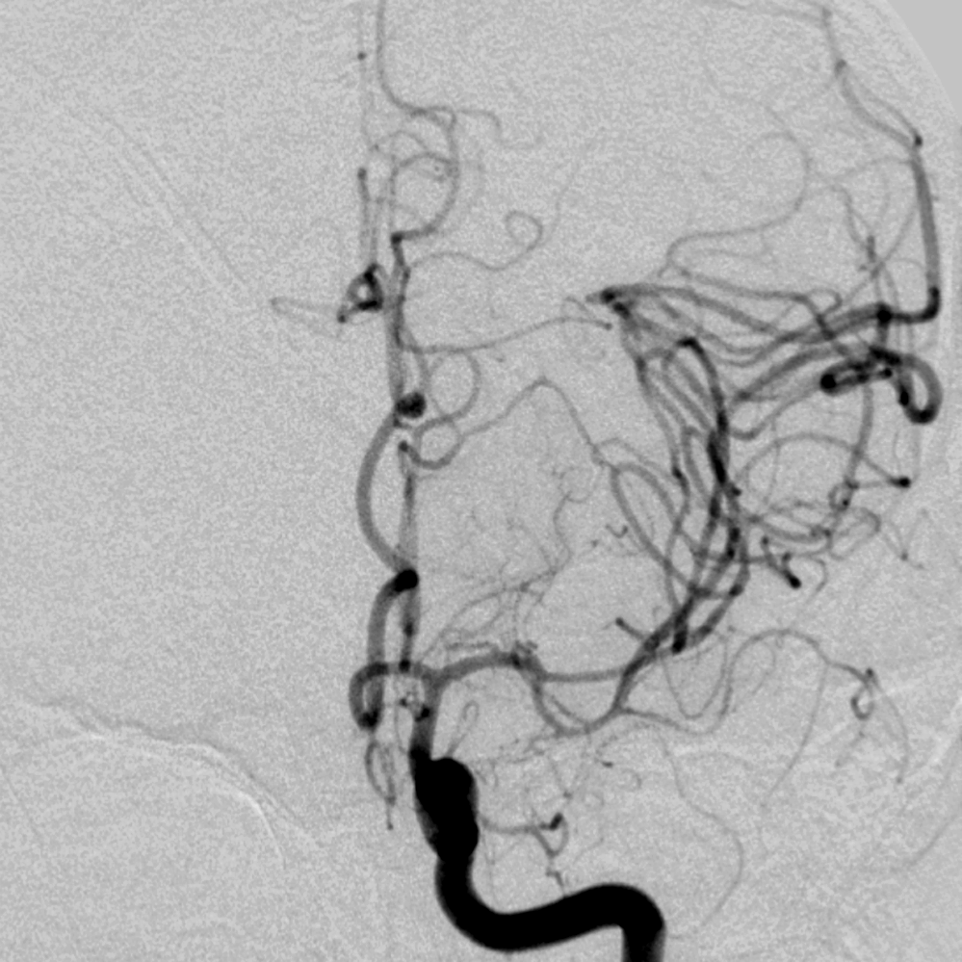
AP Angiogram Middle Cerebral Artery

Slide 52
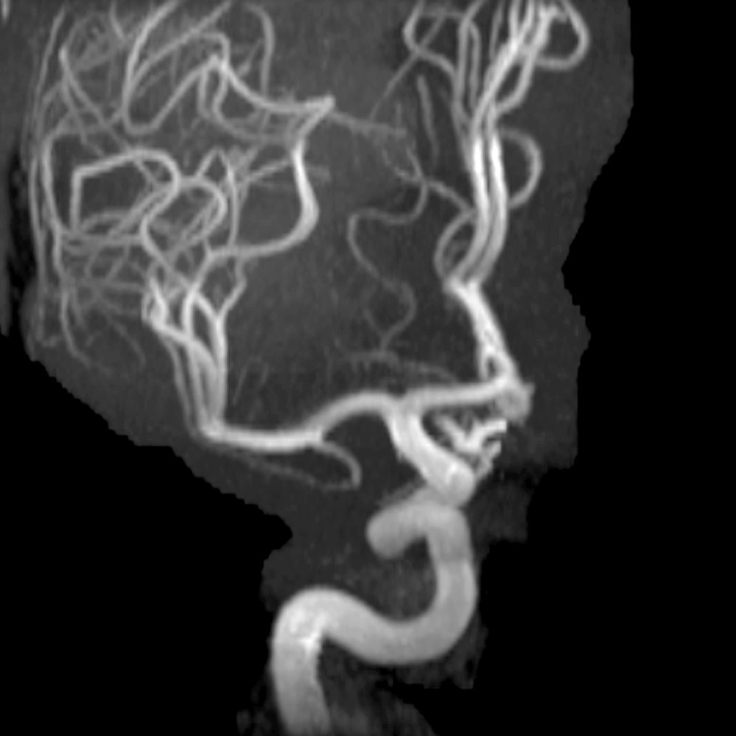
AP MRA Middle Cerebral Artery

Slide 53


Arteries of Posterior Fossa
Vertebrobasilar System

Slide 54


Arteries of Posterior Fossa
Vertebrobasilar System

Slide 55


Arteries of Posterior Fossa
Vertebrobasilar System

Slide 56

Lateral Angiogram Verterbral Artery

Slide 57

AP Angiogram Vertebral Artery

Slide 58

Arteries of Posterior Fossa

Slide 59

AP MRA Vertebral Artery

Slide 60
Posterior Circulation

Slide 61
The lateral wall of the cavernous sinus has been removed: View of the intrapetrous and intracavernous carotid artery and foramen lacerum, right VI CN and Dorello’s canal

Slide 62

Left Transcavernous View: Basilar Apex

Slide 63

Left Transcavernous View:
Vertebral Confluens

Slide 64

Anterior petrosectomy surgical window: basilar artery, vertebro-basilar junction, and right aica are visible

Slide 65

Left trans-otic surgical window: sigmoid sinus, jugular bulb, left intrapetrous carotid artery, left facial nerve, left aica, left petrosal vein, are visible

Slide 66

Right trans-cochlear surgical window: basilar artery, right aica, right petrosal vein and right VI CN are visible

Slide 67

Right far lateral approach: superior oblique muscle is lifted and extra-cranial vertebral artery is exposed, right occipital artery is visible

Slide 68

Far Lateral View: Cervical Vertebral

Slide 69

Left far lateral approach: dura is opened and left Pica is visible

Slide 70

Left Far lateral approach: Pica, vertebral artery, spinal and cranial XI, XII CNs are visible

Slide 71

Left far lateral surgical window: brunches of Pica, IX, X CNs and choroid plexus of IV ventricle are visible

Slide 72

Trans-facial surgical window: vertebral arteries, vertebro-basilar junction, both VI, left VII, left VIII CNs, aica, anterior spinal arteries and petrosal vein are visible

Slide 73

Trans-facial surgical window: vertebral arteries, vertebro-basilar junction, both VI, left III CNs, both AICAs, both PICAs, anterior spinal arteries, both SCAS, left P1, P2, left PComA, and petrosal veins are visible

Slide 74


Posterior Cerebral Artery

Slide 75


Posterior Cerebral Artery

Slide 76
Posterior Cerebral Artery
Thalamoperforating Arteries
Origin: PCoA (Anterior) and P1 Segment of PCA (Posterior)
Enter: Posterior Perforating Substance
Supply: Thalamus, Hypothalamus, Subthalamic Nuclei, Nuclei of CN 3 + 4, Oculomotor nerve, Posterior Limb of Internal Capsule

Slide 77
Posterior Cerebral Artery
P2 Segment Branches
Thalamogeniculate Arteries: Thalamus, Posterior Limb Internal Capsule, Geniculate, optic tract
Medial Posterior Choroidal: Thalamus, Pineal Body, Choroid Plexus
Lateral Posterior Choroidal: Cerebral Peduncle, Posterior commissure, lateral
geniculate, Thalamus, Fornix, Caudate
Inferior Temporal Arteries

Slide 78

Posterior Cerebral Artery

Slide 79

Lateral Angiogram Posterior Cerebral Artery

Slide 80

AP Angiogram Posterior Cerebral Artery

Slide 81

Lateral MRA Posterior Cerebral Artery

Slide 82

Submental Vertex View of PCA

Slide 83
Posterior Cerebral Artery
P3 Segment Branches
Parieto-Occipital
Calcarine
Splenial

Slide 84


Venous Drainage of Head

Slide 85


Venous Drainage of Head

Slide 86


Venous Drainage of Head

Slide 87


Venous Drainage of Head

Slide 88

Venous Drainage of Head

Slide 89


Venous Drainage of Head

Slide 90

Venous Drainage of Head

Slide 91

Venous Phase Angiogram

Slide 92

View of Superior Sagittal Sinus

Slide 93

AP Venous Angiogram

Slide 94

Lateral MRV

Slide 95

AP MRV

Slide 96

Submental Vertex MRV

Slide 97

Venous Drainage of Posterior Fossa

Slide 98

Venous Drainage Around Brain Stem

Slide 99

Ventricular Venous Drainage

Slide 100

Venous Drainage of Head

