Slide 1
Introduction to Neurosurgical Subspecialties: Tumor and Skull Base Neurosurgery
Brian L. Hoh, MD¹ and Gregory J. Zipfel, MD²
¹University of Florida, ²Washington University

Slide 2
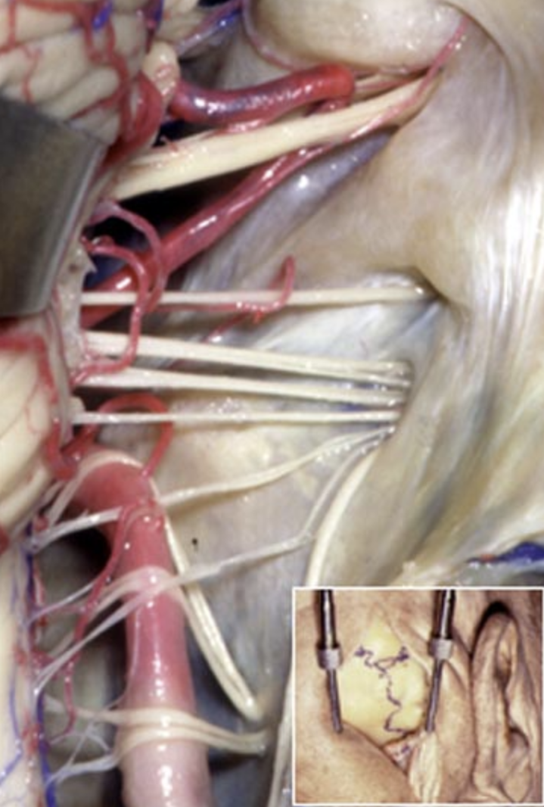
Tumor / Skull Base Neurosurgery
Brain tumor / skull base neurosurgeons treat patients with:
Intrinsic primary brain tumors
Astrocytoma, ependymoma, oligodendroglioma, pineal region tumor, craniopharyngioma, hemangioblastoma,, etc.
Extrinsic brain tumor tumors
Meningioma, schwannoma, pituitary adenoma, etc.
Skull tumors
Chordoma, chondrosarcoma, etc.
Brain metastases
Rhoton collection

Slide 3
Tumor / Skull Base Neurosurgery
Fellowship not required, but some neurosurgeons opt for further specialized training in neurosurgical oncology and/or skull base surgery via fellowship
Skull base fellowship
Surgical Neuro-Oncology fellowship
Postdoctoral lab fellowship

Slide 4
Case Illustration #1
36 yo female with headaches and diplopia; large petroclival meningioma on MRI

Slide 5
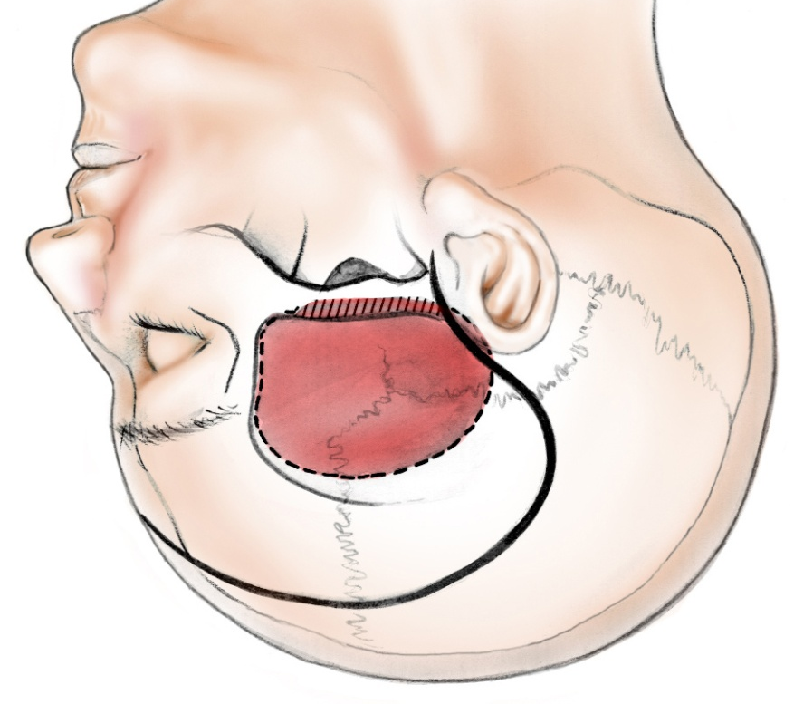
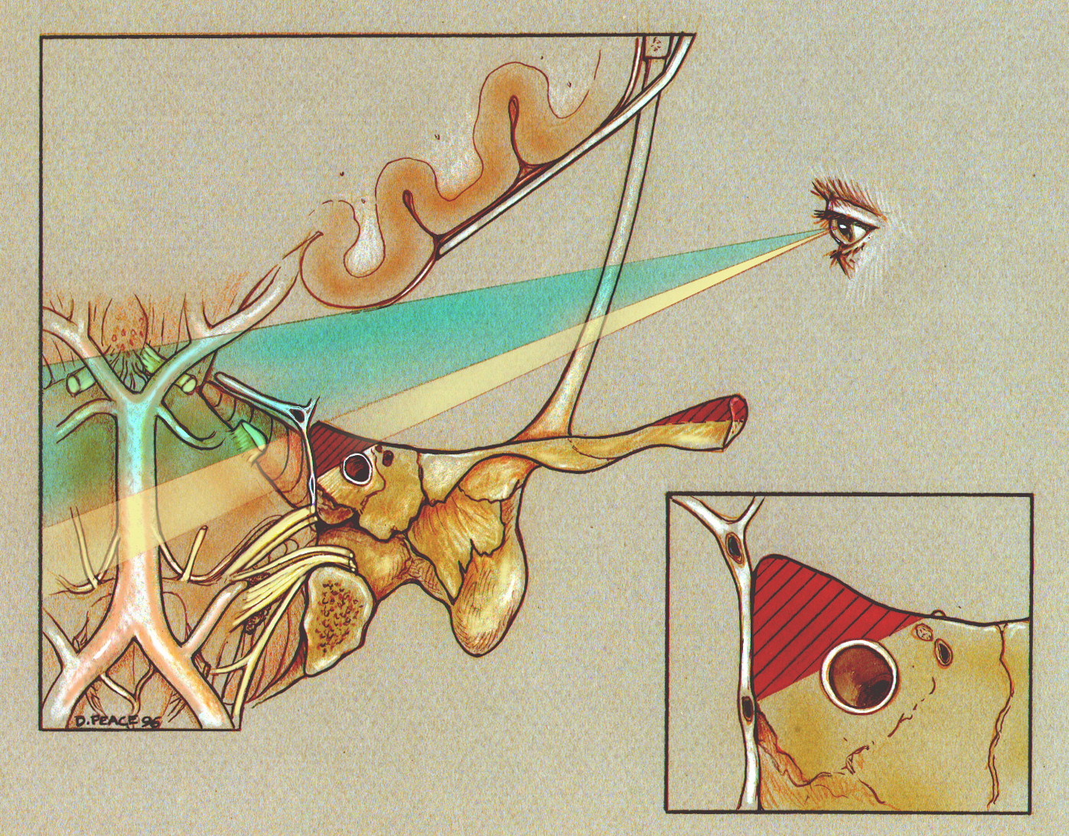
Case Illustration #1
Subtemporal approach with petrosectomy
Post-op MRI
(-) Gad
(+) Gad

Slide 6
Case Illustration #2
72 yo right handed female with large right insular tumor presented with headache

Slide 7
Case Illustration #2
Gross total resection was achieved via right pterional transsylvian approach using continuous transcranial MEP/SSEP monitoring
Pathology = glioblastoma

Slide 8
Case Illustration #3
45 year old right-handed woman presented with transient expressive aphasia and found to have 6 cm left inferior frontal FLAIR hyperintense tumor pushing Broca’s area posteriorly

Slide 9
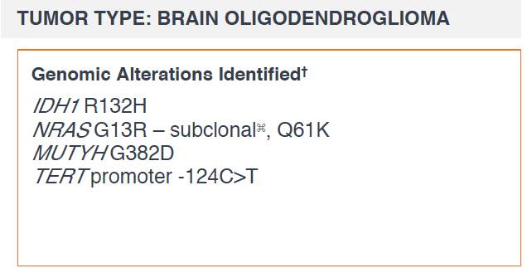
Case Illustration #3
A gross total resection was achieved using left frontal awake craniotomy with speech mapping
Pathology = grade II oligodendroglioma, IDH1 and TERT mutant

Slide 10
Case Illustration #4
51-year-old left-handed female who presents with 1-2 months of increasing paresthesias and weakness in her right hand and forearm, headaches, and an increasingly unstable gait.

Slide 11
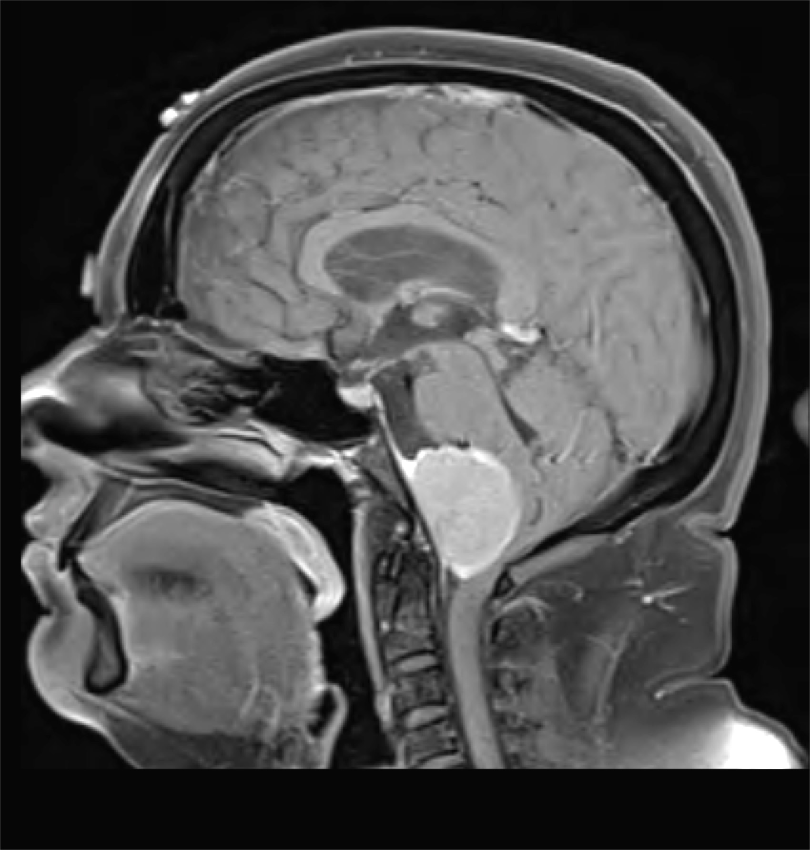
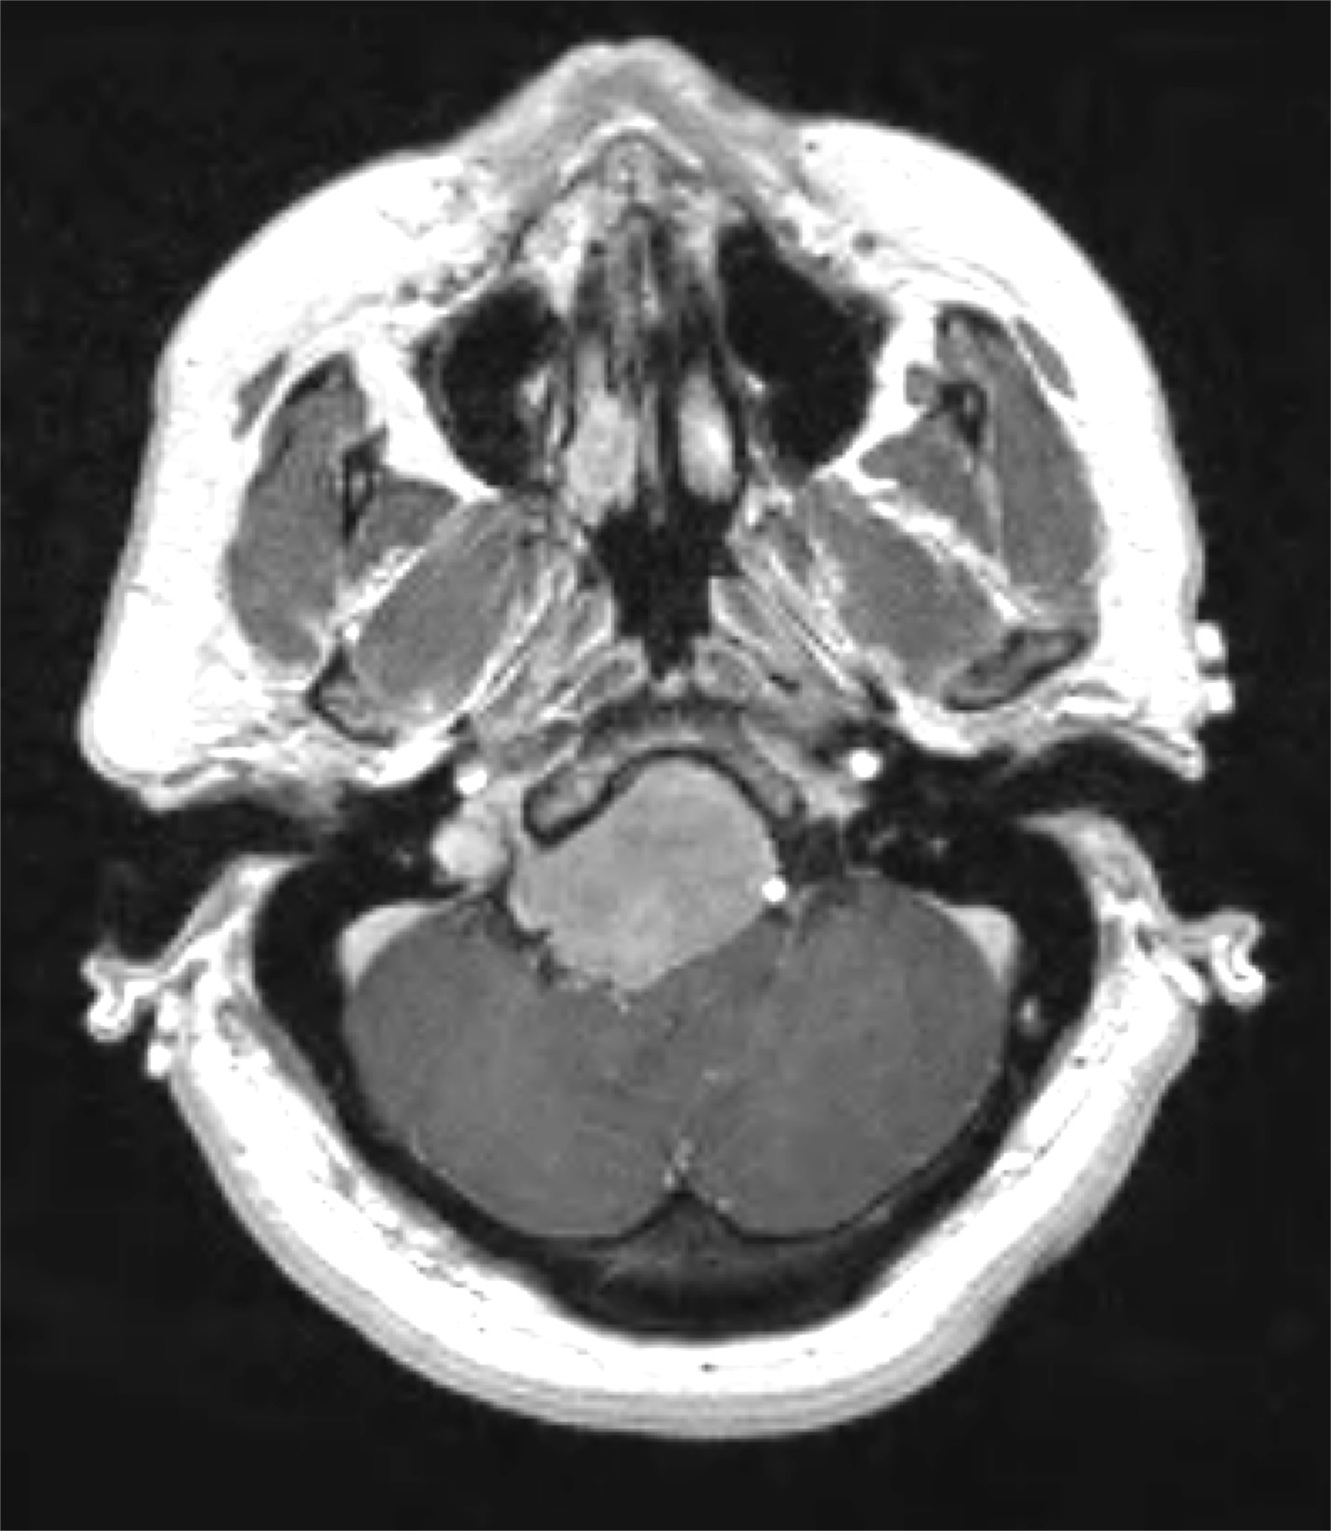
Case Illustration #4
MRI of the brain showed a large, extra-axial mass with an origin at the anterolateral dura of the lower clivus and foramen magnum. Severe lower brainstem and upper cervical spinal cord compression was noted.

Slide 12
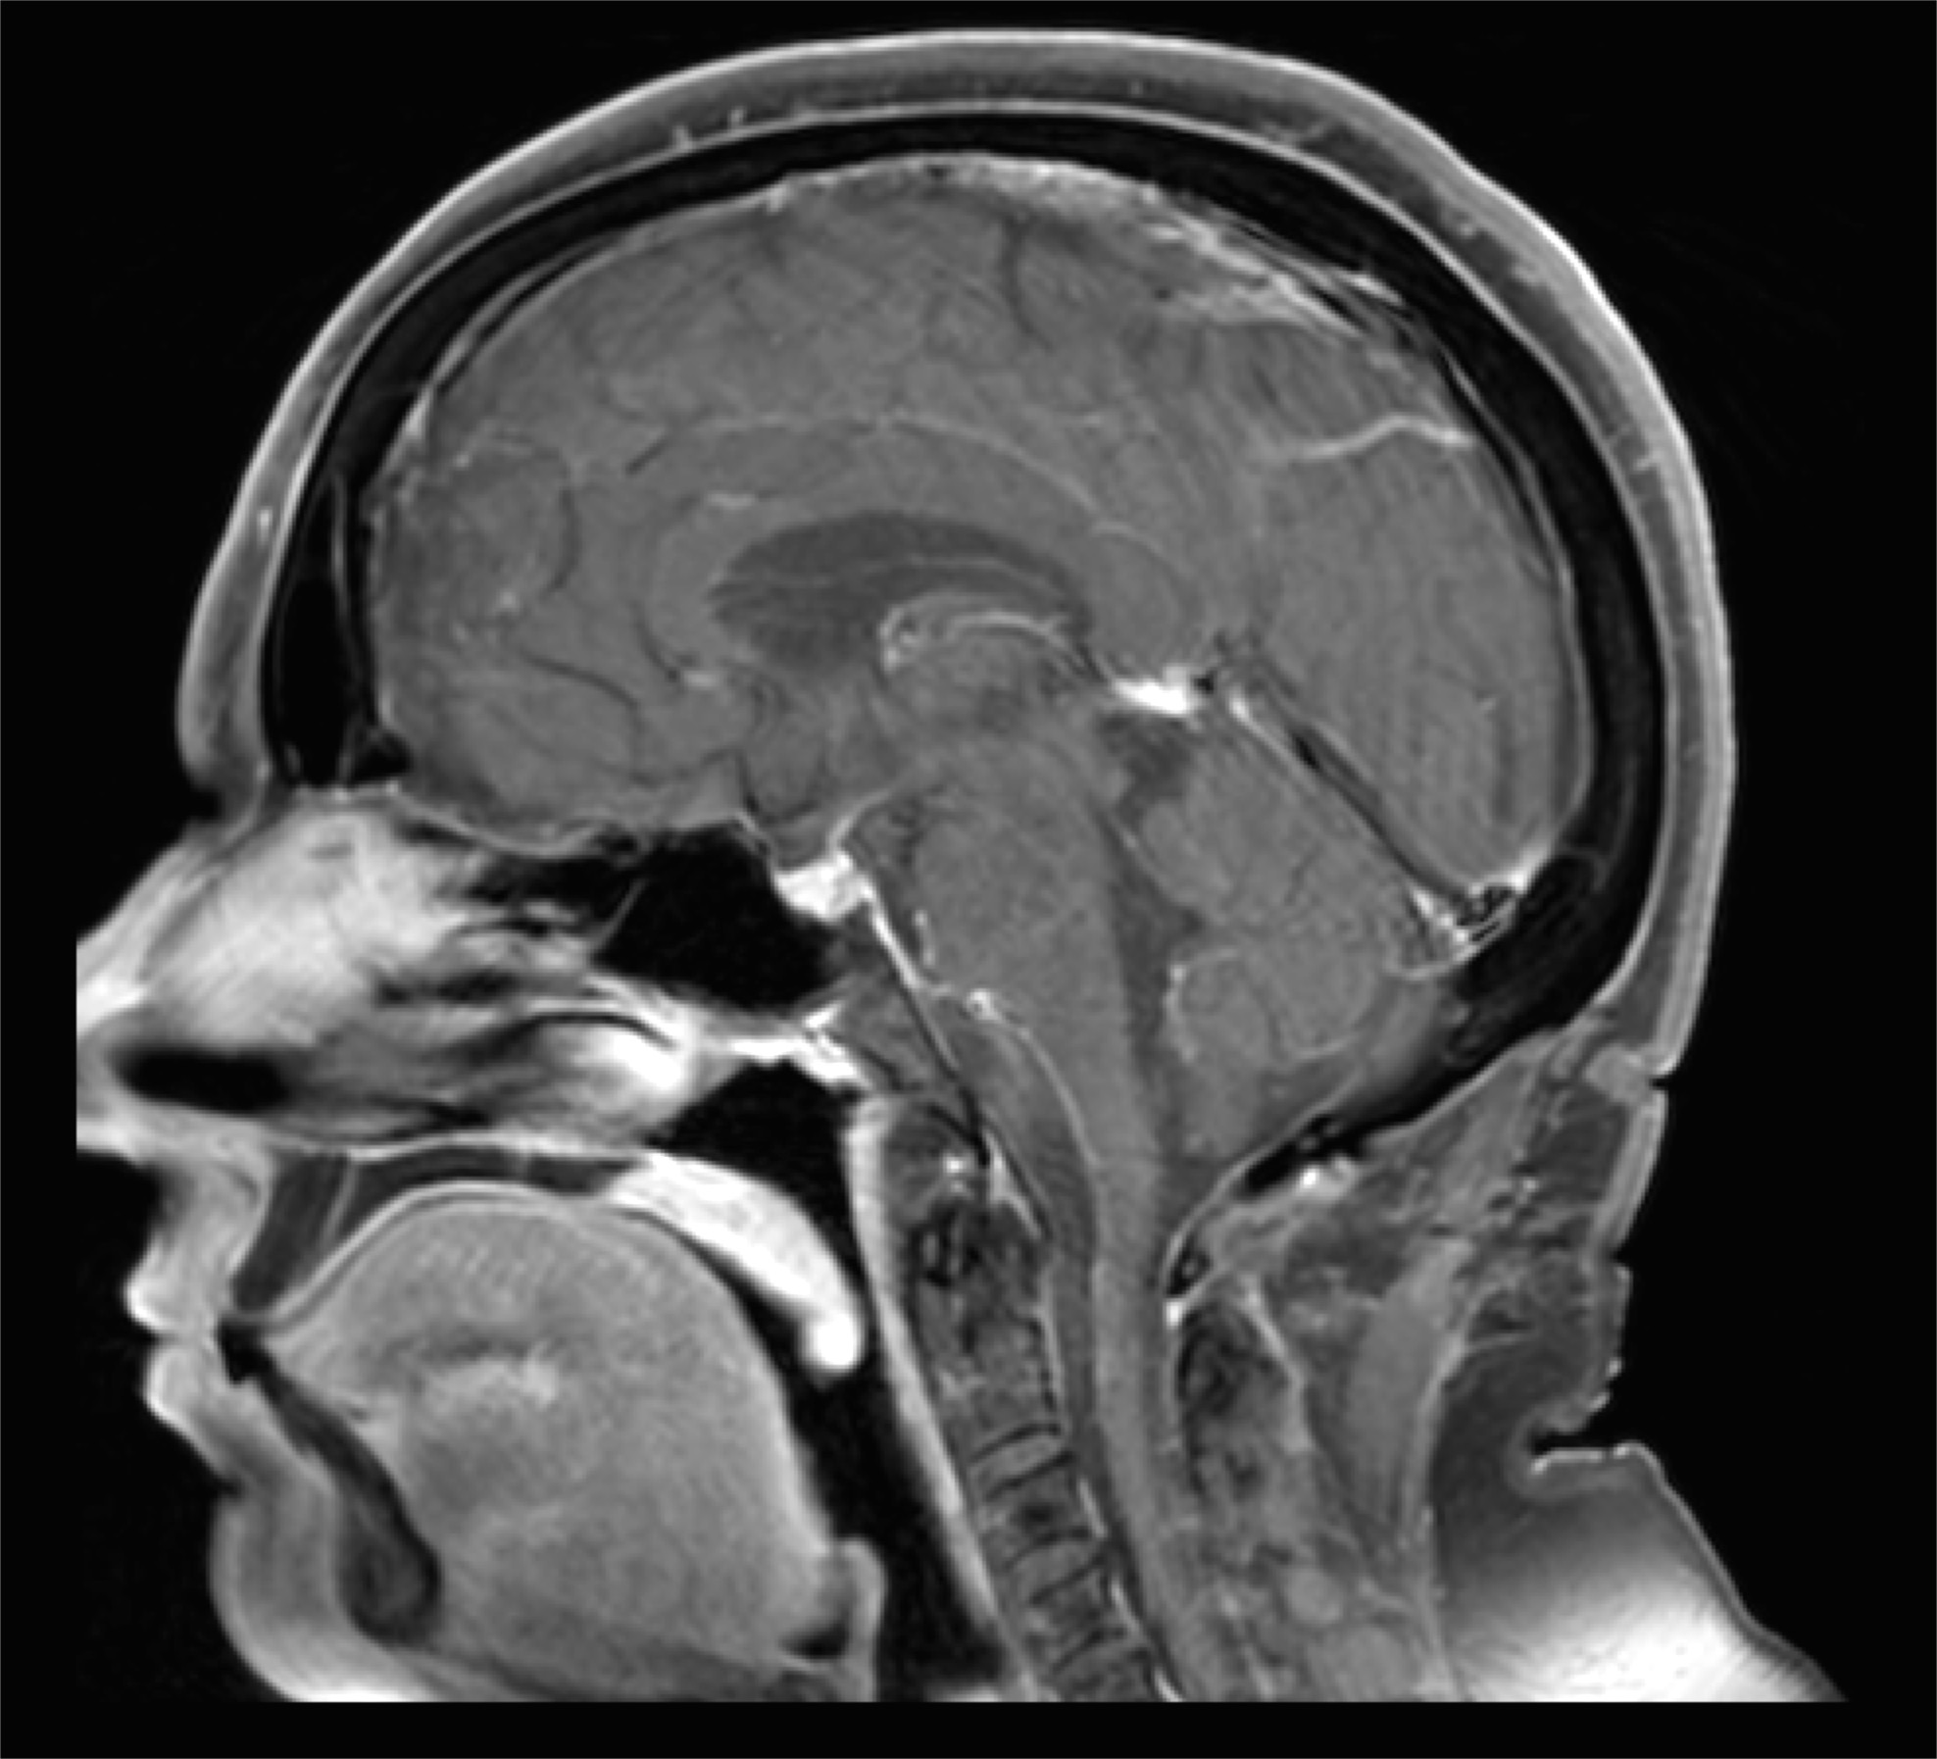
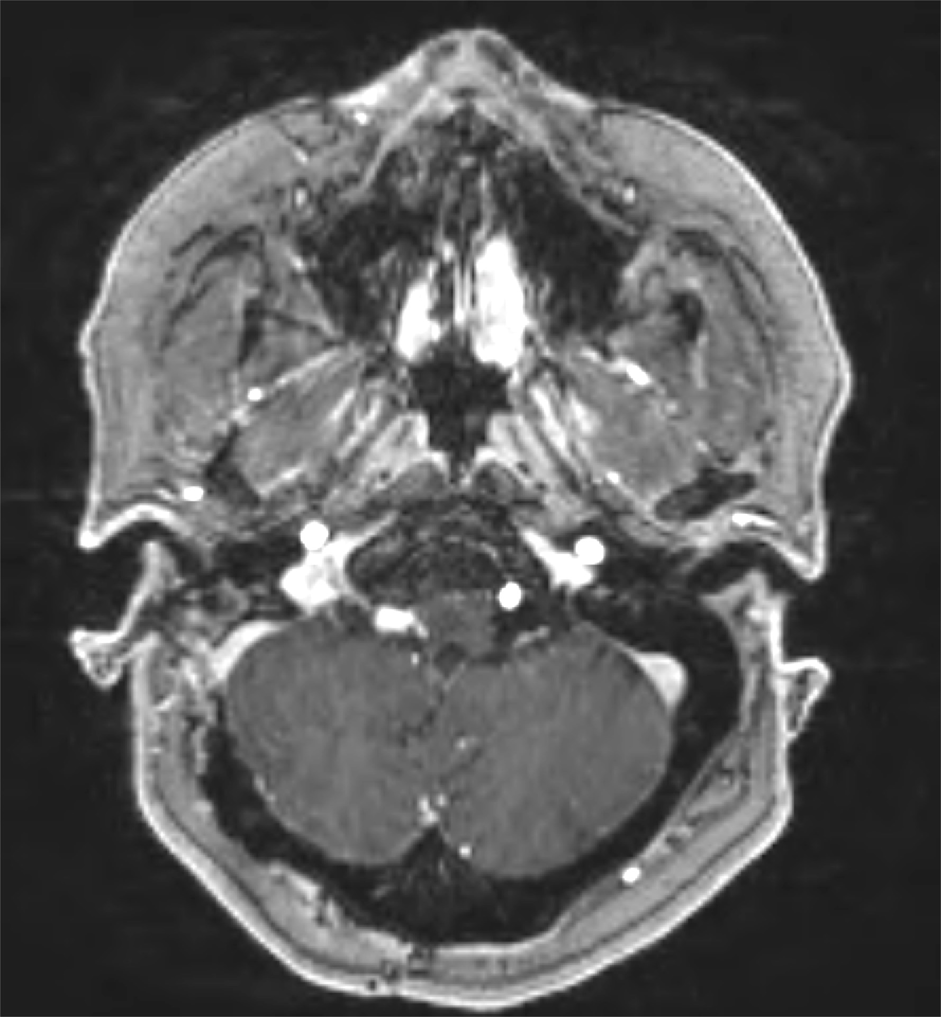
Case Illustration #4
A gross total resection was achieved through a far lateral approach, which includes a retrosigmoid craniotomy, C1 laminectomy, and partial right occipital condyle removal.
Pathology revealed a grade 1 meningioma

Slide 13
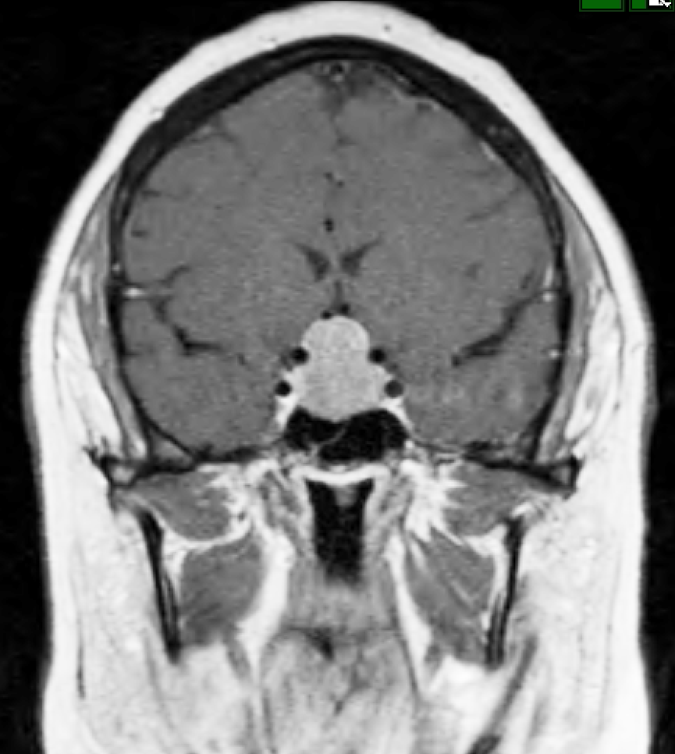
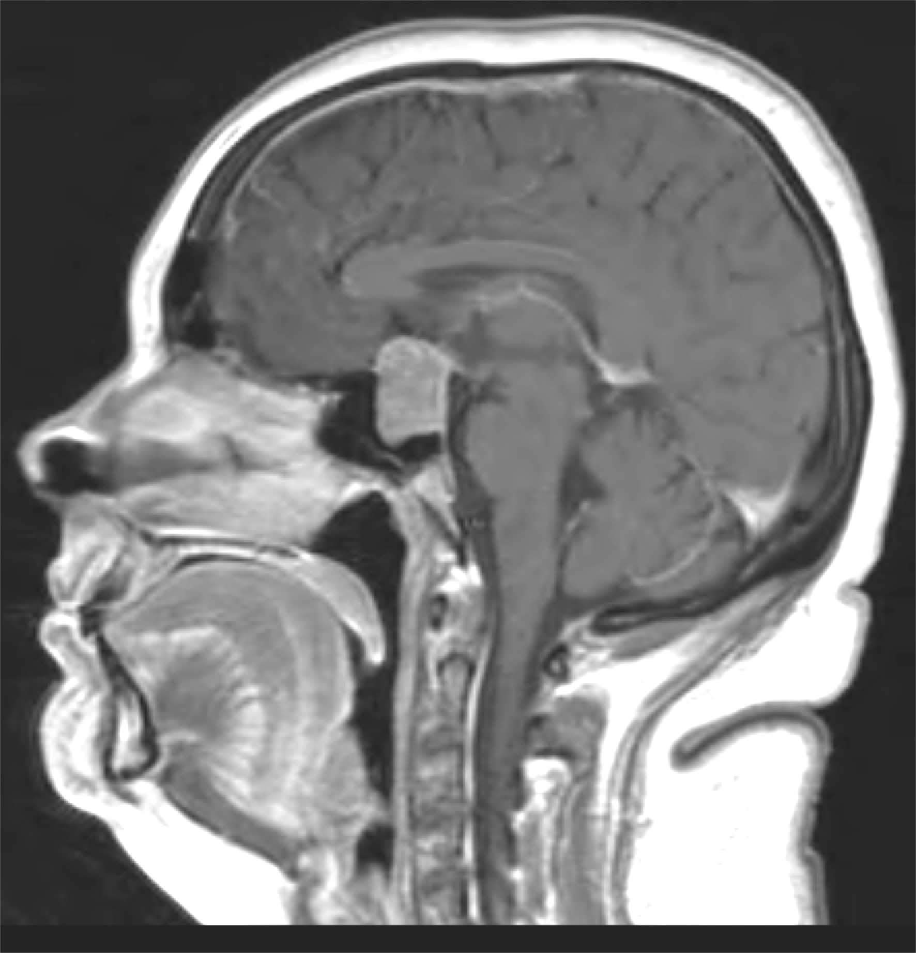
Case Illustration #5
42-year-old right-handed female presents with progressive mild headaches and bitemporal hemianopsia. Pituitary hormone laboratories were within normal limits.

Slide 14
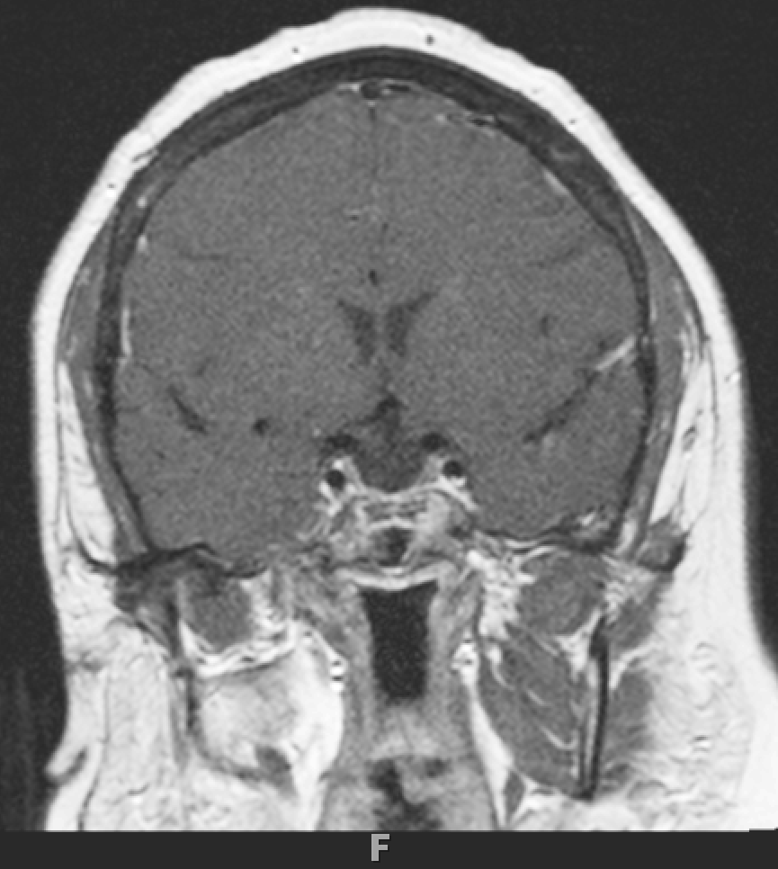
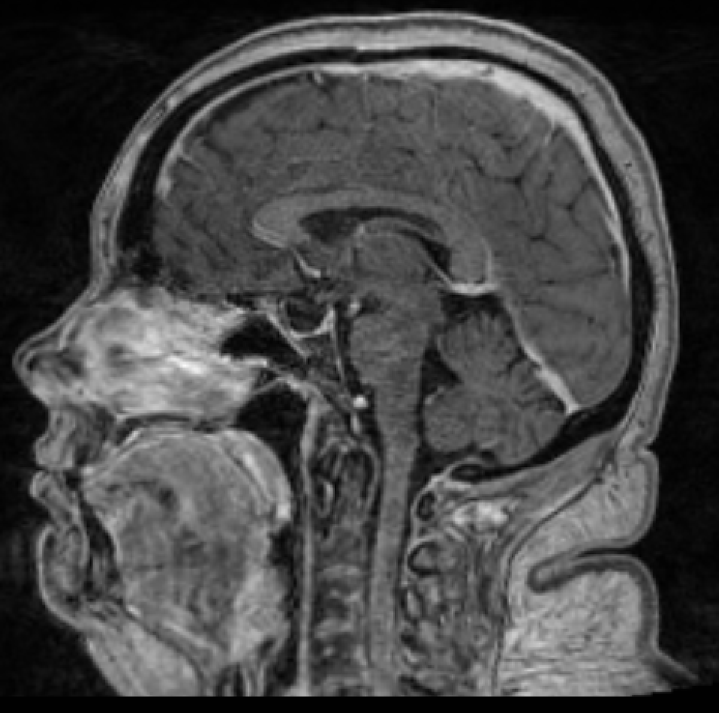
Case Illustration #5
A gross total resection was achieved through an endonasal endoscopic transsphenoidal approach in collaboration with otolaryngology. Her visual field deficits improved completely, and she had no new hormonal deficits.
Pathology revealed a typical pituitary adenoma.

Slide 15
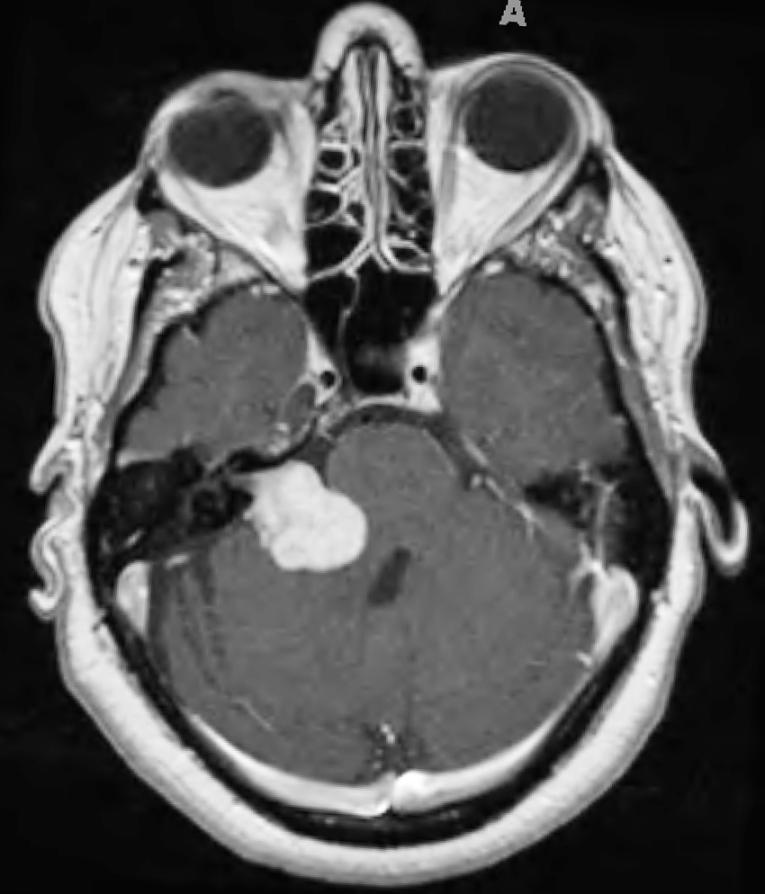
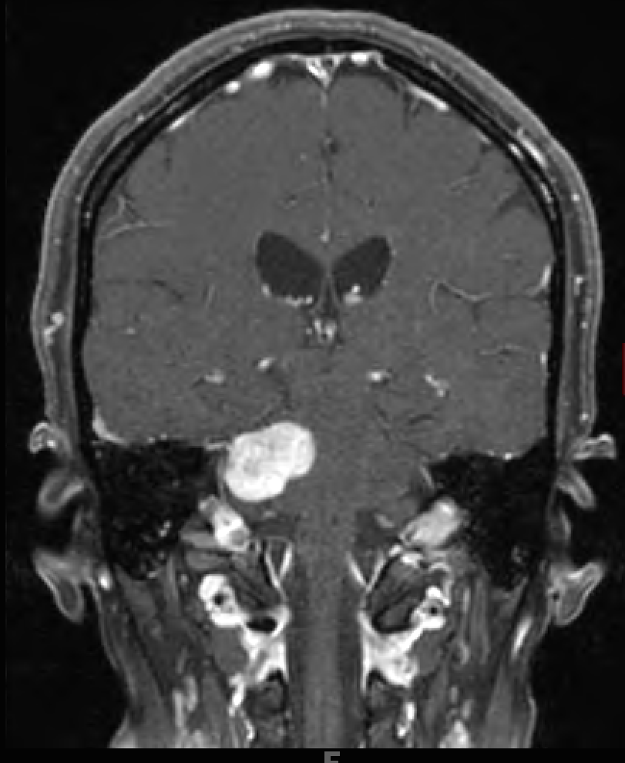
Case Illustration #6
49-year-old right-handed female who had progressive hearing loss and a new headache, which prompted an MRI.

Slide 16
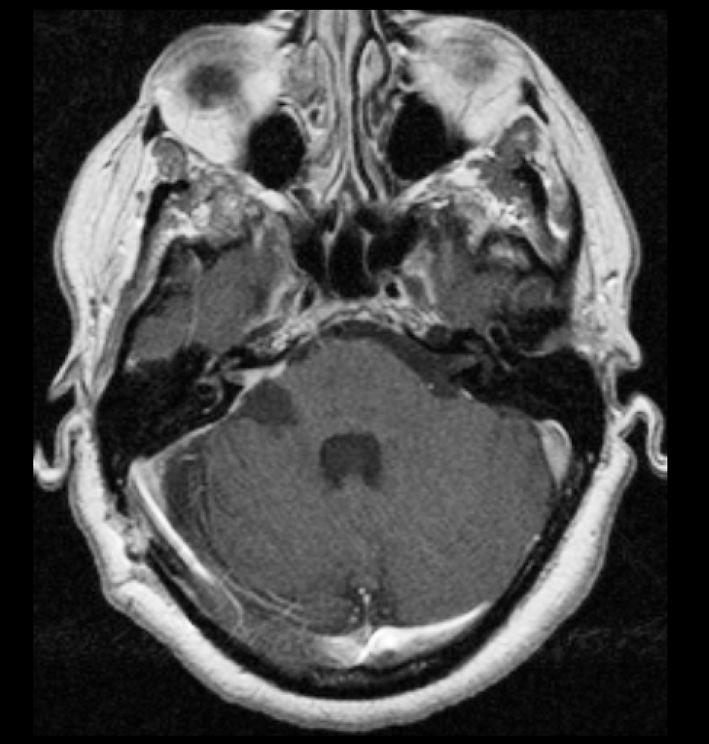
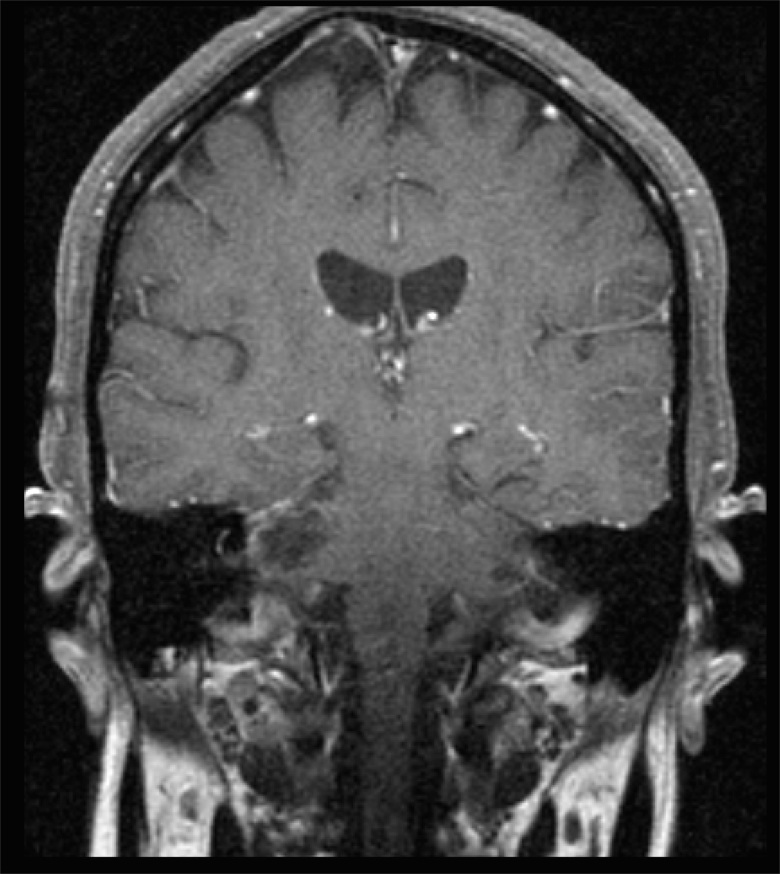
Case Illustration #6
A near gross total resection was achieved through a retrosigmoid approach with internal acoustic canal drilling by otolaryngology. A small amount of tumor adherent to facial nerve was left. The patient had a transient right facial nerve weakness (House Brackmann grade II), which improved to normal within 1 month.
Pathology revealed a vestibular schwannoma.

Slide 17
Subspecialization within Neuro-oncology and Skull Base Neurosurgery
Intra-axial tumors: gliomas, metastasis
Meningiomas and skull base meningiomas in particular
Skull Base pathologies from head and neck cancers.
Neuro-endocrinology/neuro-endoscopy
Vestibular schwannomas

Slide 18
Conclusions
Neuro-oncology is a fascinating field where more understanding of tumor development and treatment are required
Skull base neurosurgery is a challenging and varied field that addresses tumors along the base of the skull

