Slide 1
ICP Management
The Society of Neurological Surgeons
Bootcamp

Slide 2
Monro-Kellie Doctrine (Edinburgh, 1783)
CSF ↔ Blood ↔ Brain Tissue
(3 Compartments)
Increased ICP may be conceived as the result of an attempt to force excess volume into a rigid container

Slide 3
CO₂ Reactivity
With hypercarbia
Hypoventilation, CO₂ ↑ ∆ → Vasodilatation →
CBF ↑
With hypocarbia
Hyperventilation, CO₂ ↓ → Vasoconstriction →
CBF ↓

Slide 4
Hyperventilation
Hyperventilation → intravascular CO₂ ↓ → extravascular CO₂ ↓ (CO₂ readily crosses BBB) → pH ↑→ vasoconstriction (H⁺ ion is vasodilator)
Hyperventilation remains an excellent means for rapidly reducing high ICP
Preventive hyperventilation retards recovery from severe head injury
Any hyperventilation is ideally accompanied by some monitoring of cerebral oxygenation (PbtO₂, SjvO₂/AVDO₂, CBF, infrared spectroscopy)
In the absence of such monitoring, hyperventilation is used as a later step in ICP control and always with sufficient arterial blood pressure (MAP >90 mmHg, CPP >60 mmHg)

Slide 5
Mannitol is used
To decrease high intracranial pressure
To decrease brain bulk during operation
To improve CBF
Decreases viscosity → Increase in CBF →
Compensatory vasoconstriction (‘Autoregulation”) →
CBF back to baseline, CBV decreases, ICP decreases

Slide 6
ICP
Topic | Level 1 | Level 2 | Level 3
Indications for ICP monitoring | There are insufficient data | Intracranial pressure (ICP) should be monitored in all Salvageable GCS score of 3–8 after resuscitation and an abnormal CT | ICP monitoring is indicated in patients with severe TBI with a normal CT scan if > 40 years, blood pressure BP <90 mm Hg.
Intracranial Pressure Thresholds | There are insufficient data | Treatment should be initiated with ICP> 20 mm Hg. | A combination of ICP values, and clinical and brain CT findings, should be used to determine the need for treatment.

Slide 7
Intracranial Pressure Monitoring Technology
Ventricular catheter connected to an external strain gauge is the most accurate, low-cost, and reliable method of monitoring intracranial pressure (ICP). It also can be recalibrated in situ.
ICP transduction via fiberoptic or micro strain gauge devices placed in ventricular catheters provide similar benefits, but at a higher cost.
Parenchymal ICP monitors cannot be recalibrated during monitoring.
Subarachnoid, subdural, and epidural monitors (fluid coupled or pneumatic) are less accurate.

Slide 8
CPP=MAP-ICP

Slide 9
Step-wise ICP Management
Decompressive
Craniectomy
Wide, open dura
Pentobarbital bolus then
continuous IV or Propofol
continuous IV
Treatment is escalated to the next level based upon a goal of ICP < 20 mm Hg and CPP 50 – 70 mm Hg
Barbiturates
Hypothermia
33 – 35° C with surface/IV cooling; Rewarm slowly
PaCO₂ < 35; Titrate to avoid
SjvO₂ < 60 or PbtO₂ <15
Hyperventilation*
Hyperosmolar
Therapy
Mannitol or Hypertonic Saline
boluses as needed until Serum Osm > 320
Chemical
Paralysis
Vecuronium continuous IV
Morphine or Fentanyl continuous IV
+ Midazolam or Propofol continuous IV
Sedation
CSF
Drainage
Drain @ external auditory canal as needed
* At baseline, PaCO₂ is kept 40 mm Hg

Slide 10
1.

Slide 11
2.
Check for 30-degree head elevation
Loosen Cervical collar if in place
Assure ET tube tape is not constricting tube
Open EVD for ICP > 20 for 10 minutes and then close and transduce ICP Repeat once If ICP > 20 keep open at 15 above midbrain, and proceed with ICP module

Slide 12
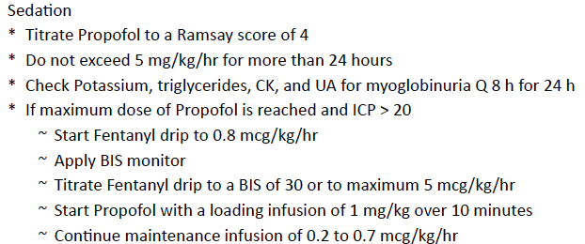
3.

Slide 13
4.
Keep Body temperature < 37.5

Slide 14
6.

Slide 15
7.

Slide 16
8.

Slide 17
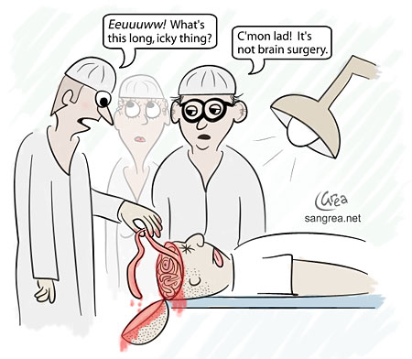
9.
Decompressive Hemicraniectomy
Bilateral Frontal Craniectomy

Slide 18
Case Example
27 y/o patient after ATV accident
Needs to be intubated at the scene
Does not open eyes
No movement in arms but cramping- extending legs

Slide 19
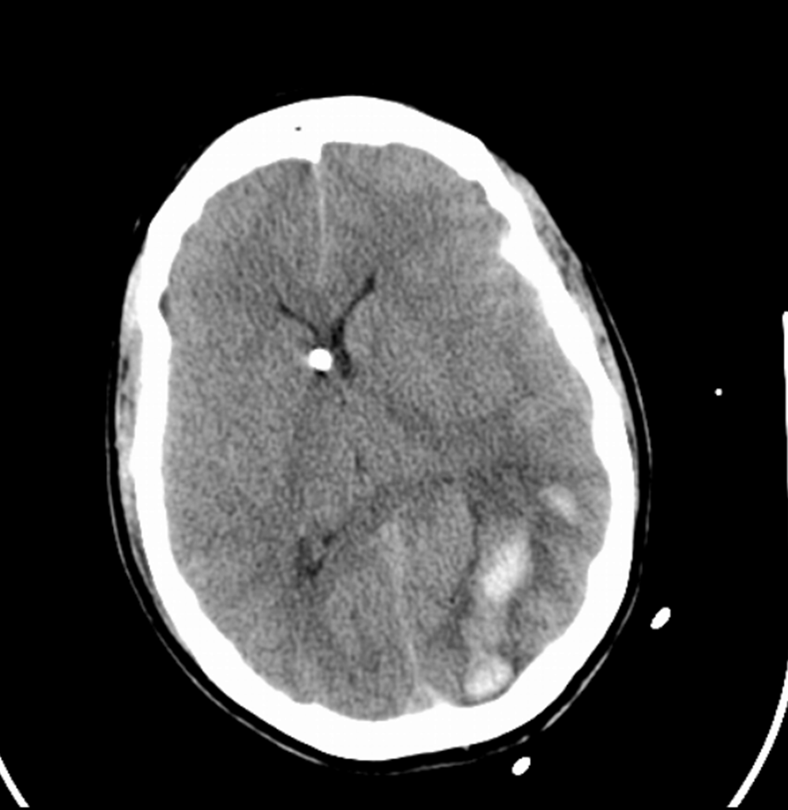
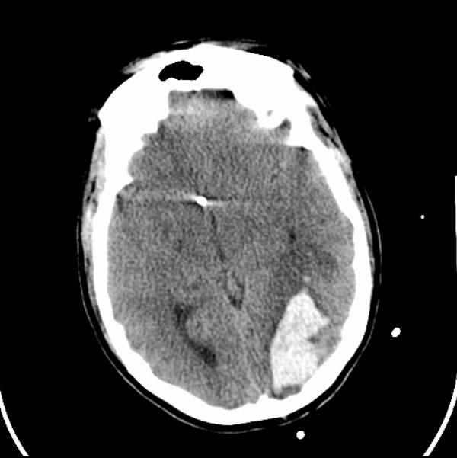
Injury

Slide 20
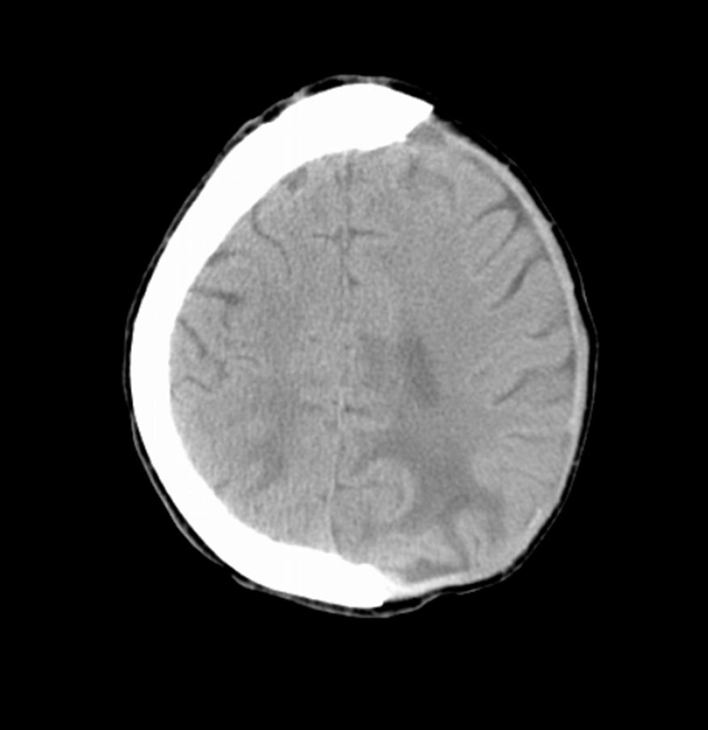
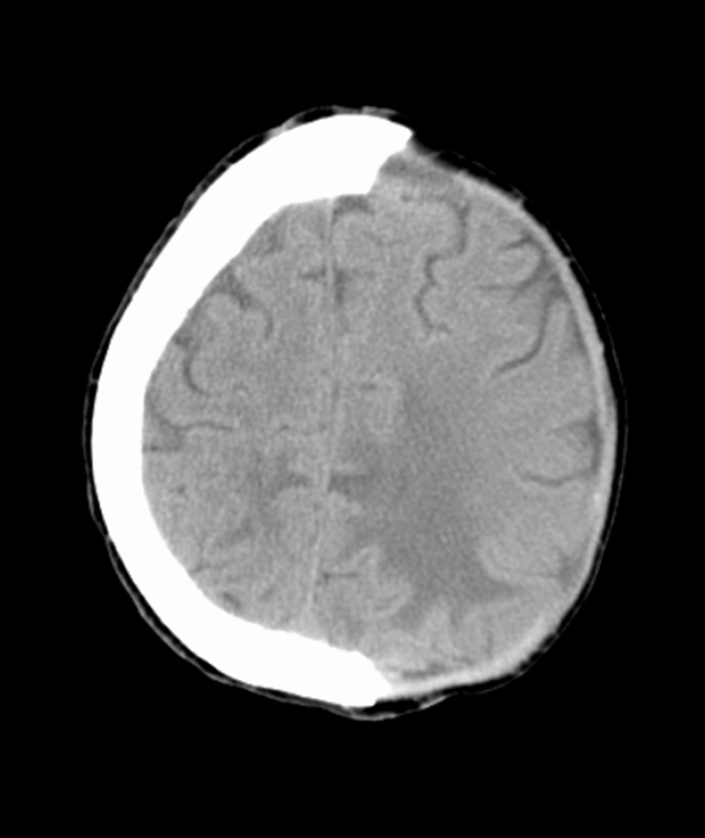
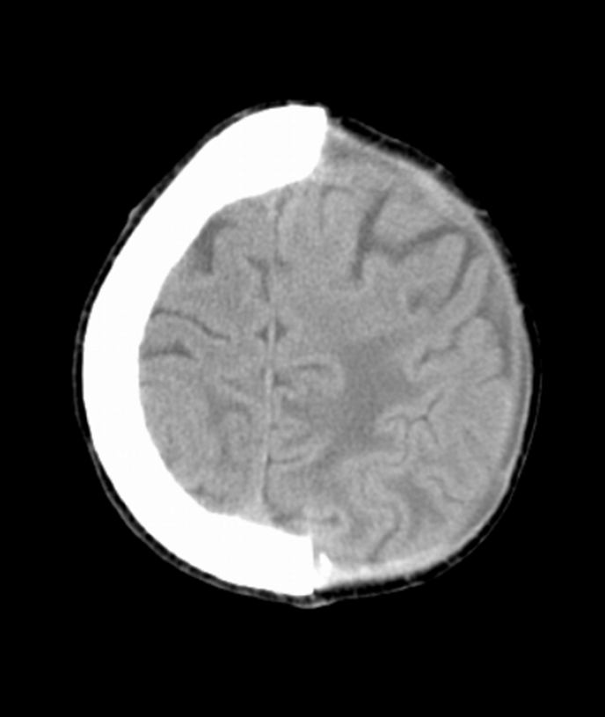
Decompression

Slide 21
Barbiturates/Coma

Slide 22
Seizure Prophylaxis
Topic | Level 1 | Level 2 | Level 3
Antiseizure Prophylaxis | There are Insufficient data | Anticonvulsants are indicated to decrease the incidence of early PTS (within 7 days of injury). | n/a

