Slide 1
One Neurosurgery Summit: Washington Committee
Katie O. Orrico, Esq., Director
AANS/CNS Washington Office

Slide 2
AANS/CNS Washington committee mission statement
Quality neurosurgical care is essential to the health and well-being of society. As the voice of neurosurgery before legislative, regulatory and other health care stakeholders, the AANS/CNS Washington Committee exists to advocate for our specialty and patients.

Slide 3
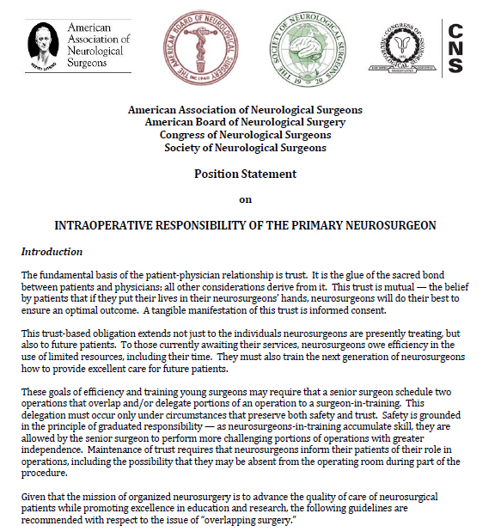
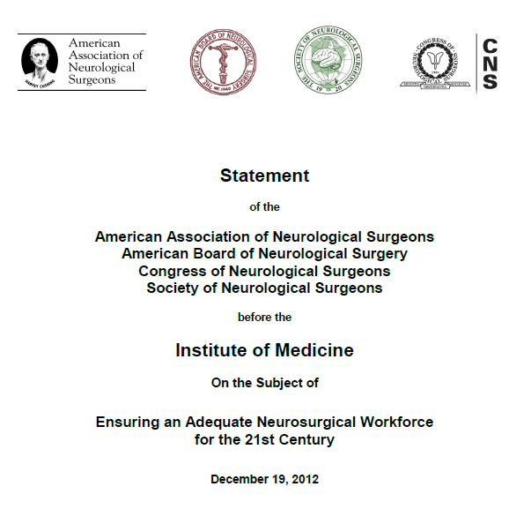
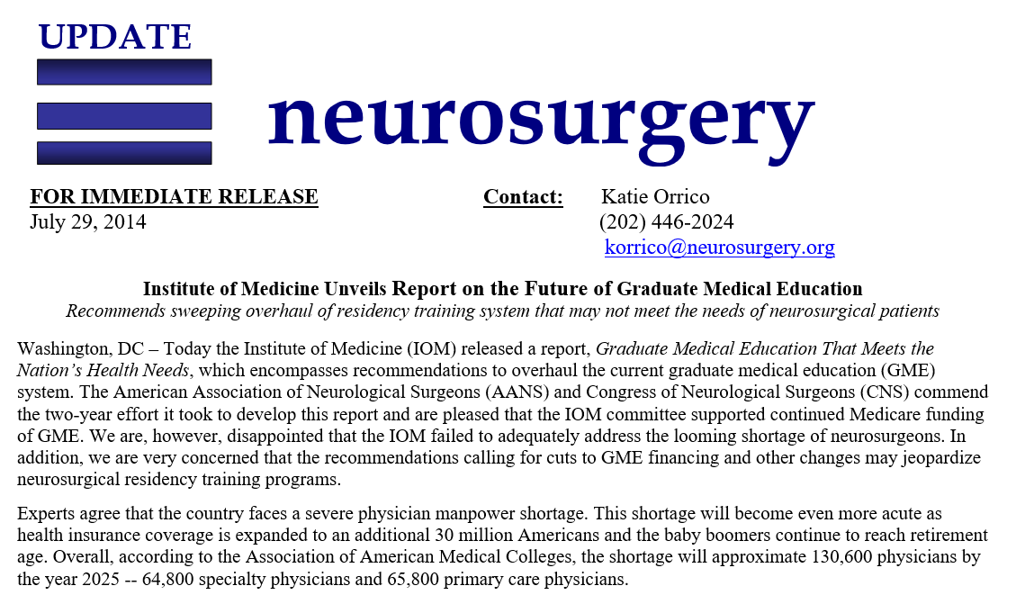
Serving the summit through:
Advocacy
Position Statements
Coalition Building / Outreach
Communications & Public Relations

Slide 4
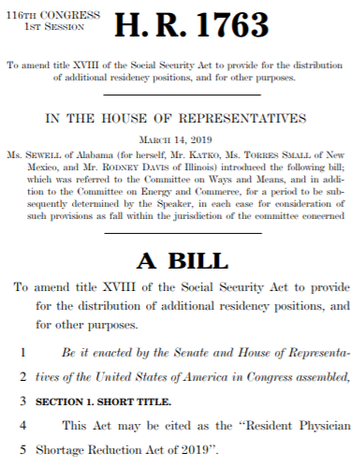
topics / Examples:
Institute of Medicine Report Graduate Medical Education That Meets the Nation's Health Needs
Physician Workforce Shortages
GME legislation & regulations
Resident Duty Hours
Overlapping Surgery
RRC Nominations

