Slide 1
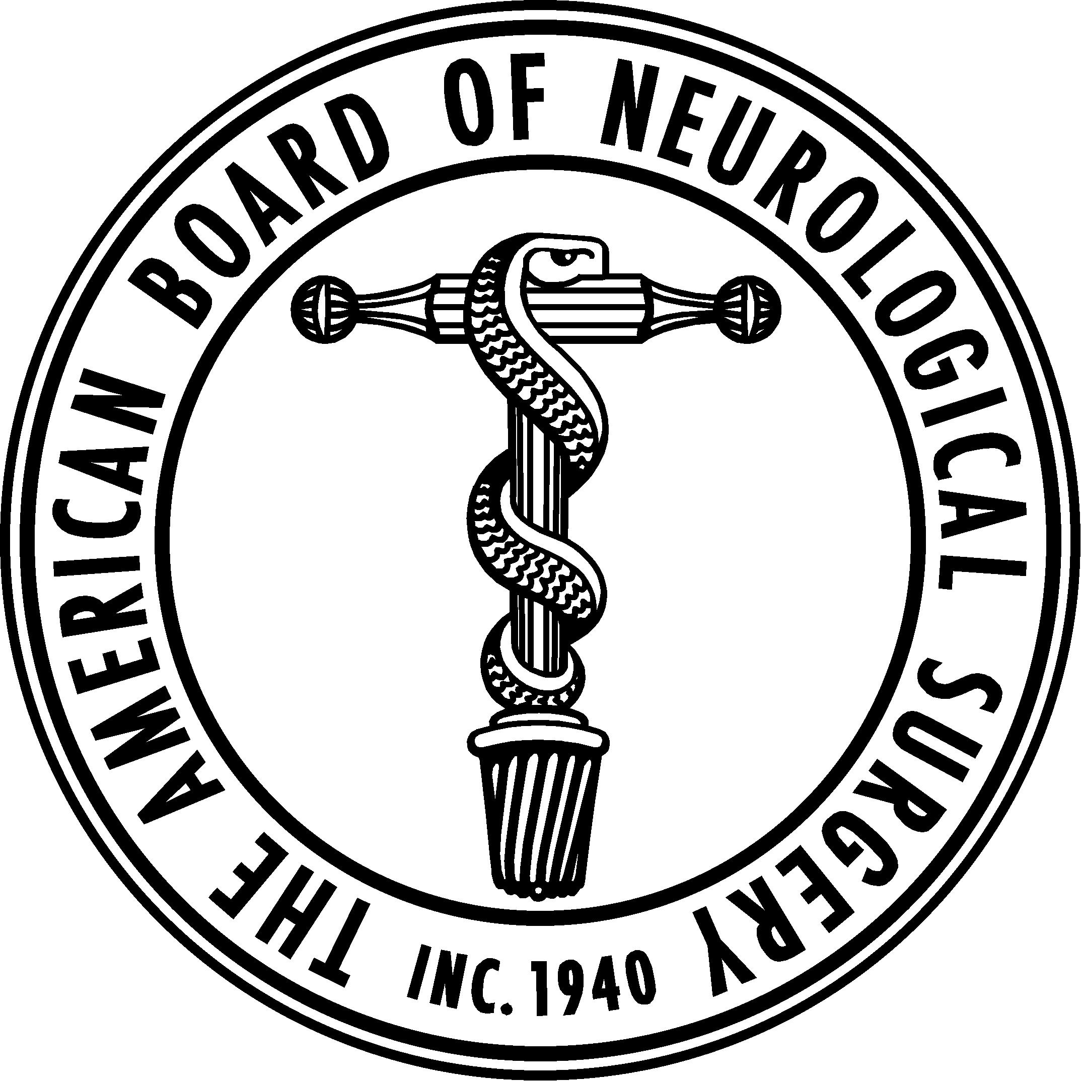
ABNS One Neurosurgery Summit
Carl Heilman MD
Secretary ABNS

Slide 2
ABNS Topics Requiring Input From Summit Leaders
Individual Resident Case Log Requirements
Development of the PGY2 Neuroanatomy Exam
Enfolded Fellowships and their relationship to Chief Residency Year
Changes to the ABNS Oral Exam
Changes to Continuous Certification
6 + 1 and the length of residency
Recognition of Focused Practice (RFP)
Pediatric Neurosurgery
Neurocritical Care
CNS Endovascular

