Slide 1
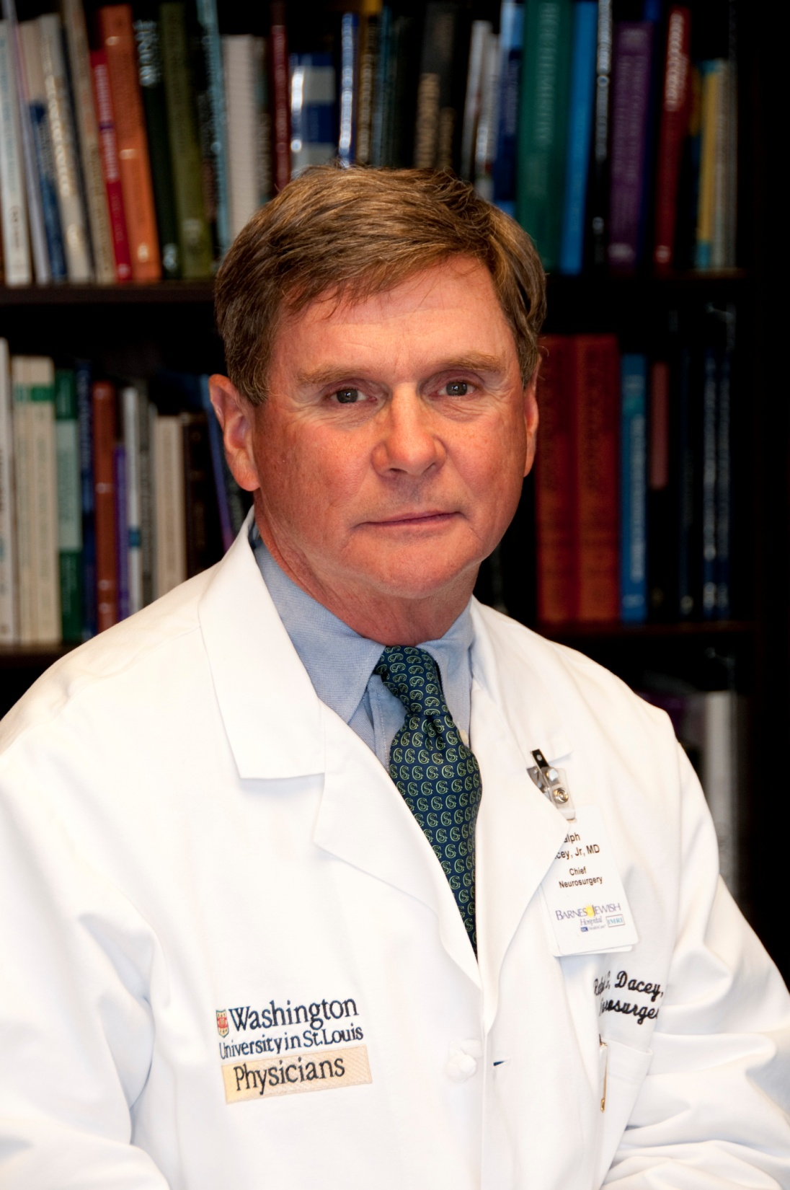

Slide 2
Appointments and Honors
Fellow of the Academy of Science of St. Louis
Institute of Medicine
NIH
ACGME
American College of Surgeons

Slide 3
Royal College of Surgeons of Ireland

Slide 4
Public Perception of a Neurosurgeon

Slide 5
Level 5 leader

Slide 6
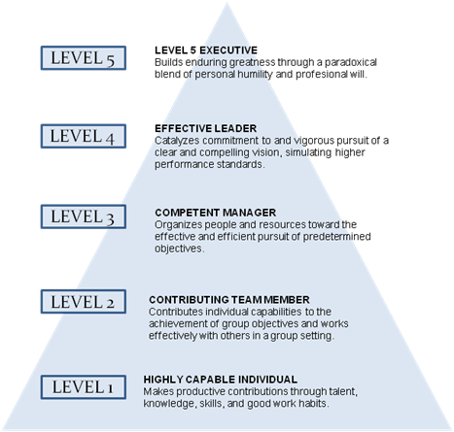
Humility and Fierce Resolve

Slide 7
Extraordinary Mentors

Slide 8
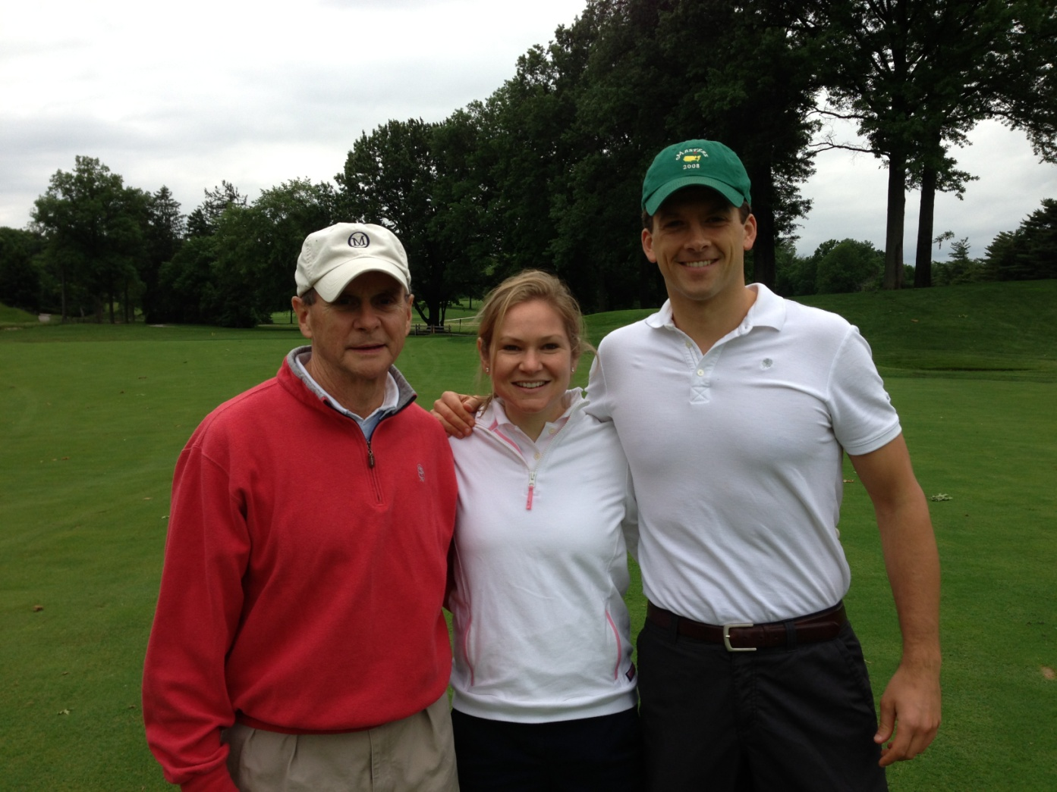
A Supportive Family

Slide 9
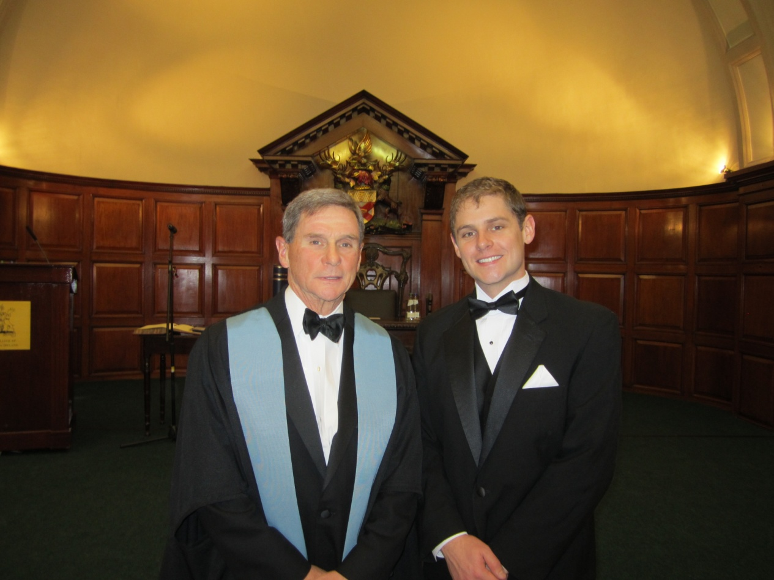
A Supportive Family

Slide 10
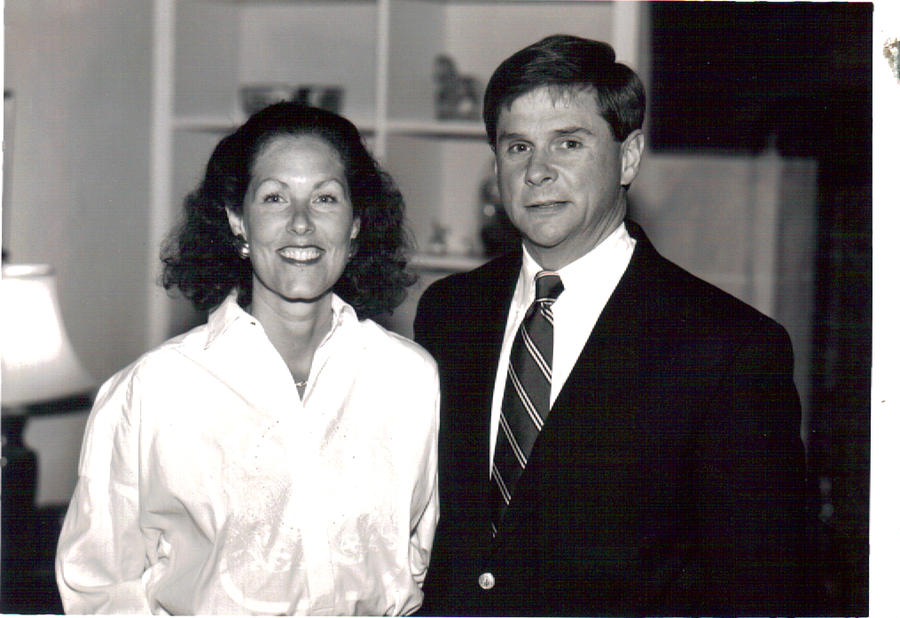
A Tolerant and Loving Spouse

Slide 11
Ralph G. Dacey Jr., M.D.
87th President SNS

