Slide 1
Introduction to Neurosurgical Subspecialties:
Spine Neurosurgery
Brian L. Hoh, MD¹ and Gregory J. Zipfel, MD²
¹University of Florida, ²Washington University

Slide 2
Spine Neurosurgery
Spine neurosurgeons treat patients with:
  Degenerative spine disorders
    Herniated discs
    Spinal stenosis
    Spondylosis
    Spondylolisthesis
  Spine fractures
  Tumors of the spine
  Deformity and scoliosis

Slide 3
Spine Neurosurgery
Both neurosurgeons and orthopedic surgeons can specialize in spine surgery
Fellowship not required for neurosurgeons, but some neurosurgeons opt for specialized training via complex spine fellowship

Slide 4
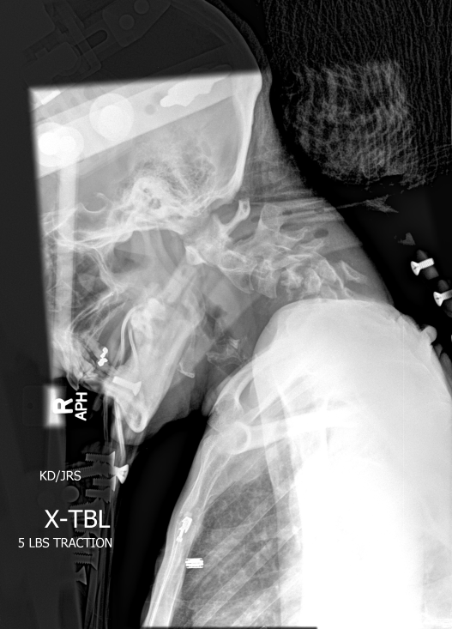
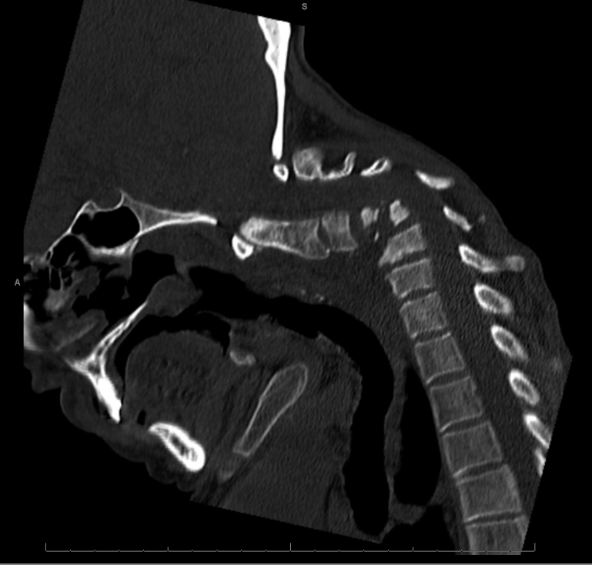
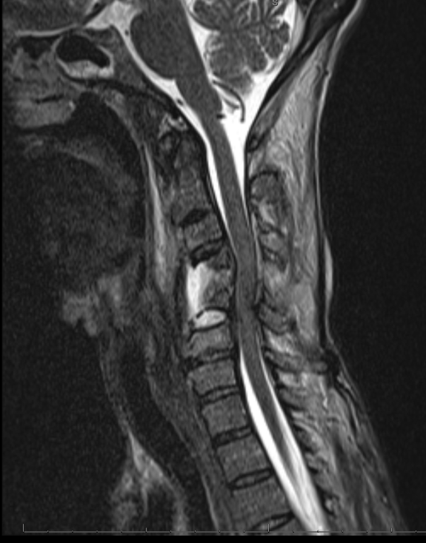
Spine Neurosurgery
Case Illustration #1
50 yo woman with progressive chin-on-chest deformity and presenting with cervical myelopathy

Slide 5
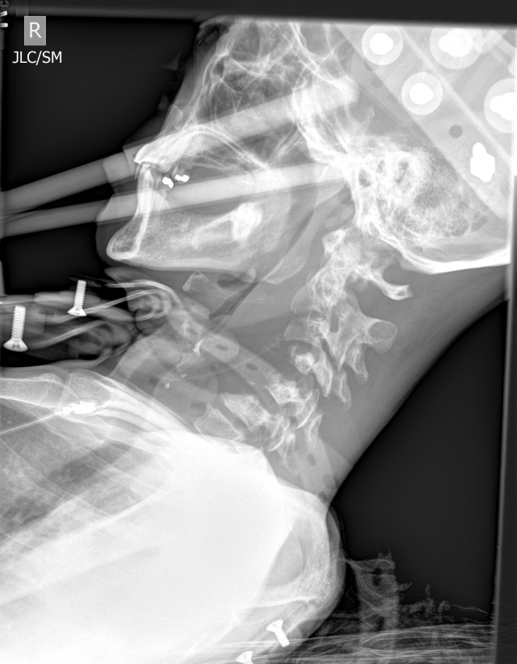
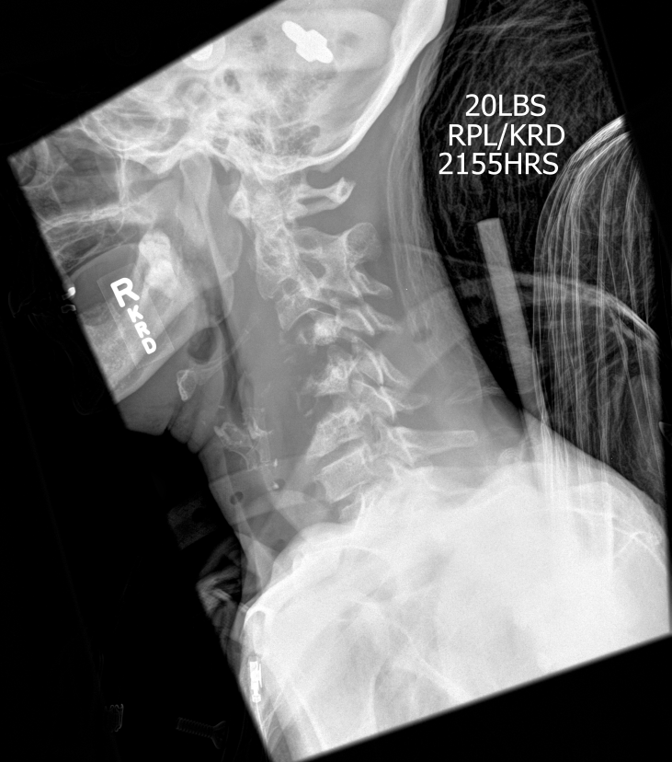
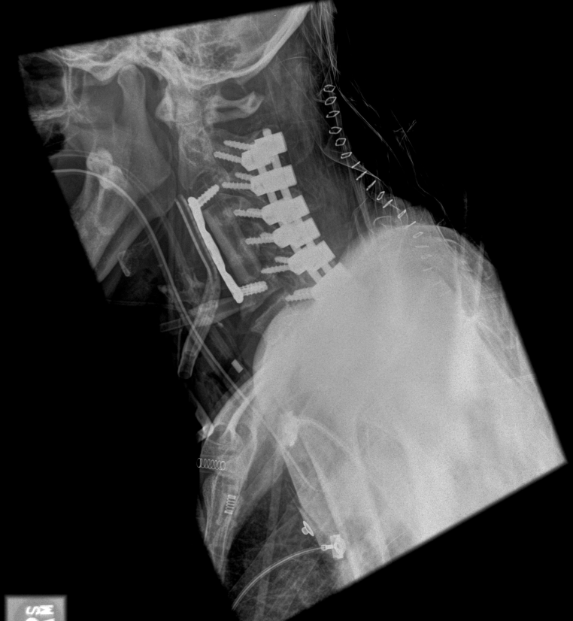
Spine Neurosurgery
Case Illustration #1
Pre-traction
Post-traction
Cervical 360 Reconstruction

Slide 6
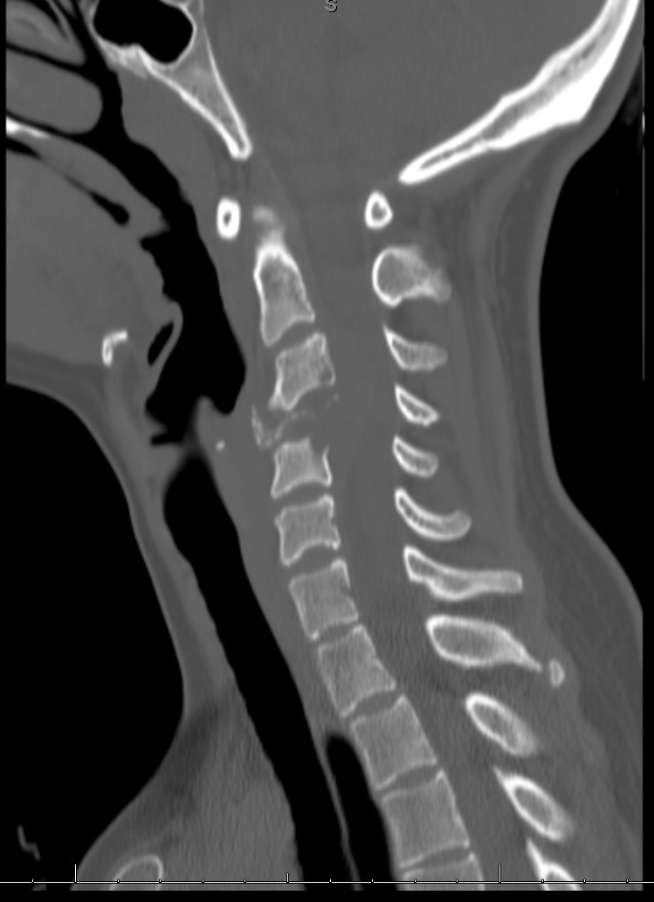
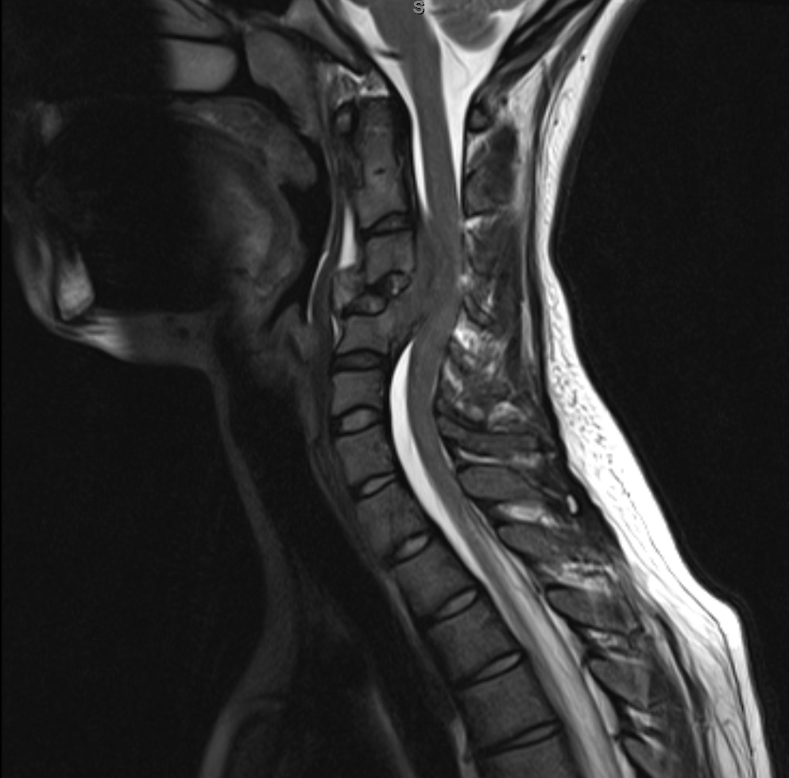
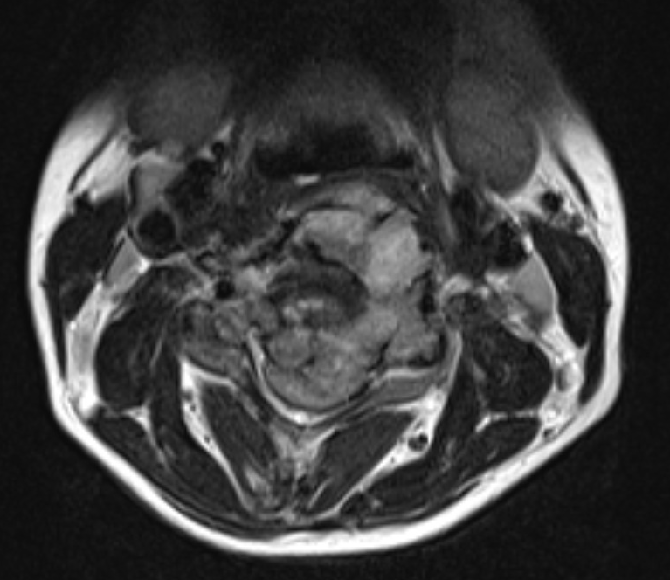
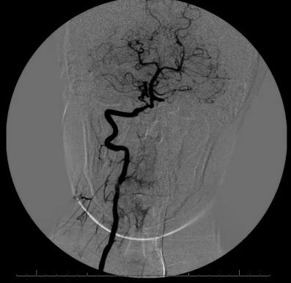
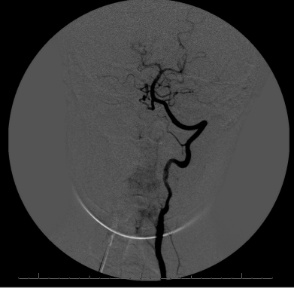
Spine Neurosurgery
Case Illustration #2
21 yo female with cervical chordoma with progressive pathologic fracture and myelopathy. Tumor encircling bilateral vertebral arteries. Passed preoperative balloon test occlusion of vertebral arteries.

Slide 7
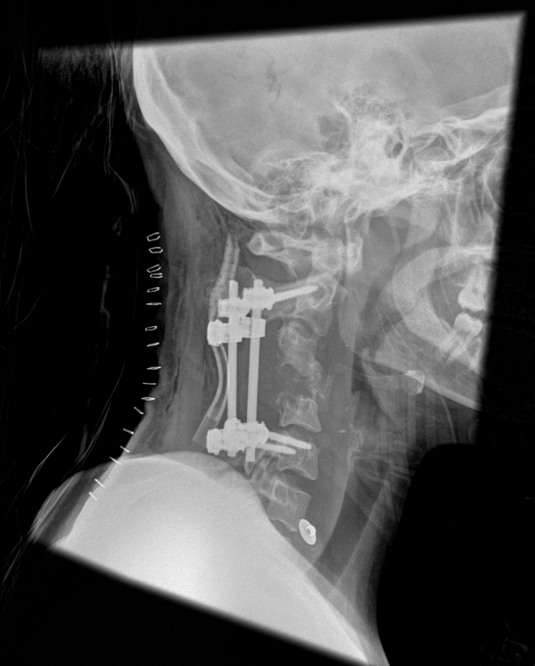
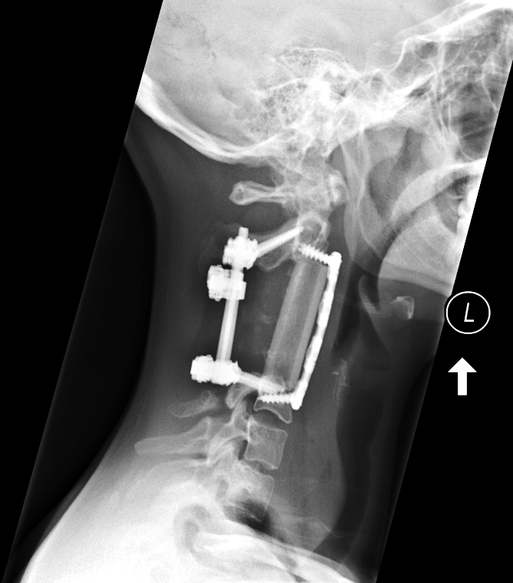
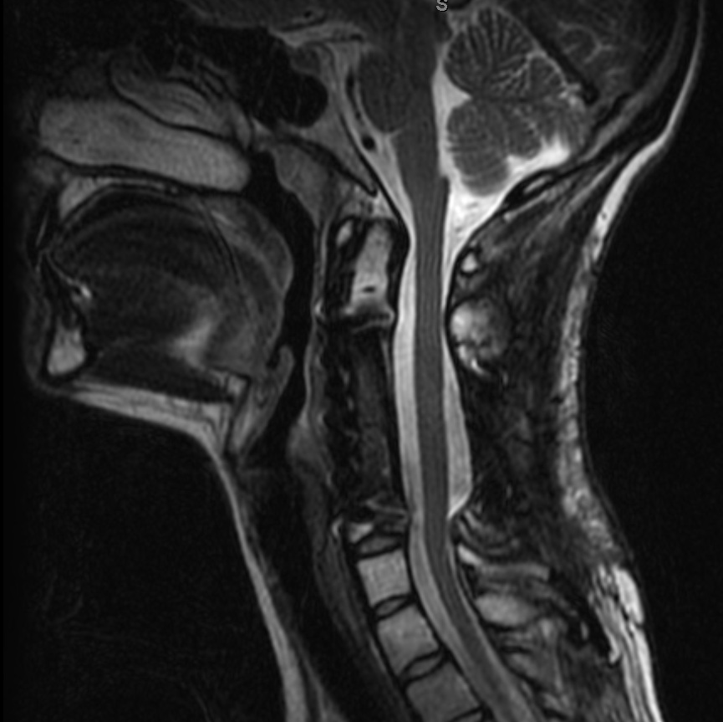
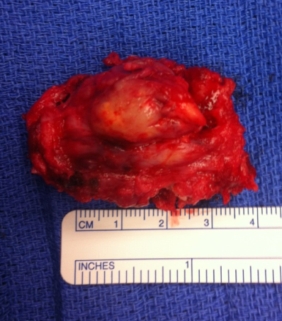
Spine Neurosurgery
Case Illustration #2
Staged posterior - anterior tumor resection and cervical 360 reconstruction.
Stage 1: posterior tumor removal and stabilization
Stage 2: multilevel anterior corpectomy and reconstruction

Slide 8
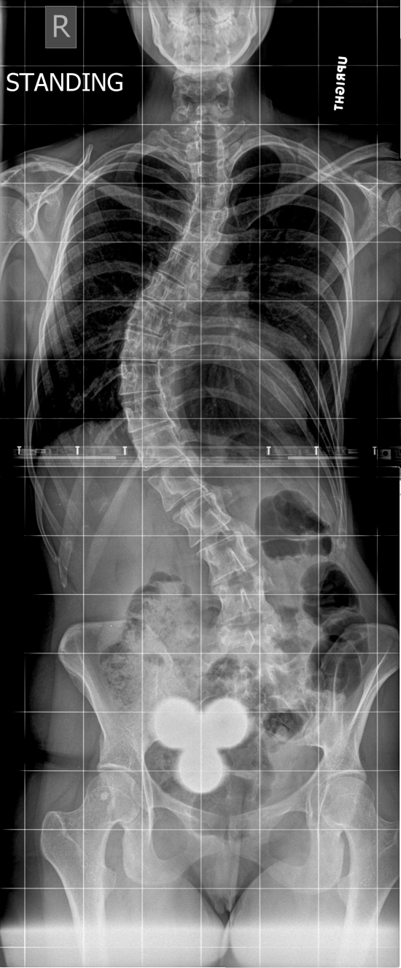
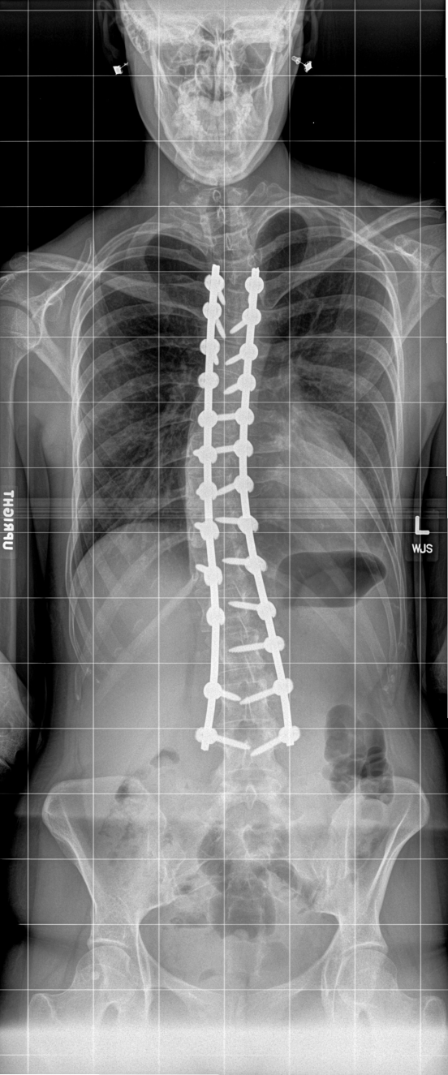
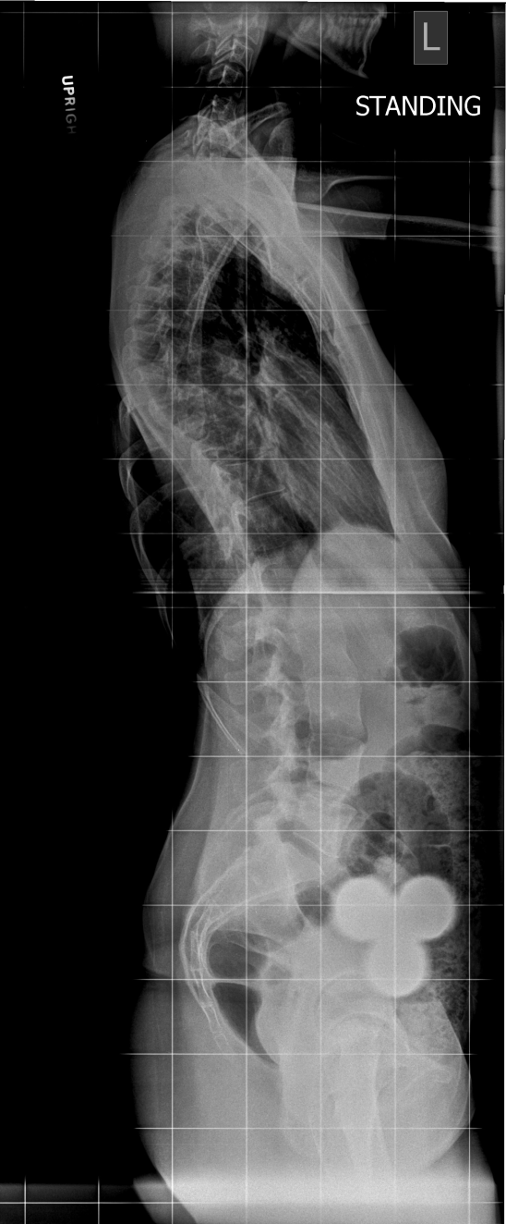
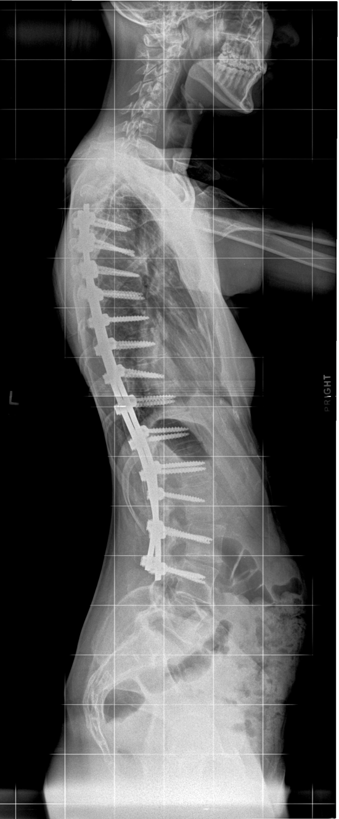
Spine Neurosurgery
Case Illustration #3
28 yo female presents with history of scoliosis and back pain.

Slide 9
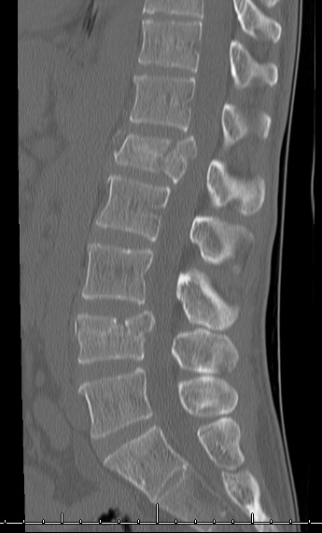
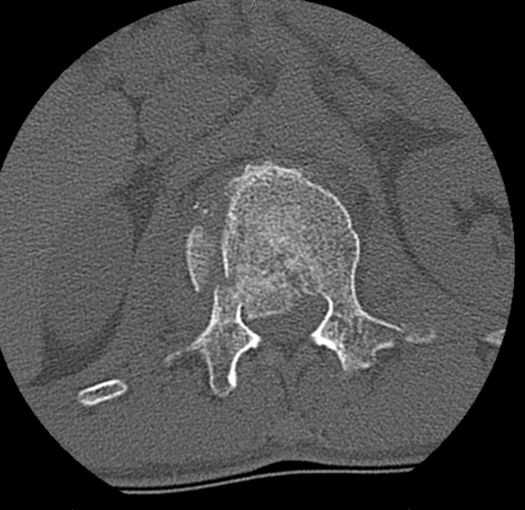
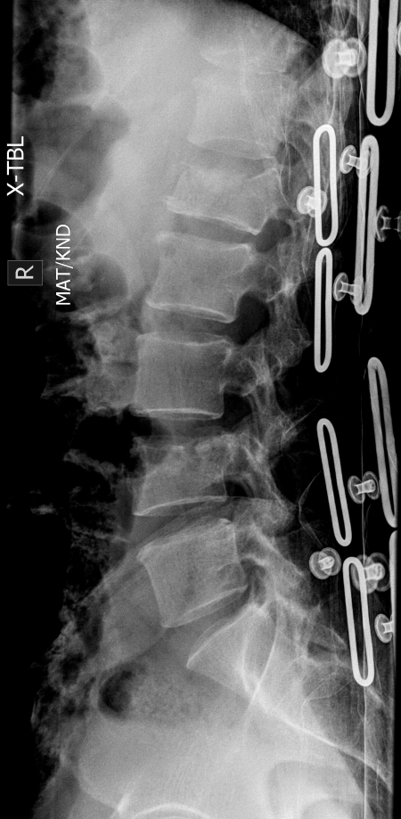
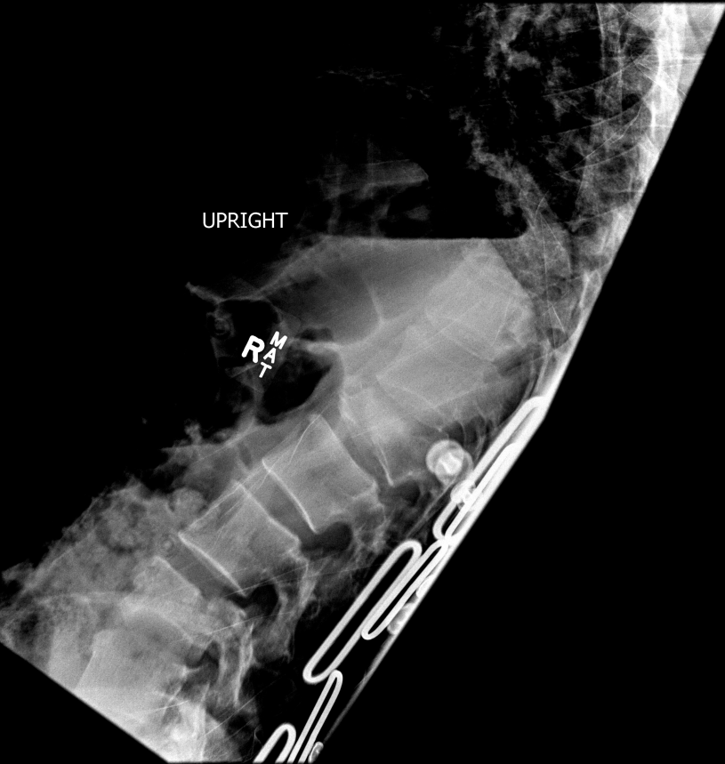
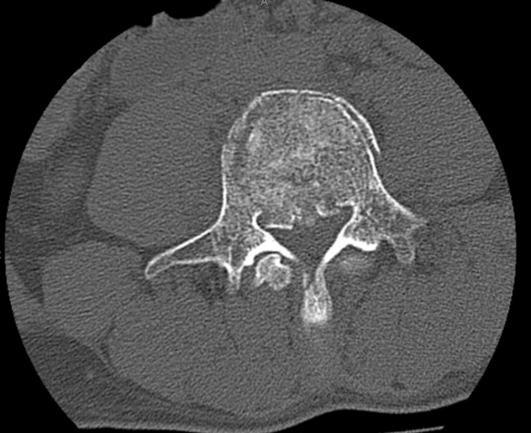
Spine Neurosurgery
Case Illustration #4
40 yo fell from a height. L1 and L4 burst fractures. Standing upright with a brace resulted in kyphosis and leg numbness consistent with acute instability

Slide 10
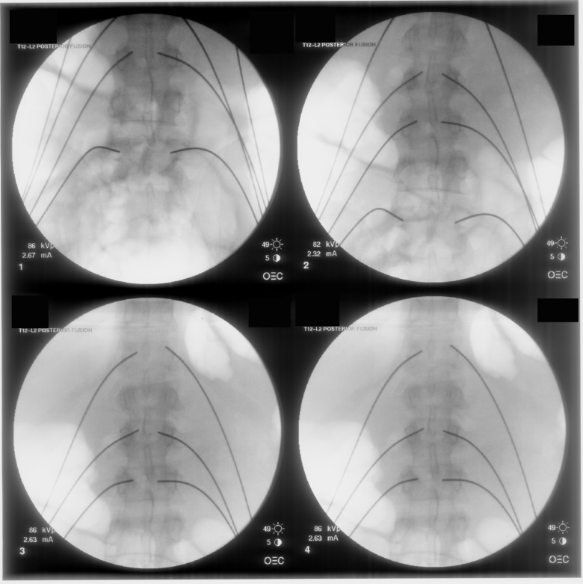
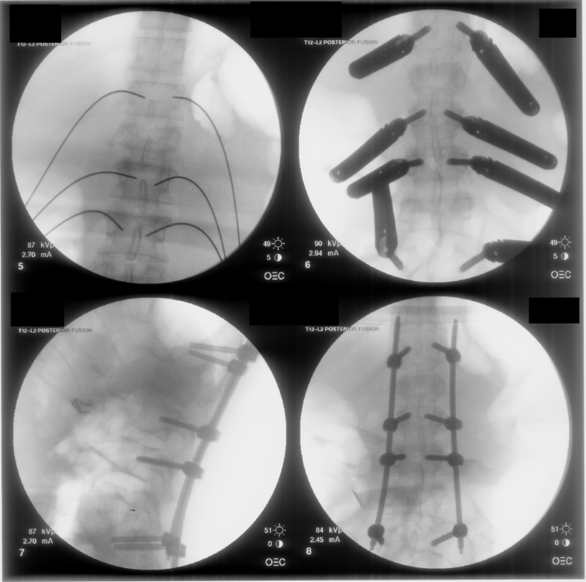
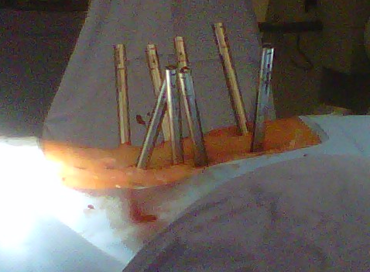
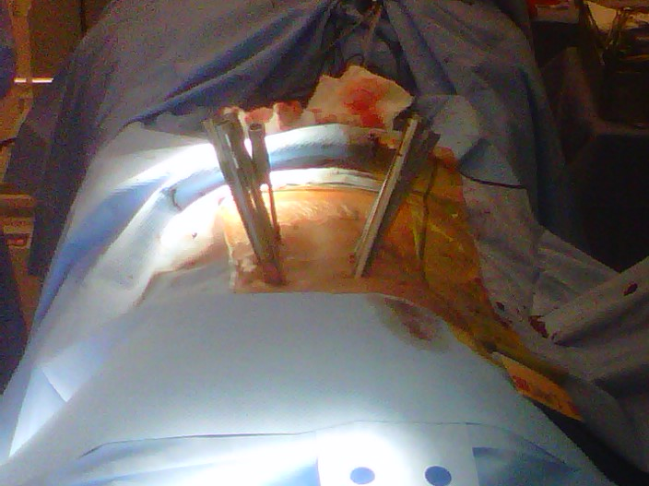
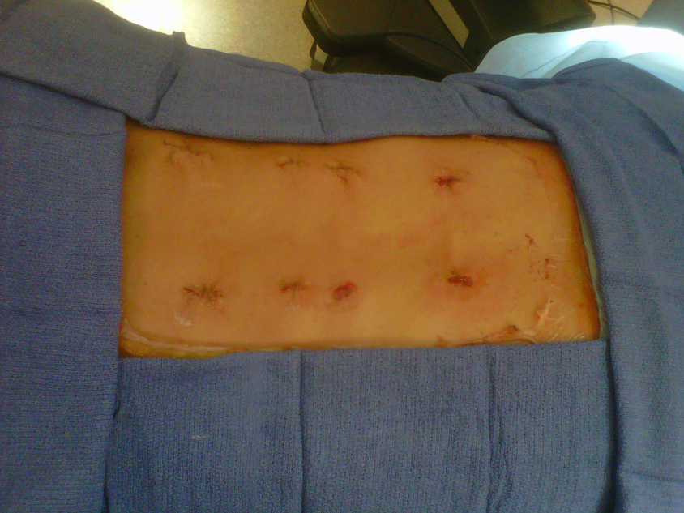
Spine Neurosurgery
Case Illustration #4
Minimally invasive, percutaneous stabilization across both fractures
Guidewire insertion
Cannulated screw placement
Percutaneous connecting rod placement
Closure of 8 x 1 cm incisions

Slide 11
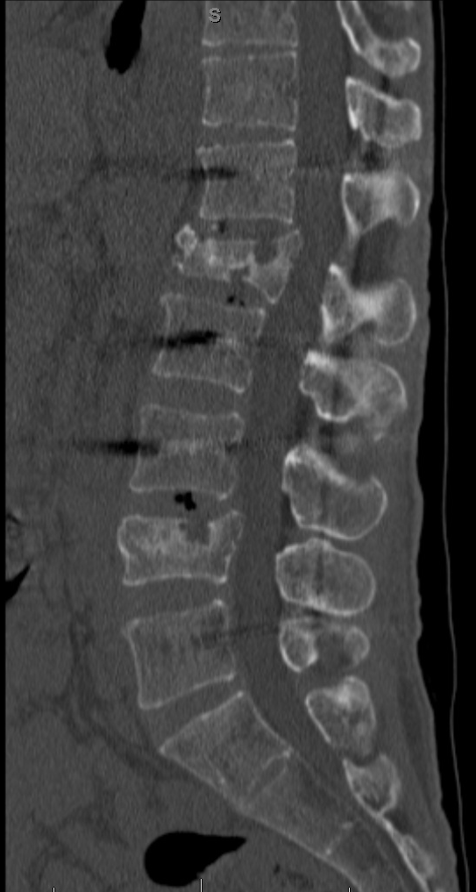
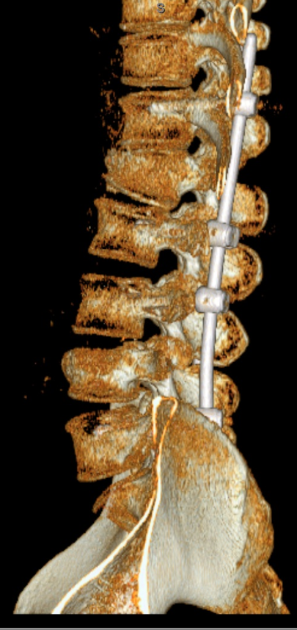
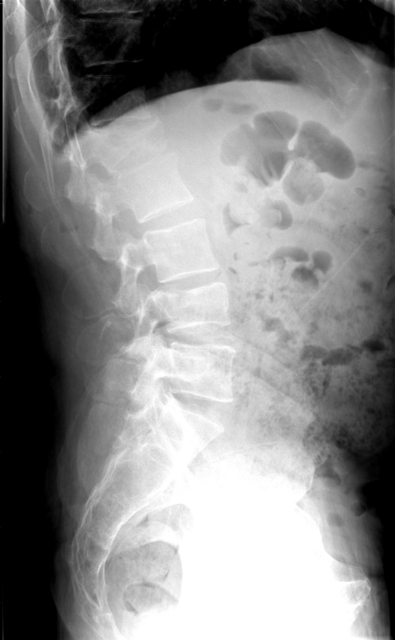
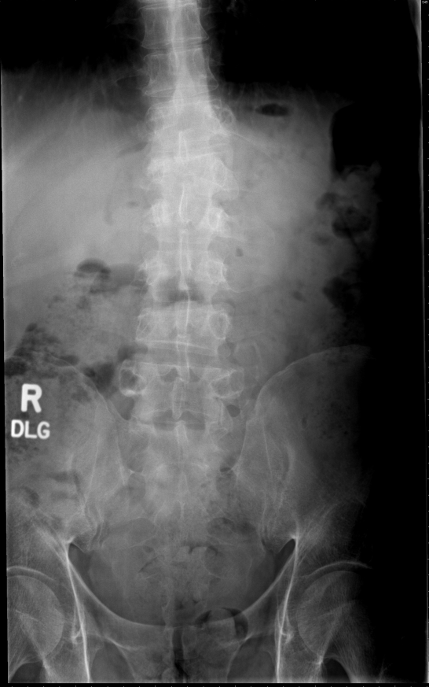
Spine Neurosurgery
Case Illustration #4
>4 months postop shows healing of both fractures. Screw and rods removed.

Slide 12
Peripheral Nerve Neurosurgery
Peripheral nerve neurosurgeons treat patients with:
  Carpal tunnel syndrome
  Ulnar nerve entrapment
  Brachial plexus injury
  Other peripheral nerve injuries

Slide 13
Peripheral Nerve Neurosurgery
Neurosurgeons, orthopedic surgeons, and plastic surgeons specialize in peripheral nerve surgery
Fellowship for peripheral nerve neurosurgery is not required but some may opt for specialized training via fellowship

Slide 14
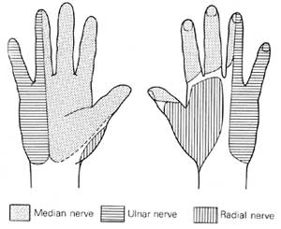
Carpal Tunnel Syndrome
Most common peripheral nerve entrapment neuropathy
Compression of the median nerve at the level of the wrist (flexor retinaculum)
Nocturnal symptoms of having to “shake out hands”; sensory loss/pain in palmar aspect of hands

Slide 15
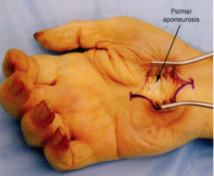
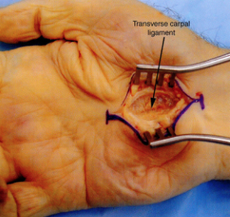
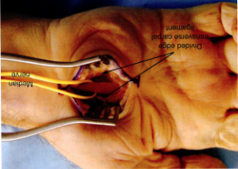
Carpal Tunnel Syndrome

Slide 16
Cubital Tunnel Syndrome
Second most common peripheral nerve entrapment neuropathy
4th and 5th digit numbness and hand weakness
McGowan classification
  Grade 1 – Minimal; parasthesias and numbness present, but no weakness
  Grade 2 – Intermediate; wasting of interosseous muscles
  Grade 3 – Severe; complete intrinsic paralysis

Slide 17
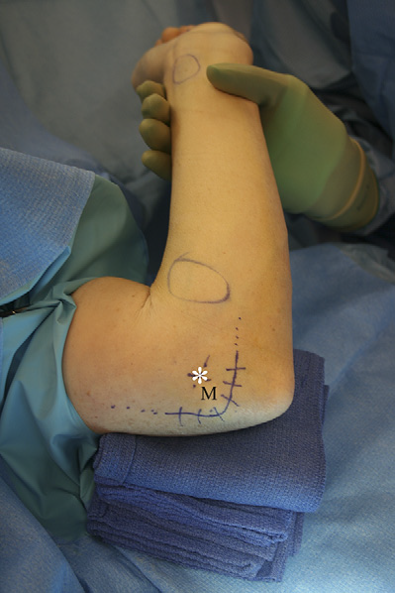
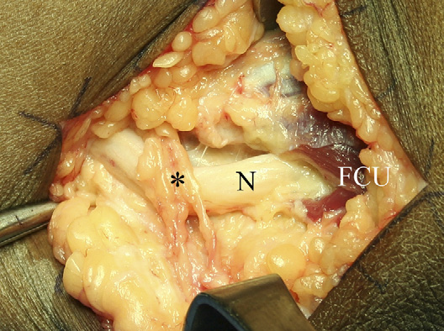
Cubital Tunnel Syndrome
MABC

Slide 18
Nerve Transfers
Utilize redundant or less critical nerve function to reinnervate more critical denervated/injured target muscles
Transform proximal injuries to a more distal injury by placing regenerating axons closer to the denervated motor endplates

Slide 19
Nerve Transfers
Most common nerve transfers
  Elbow-flexion
    Oberlin procedure (ulnar fascicle to biceps) or double fascicular transfer (median/ulnar fascicle to biceps and brachialis)
  Shoulder abduction
    Triceps to axillary and spinal accessory to supraspinatus

Slide 20
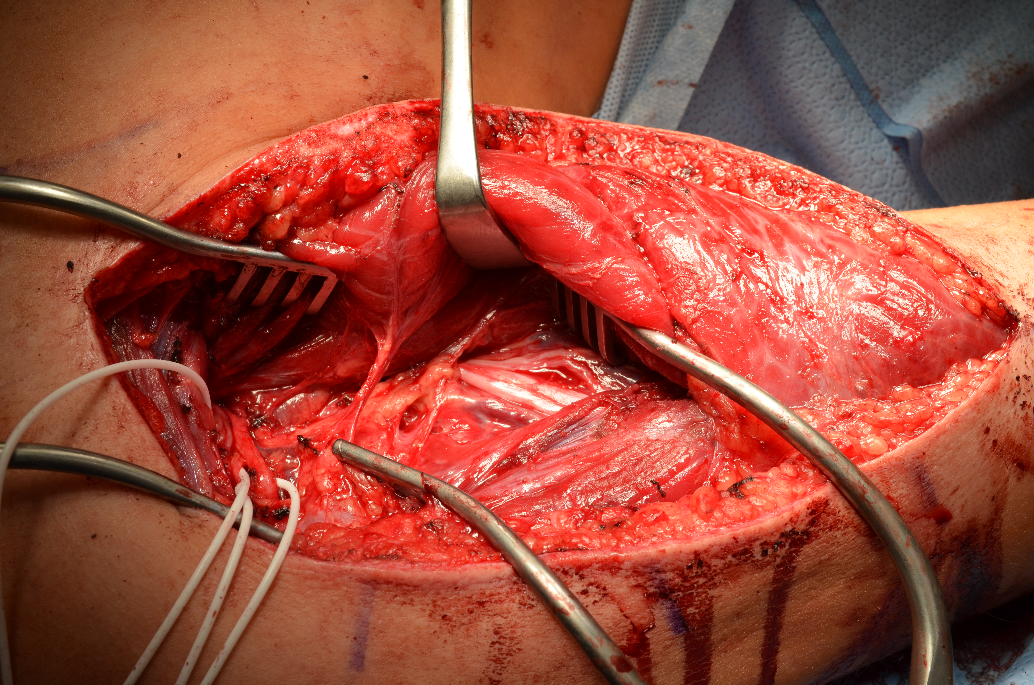
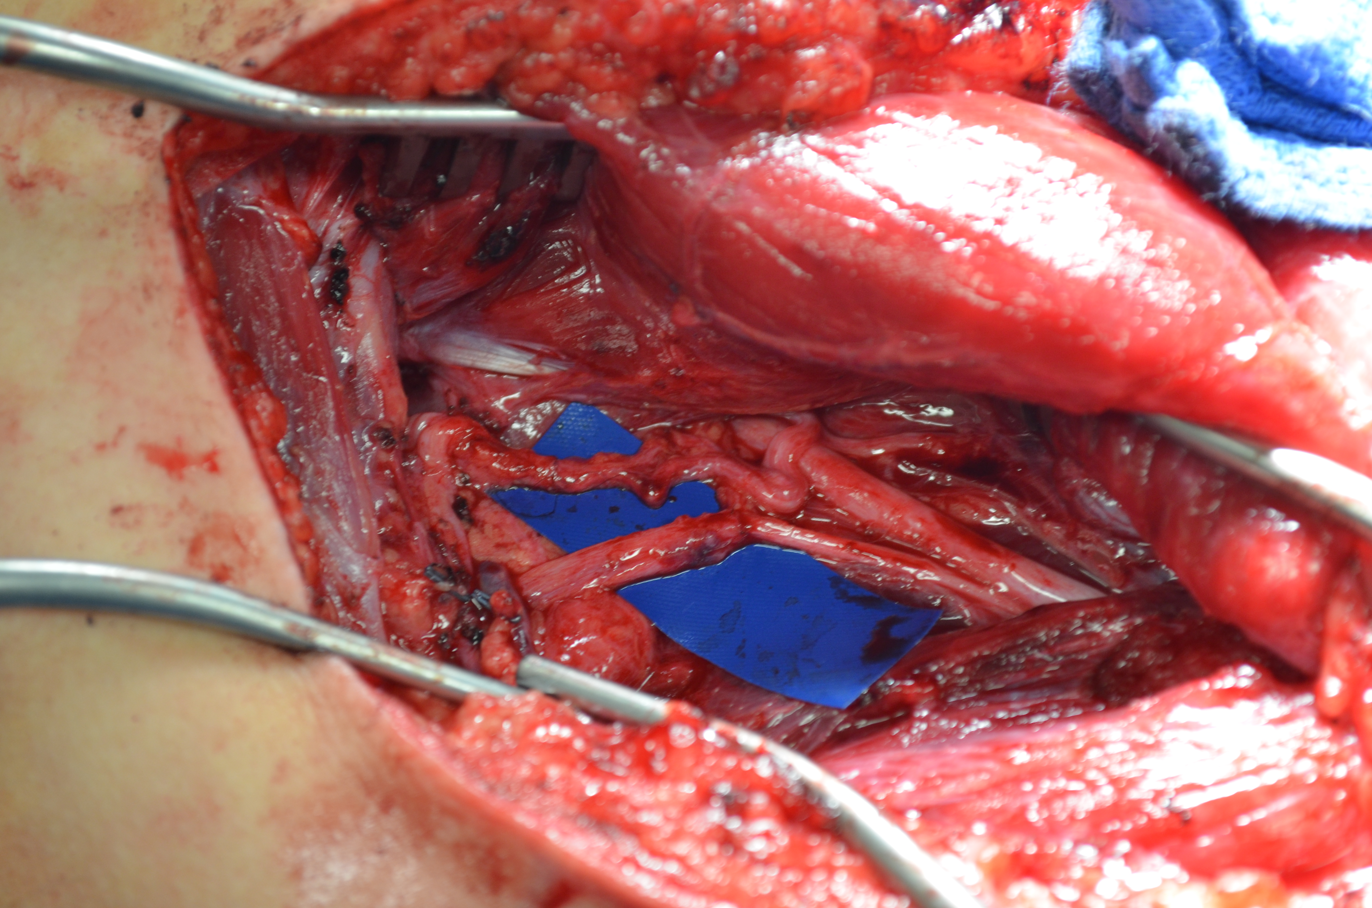
Triceps to Axillary
(n) Axillary
(n) Triceps
(n) Triceps
(n) Axillary

Slide 21
Conclusions
Surgery of the spine plays a large role in the field of neurosurgery
Even within the subspecialty of spinal surgery, there are several further subspecialties, including trauma, degenerative spine disease, and spinal oncology
Peripheral nerve surgery is a relatively smaller subspecialty but can provide pain relief and improved function for many patients

