Slide 1
Quality in Neurosurgery
Chris Zacko MS MD FAANS
Director of Neurocritical Care
Vice Chair of Quality and Patient Safety
Surgical Director of Perioperative Medicine
Associate Professor of Neurosurgery

Slide 2
No disclosures

Slide 4
INCREASED ATTENTION
Increased regulatory and economic pressure
Value based care
Publications
Notes:
Regulatory pressure, seeking cost-effectiveness

Slide 5
Current Tools
Clinical databases
“Big data”, National and Regional clinical registries
TD ABC (Time-Driven Activity-Based Costing)
Comprehensive Unit-based Safety Program
NeuroPoint Alliance

Slide 6
NeuroPoint Alliance
Established 2008 to improve the quality of neurosurgical care through the acquisition, analysis and reporting of clinical data via registries and related studies
Quality Outcomes Database (QOD)
Lumbar, cervical, deformity, neurovascular modules
Also funds small studies and quality initiatives
Collaboration with other organizations

Slide 7
NEUROSURGERY AS LEADERS IN QUALITY

Slide 8
ADVANTAGES
Less faculty, less residents
High-energy, highly effective, highly-intelligent people
Other people are either scared or confused by what we do

Slide 9
DISADVANTAGES
High-energy, highly effective, highly-intelligent people
High-risk patient population

Slide 10
PSU SUCCESSES

Slide 11
PSU RECIPE FOR SUCCESS
Be present and engaged on hospital committees
Build up “social capital”
Transparency with frequent faculty/resident updates
ICU-based projects
Mesh with organizational goals
More staff for ‘attention to detail”
Can do the work for others
Pick your battles
Proactive and pre-emptive

Slide 12
REACTIVE

Slide 13
CAUTI
Rate 1.71 since May 2017
 | 2011 | 2012 | 2013 | 2014 | 2015 | 2016 | 2017 | 2018
# | 31 | 23 | 9 | 6 | 5 | 3 | 4 | 0

Slide 14
Observed/Expected (O/E) Mortality Ratio
2014
1.26 and ranked 95th/124

Slide 15
Action Plan
Clinical Documentation Improvement (CDI) liaisons at rounds
Top 25 DRG’s tip cards
Identify missed opportunities
Better use of hospice
Chart reviews
Continue to refine evidence-based treatment paradigms

Slide 16
Observed/Expected (O/E) Mortality Ratio
2014
1.26 and ranked 95/124
2017
0.57 and ranked 10th/124

Slide 17
CUSP
Comprehensive Unit-based Safety Program for Mechanically Ventilated Patients and Ventilator-associated Pneumonia (CUSP4MVP-VAP)
NCCU’s 12 month commitment to participate in the journey with CUSP4MVP-VAP began on September 8th, 2015.
Goal of CUSP4MVP-VAP
Improve outcomes for ventilated patients
Initiative focused on:
Daily care processes
Early mobility
Low tidal volume ventilation
Notes:
Neuroscience Critical Care Unit (NCCU) had a total of 10 VAPs and 51 VAEs attributed to the unit for CY14
To decrease ventilator harm, NCCU made a 12 month commitment to participate in the Comprehensive Unit-based Safety Program for Mechanically Ventilated Patients and Ventilator-associated Pneumonia (CUSP4MVP-VAP)

Slide 18
CUSP SUCCESSES
Monthly HOB compliance rate sustained at 100%
SATs and SBTs now tasked daily at 0500 for all ventilated patients to all Respiratory Therapists
NCCU (HSOPS) results improved in 8 out of 12 categories
Compliance rate of SBTs performed with sedation off sustained at 100% from Jan 2016 to Aug. 2016
Family Involvement Menu initiated by NCCU Integrated Nursing Council in Aug. 2016
38% decrease in VAEs occurred from Sept. 2015 –Sept. 2016,
57% decrease in VAPs occurred from Sept. 2015 –Sept. 2016, since only 2 VAPs
Reduced unplanned extubations and re-intubation

Slide 19
PICKING YOUR BATTLES…

Slide 20
Surgical Site Infections
12
0.57
Notes:
April 2017

Slide 22
PRE-EMPTIVE AND PROACTIVE

Slide 23
External Ventricular Drain Infections
January – August 2015:
7 EVD infections
Rate 14%
Instituted a new EVD insertion bundle

Slide 24
Penn State Health EVD Insertion Protocol
Hand hygiene
Door closed in procedure room
Skin shaved to accommodate bandage
Skin prepped and dried for 3 minutes
Full body drapes
BACTISEAL catheter
Tunneled >5cm
BioPatch
Tegaderm occlusive dressing

Slide 25
EVD Results
August 2015 to February 2018 without an EVD infection
February credited with an infection that was deemed a contaminate in 28 months

Slide 26
Neurocritical Care Transition Project
Provide support services for patients with resolving critical illness
Transitions of care are vulnerable times
~10% of patients require readmission during the same hospital stay
ICU readmissions expose patients to increased risk as transfers between healthcare professionals have been linked to a fourfold higher mortality rate and longer hospital stays.
Not to mention the unnecessary tests and procedures

Slide 27
INTERVENTION
All patients admitted >24h will be evaluation by a Neurocritical Care APC
PROCESS
Decision to downgrade
Transfer Note and Verbal Signout
Evaluate patient 48-72h after discharge from ICU
Follow Up Note with verbal discussion

Slide 28
Primary Goal
To improve the quality of care delivered to patients no longer requiring services in the Neurocritical Care Unit (NCCU).

Slide 29
Secondary Goals
Improve patient/family satisfaction
Improve communication between clinical staff and patient/family
Decrease hospital length of stay (LOS)
Decrease mortality
Provide early detection and management of clinical deterioration
Facilitate continuity of care
Improve utilization of the NCCU by reviewing goals of care to ensure that treatment plans are consistent with the patients clinical circumstances and preferences
Decrease readmission to ICU

Slide 30
REVIEW

Slide 32
PSU RECIPE FOR SUCCESS
Be present and engaged on hospital committees
Build up “social capital”
Transparency with frequent faculty/resident updates
ICU-based projects
Mesh with organizational goals
More staff for ‘attention to detail”
Can do the work for others
Pick your battles
Proactive and pre-emptive

Slide 33
FUTURE STATE
Continue to publish on issues such as Overlapping Surgery etc
Guidelines
National databases and registries
NeuroPoint Alliance
Evaluate recommendations by the Joint Commission, Leapfrog etc

Slide 34
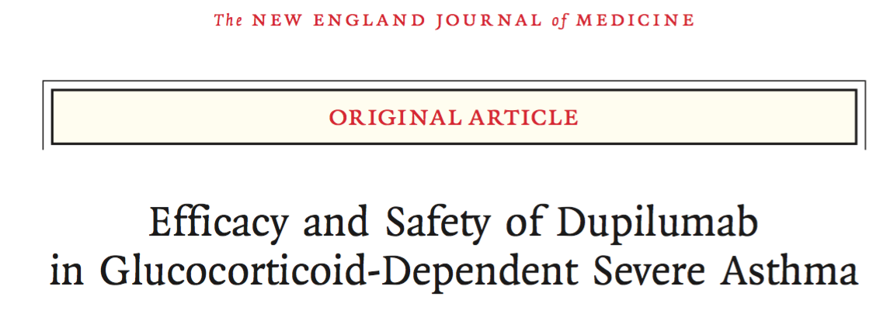
The Joint Commission:
Making Things Up One Visit At A Time

