Slide 1
Residency: Leadership
Roland D. Eavey, MD, SM
Director, Vanderbilt Bill Wilkerson Center
Guy Maness Professor and Chair of Otolaryngology
Executive Medical Director, VUMC Health Plan and Population Health

Slide 2
Disclosure
No Financial
Just want to disclose that I am grateful ☺

Slide 3
Residency Leadership Training
Why
What
How

Slide 4
WHY
“Imagine that you have just been told that you have a diagnosis of CANCER.”

Slide 5
WHY
Definition of “Doctor”

Slide 6
WHY
Leader
Teacher

Slide 7
WHAT
Military Leadership
Public Speaking
Micro-MBA
Capstone: Prevention and Population Health

Slide 8
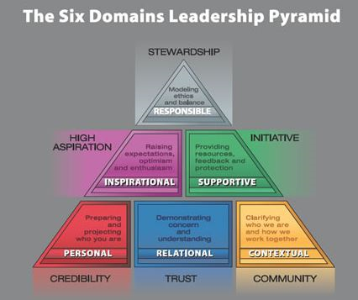

Slide 9
Public Speaking
Evaluate: TED talks/speeches
Elements: Your story, Your point
Body: Posture, Projection, Gestures
PowerPoint Tips
Give 3 talks: Culture of helpful critique; NO criticism

Slide 10
Micro-MBA
Organizational Behavior: Pyramid - Servant Leader
Conflict Management
Decision Making
Strategy
Operations Management
Finance: Funds Flow
CV vs. Resume/Contracts

Slide 11
Expose to Leaders
External: AMA, Partners, Permanente, Press-Ganey…..
Internal: CEO of Hospitals & Clinics, CFO, COO

Slide 12
Prevention & Population Health

Slide 15
HOW
Four year program: PGY 2-5
Sessions: SUBSTITUTION, not addition
Always Residents, Sometimes faculty

Slide 16
Awareness
NEJM/HBR Blog
HBR article
West Point
Other programs

Slide 17
Vanderbilt Otolaryngology Residency Training
WHY
What
How

Slide 18
THANK YOU!

