Slide 1
Neurosurgery Research Career Development Program (NRCDP)
Emad Eskandar, MD
Director Functional Neurosurgery
Director Residency Program
Massachusetts General Hospital
Associate Professor
Harvard Medical School

Slide 2
What Is It?
A National NIH Funded Program
K12 funding mechanism
Provides two to three years of support
Two candidates receive award annually
$95,000 for salary
$50,000 for supplies

Slide 3
Who Is Eligible?
Junior faculty members within one year of finishing residency or fellowship
Any academic program in the United States
Established mentor
50% effort dedicated to research
Letter of Support from department chair

Slide 4
Why is this different?
Parent K12 grant has already been awarded and mechanism is in place
National Advisory Committee (review panel) is made up primarily of neurosurgeons
Panel is more attuned to particular needs and challenges of neurosurgical research compared to traditional NIH study sections
Unique opportunity to demonstrate quality and value of neurosurgical research

Slide 5
Who is on the Committee?
Aviva Abosch, MD, PhD University of Colorado
Sepideh Amin Hanjani MD University of Illinois
Mitchel Berger, MD UCSF
Nicholas Boulis, MD PhD Emory University
Nino Chiocca, MD PhD BWH / Harvard
Ralph Dacey, MD PhD Washington University
Suzanne Haber PhD University of Rochester
Linda Liau, MD, PhD UCLA
Robert Martuza, MD MGH / Harvard
Gary Mathern, MD UCLA
Nelson Oyesiku, MD Emory University
Alfredo Quinones, MD Johns Hopkins University
Gerold Vitek, MD, PhD University of Minnesota
THANK YOU!

Slide 6
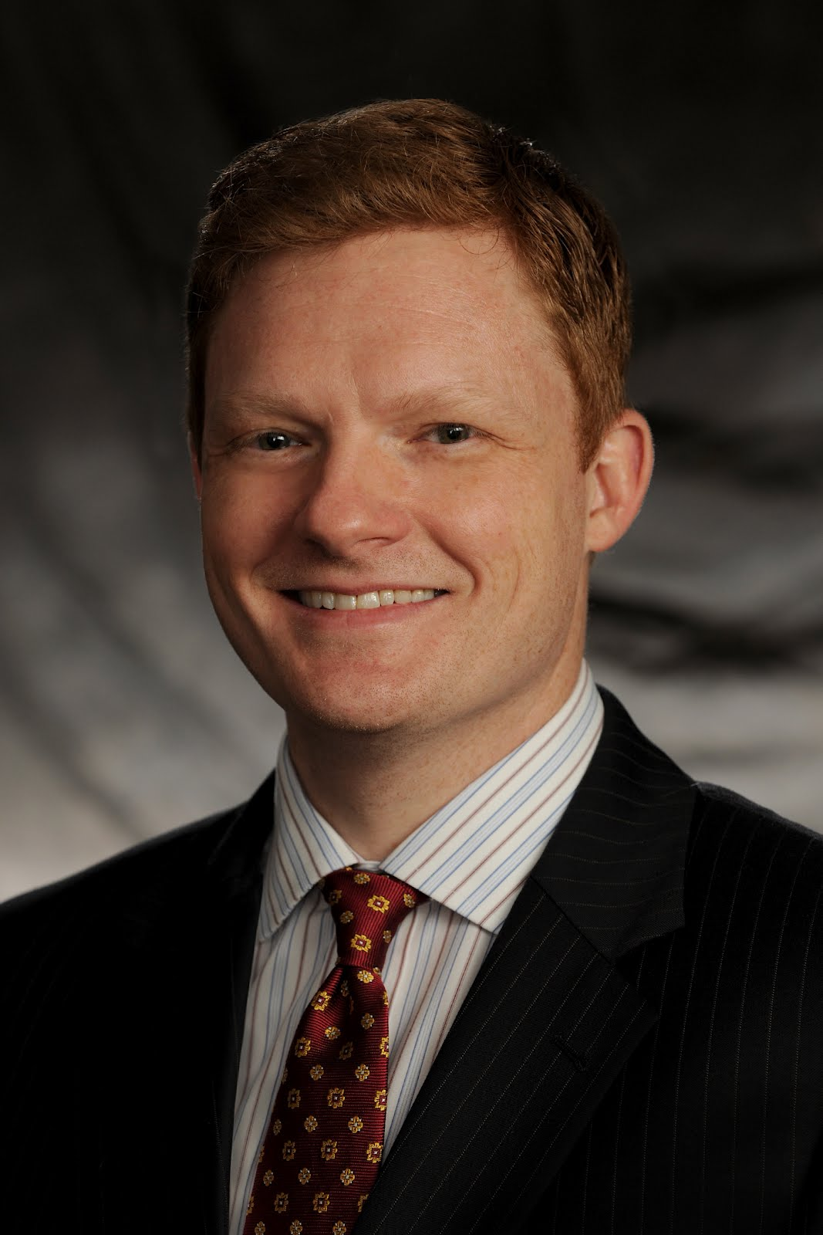
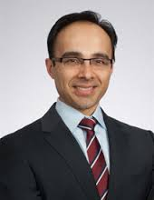
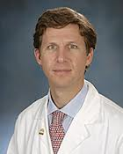
Who was Awarded in 2012?
Timothy Lucas, MD PhD
University of Pennsylvania
Chairman: Sean Grady, MD
Sameer Sheth, MD PhD
Columbia University
Chairman: Robert Solomon, MD
Graeme Woodworth, MD
University of Maryland
Chairman: Howard Eisenberg, MD
Thanks to the Chairs for their support

Slide 7
How Does One Apply?
Application deadline is October 1st, 2013
Email: eeskandar@partners.org
Google: NRCDP
Website: http://www.neurocdp.org

Slide 8
How Does One Apply?

Slide 9
Conclusions
NRCDP is unique funding mechanism dedicated to junior neurosurgeon scientists
NRCDP is an excellent way to start promising young neurosurgeons on their academic careers
Please direct junior faculty members to apply

Slide 10
Questions

