Slide 1
Training the Current Generation
Alex Spiotta, MD
Medical University of South Carolina

Slide 2
Training the Current Generation
Challenges
Alex Spiotta, MD
Medical University of South Carolina

Slide 4
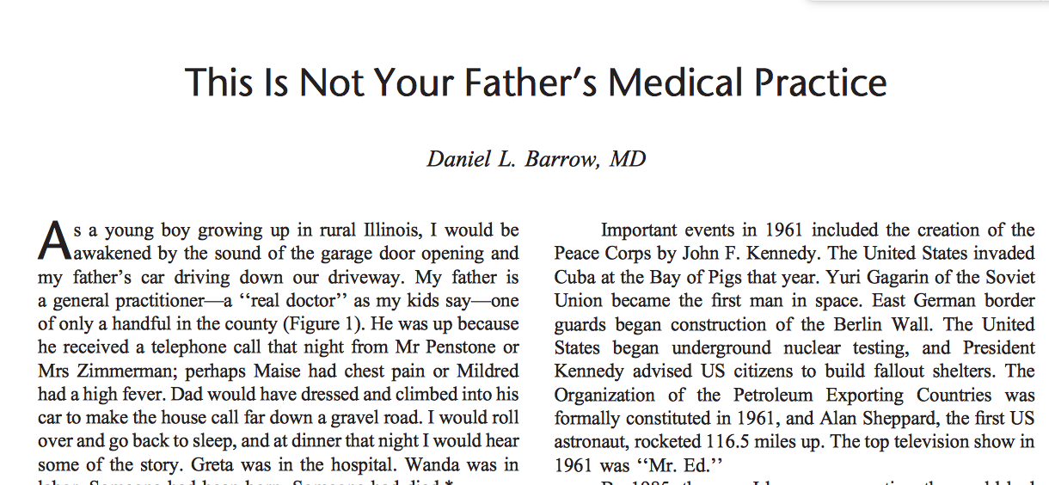

Slide 5
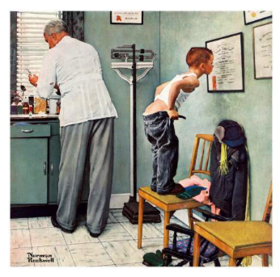
This is not your Program Director’s Residency Program

Slide 6
Case 1
Unprepared resident shows up to the O.R., resident consented patient for the wrong procedure, didn’t get a history or examine the patient, and hasn’t read up on the relevant anatomy.
The resident is told to leave the O.R. by the attending.

Slide 7
Case 1 outcome: Does Resident…
A) Vow to never let this happen again and make a list of ways to earn the trust and respect of their faculty and colleagues
B) Go directly to the GME office and file a complaint that the faculty member is interfering with their education

Slide 8
Case 1 outcome: Does Resident…
A) Vow to never let this happen again and make a list of ways to earn the trust and respect of their faculty and colleagues
B) Go directly to the GME office and file a complaint that the faculty member is interfering with their education

Slide 9
Case 2
Junior resident has been slacking on service, not following up on results, skipping patients on rounds, calling about consults without formulating a plan.
Chief resident calls resident out: telling junior resident to ‘up their game’

Slide 10
Case 2 outcome: Does Resident…
A) Contemplate on the feedback provided by their upper level resident, reflect on ways to improve their performance, make a list of ways to earn the trust and respect of their faculty and colleagues
B) Report to PD that the chief residents are promoting a negative work environment.

Slide 11
Case 2 outcome: Does Resident…
A) Contemplate on the feedback provided by their upper level resident, reflect on ways to improve their performance, make a list of ways to earn the trust and respect of their faculty and colleagues
B) Report to PD that the chief residents are promoting a negative work environment.

Slide 12
Case 3
Junior residents provide feedback to PD that they wish to have more education provided in the form of lectures.
PD requests a list of topics and agrees to support the request, but reminds residents that independent learning is a lifelong process and that faculty cannot teach them all there is to learn about Neurosurgery.

Slide 13
Case 3 outcome: Do Residents…
A) Provide a list of topics and suggested faculty, reassure PD that independent reading/learning is part of their professionalism and needed for the rest of their careers.
B) State that there is too much to be learned, they don’t know where to begin, they need a curriculum and to be told what they need to study.

Slide 14
Case 3 outcome: Do Residents…
A) Provide a list of topics and suggested faculty, reassure PD that independent reading/learning is part of their professionalism and needed for the rest of their careers.
B) State that there is too much to be learned, they don’t know where to begin, they need a curriculum and to be told what they need to study.

Slide 15
Intrinsic Generational Considerations: Baby Boomers vs. Millennials

Slide 16
Disclosures
I have adapted my approach to teaching the current Generation
I am an optimistic person
I will generalize on generational philosophies
I was born in 1979

Slide 17
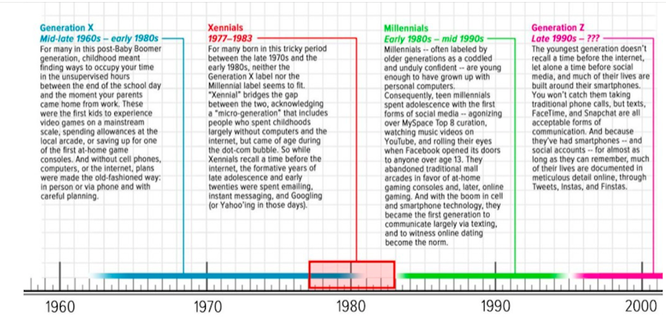

Slide 18
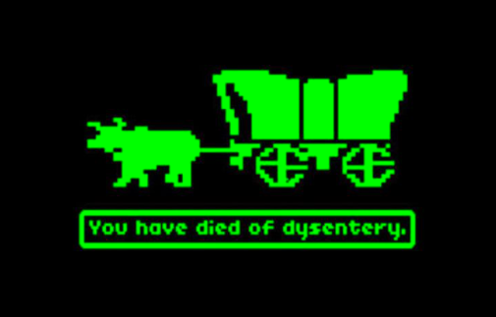
Xennials: the ‘microgeneration’ between gen-Xers and millennials
Born 1977 - 1982
Raised in Analog era / Early adulthood in Digital era

Slide 19
Xennials: What it really means
I didn’t grow up with technology, but I’m comfortable with it.
I ran loose as a child, without any real fear of predators, prescription drugs, or being cyber bullied
My parents used me as free labor and didn’t feel bad about it.
We were spanked (and don’t all need therapists).
My parents never gave me the impression that the world revolved around me.
We only got trophies if we won at a competition

Slide 20
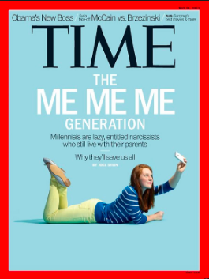
Millennial Generation (1983-2000)
Largest Generation, born to Baby Boomers/ Gen X
Will comprise more than 1/3 of adult Americans by 2020
Will make up as much as 75% of the
U.S. workforce by 2025

Slide 21
What are Millennials…?

Slide 22
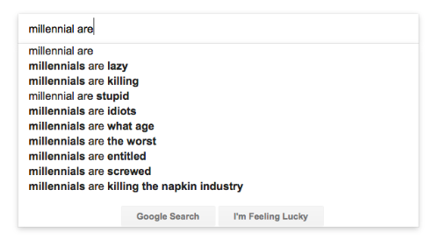
What are Millennials…?

Slide 23
Millennial Generation (1983-2000) Events that Shaped them
Terrorist attack of September 11
Media coverage of school mass shootings
Great Recession
Stock market crash
Foreclosure crisis
High levels of unemployment among young people
Rise of social media and full integration of technology into daily life.

Slide 24
Millennial Generation (1983-2000)
Middle class millennials had extremely busy, planned lives; multiple extracurricular activities organized by their ‘helicopter parents’
Very little downtime just ‘to play’ with friends.
In school or athletic competition, participation, rather than performance was awarded

Slide 25
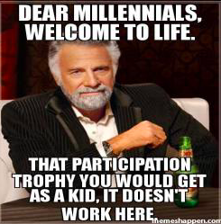

Slide 27
Millennial Generation (1983-2000)
Traits:
Confidence (often perceived as narcissistic)
Entitled individuals
Hard to manage
More tolerant on social issues
Values:
close family ties, team orientation, social responsibility, technology, and having fun at work.

Slide 28
Millennial Generation (1983-2000)
‘Instant gratification’

Slide 29
Baby Boomer / Millennial (1946-1964) (1983-2000)
Work/Career Life philosophies are diametrically opposed
Amplified: Neurosurgery

Slide 30
Baby Boomer | Millennial

Slide 31
Baby Boomer | Millennial
Driven, strong work ethic | Fiercely Independent, ambitious but lacking focus

Slide 32
Baby Boomer | Millennial
Driven, strong work ethic | Fiercely Independent, ambitious but lacking focus
“Live to work”: work is a career | “Work to live”: work is a means to an end

Slide 33
Baby Boomer | Millennial
Driven, strong work ethic | Fiercely Independent, ambitious but lacking focus
“Live to work”: work is a career | “Work to live”: work is a means to an end
Work long hours to establish self- worth, identity and fulfillment | Focus is children and family, life experiences (travel…etc)

Slide 34
Baby Boomer | Millennial
Driven, strong work ethic | Fiercely Independent, ambitious but lacking focus
“Live to work”: work is a career | “Work to live”: work is a means to an end
Work long hours to establish self- worth, identity and fulfillment | Focus is children and family, life experiences (travel…etc)
Workaholics who invented the >60 hr work week. Visibility at workplace is the key (arrive early, stay late) Value time devoted. | Effective workers but gone at 5PM sharp. View work as a “gig” or something that fills the time between weekends. Value efficiency over time devoted.

Slide 35
Baby Boomer | Millennial
Patient, Value “putting in the time” | Impatient, Value immediate results. See as a sign of disrespect any requirement to do things just because this is the way it has always been done or to pay one’s dues

Slide 36
Baby Boomer | Millennial
Patient, Value “putting in the time” | Impatient, Value immediate results. See as a sign of disrespect any requirement to do things just because this is the way it has always been done or to pay one’s dues
Loyal to careers and employers | “Me First“ attitude in work life. Strong sense of entitlement. Self-absorbed.

Slide 37
Baby Boomer | Millennial
Patient, Value “putting in the time” | Impatient, Value immediate results. See as a sign of disrespect any requirement to do things just because this is the way it has always been done or to pay one’s dues
Loyal to careers and employers | “Me First“ attitude in work life. Strong sense of entitlement. Self-absorbed.
Traditional work environment | Friendly environments. Respond poorly to inflexible hierarchical organizations. Value flex time, job sharing, and sabbaticals.

Slide 38
Baby Boomer | Millennial
If I retire, who am I? My career defines me | I will likely retire early. I may want different experiences and may change careers. I may want to take a sabbatical to develop myself.

Slide 39
Generational Differences: Counter Argument
Top 1% applying to NSGY are equal across Generations

Slide 41
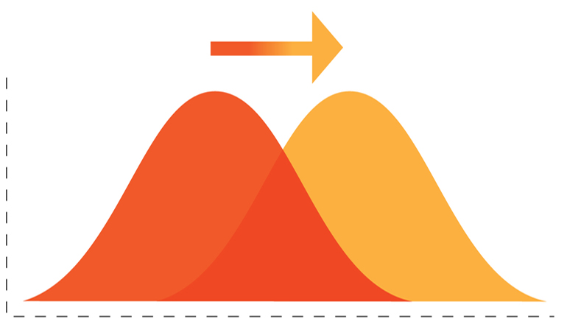
Top 1%

Slide 42
Why Different outlook on Work/Career?
Baby Boomers came of age during a time when diligently making your way up the corporate ladder was an approach that worked and was rewarded.
Millennials have grown up witnessing peers sacrificing and following the ’Rules towards Success’, with no reward at end.
Psychological toll of realizing that something you’d been told, and came to believe yourself, would be “worth it” — worth the loans, worth the time/labor— isn’t.

Slide 43
Why Different outlook on Work/Career?
Millennials generally believe the System is broken, and that prior generations are to Blame.

Slide 44
80 hr work week ≠ Normal Life Experience
Junior Resident structure:
0500 – 1900 ‘Work time’ (in hospital)
1900 – 0500 ‘Home’ mode (offline)
Spouses expect them home for dinner, every night
Make plans with friends, on a weeknight
Watch latest Game of Thrones episode
Fill these offline hours to create a sense of Normalcy

Slide 45
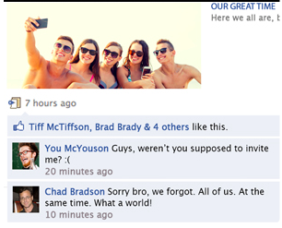
The new Keeping up with the Joneses

Slide 46
80 hr work week ≠ Normal Life Experience
What is not always happening:
Reading, preparing for tomorrow’s case
Written Board prep
Research
Writing manuscript

Slide 47
‘Wellness’ as Double Edge Sword
We must carefully monitor ourselves and how we message to the Next Generation
Nsgy Residency is no walk in the park

Slide 53
Resident Selection process
Attrition rates during Neurosurgery residency training have been stable at 15-20%

Slide 54
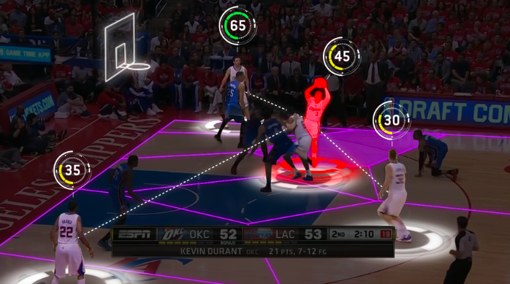
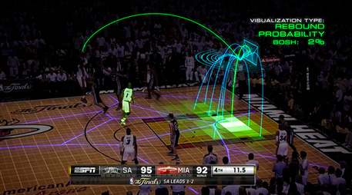
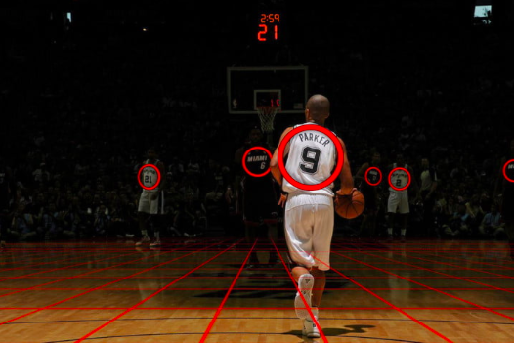

Slide 55
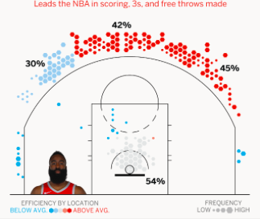
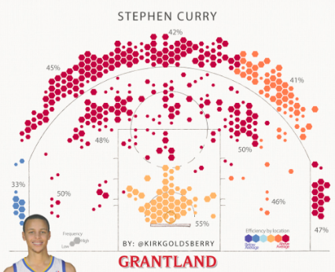

Slide 56
Attrition Rates
Our duty as neurosurgery resident educators is two-fold:
supporters, mentors and nurturers of individuals
and
protectors of patients and guardians of the subspecialty.

Slide 58
Attrition Rates: Goal should not be 100%
Resident attrition at Home Program
As PD, I felt ‘the heat’; poor reflection on program?
We must protect against this.
Only Neurosurgeons can determine who is fit to be a Neurosurgeon
Must maintain the highest of standards

Slide 59
Millennials are Savy
They ‘know their rights’
Anyone who uses the term ‘hostile work environment’ when referring to chief residents, knows their HR handbook
May use 80 hr work week as a trump card
They know they can ‘avenge’ program on ACGME survey
The ‘Power’ scales may become tipped

Slide 60
While Millennials are Savy on some topics…
They appear to need supervision in other areas…

Slide 61
I have Adapted my approach as PD
I must voice maxims that I took for granted
My Assumption: Adult learners that can prioritize, organize and follow through on independent learning
“Career prep doesn’t end at 80 hours”
“Set aside time in the evenings/weekends for Reading”
“You will not learn everything you need to learn in NSGY just by clocking in and out on clinical service”

Slide 62
I have Adapted my approach as PD
Feedback
Our Assumption: If you don’t hear anything you’re doing a good job
Immediate, specific, face – face
Negative and Positive
During/After every case, every consult, every patient update

Slide 63
Millennials

Slide 64
Try this at your program:
Scenario:
500k full time NSGY
Vs.
250k ½ time NSGY

Slide 65
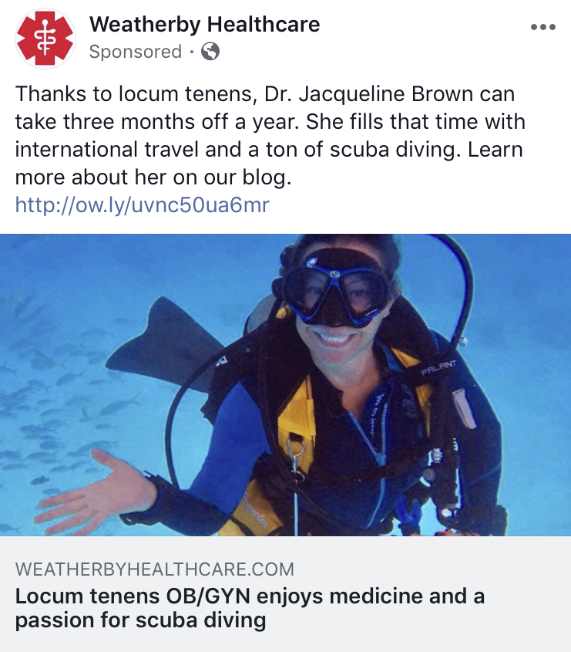

Slide 66
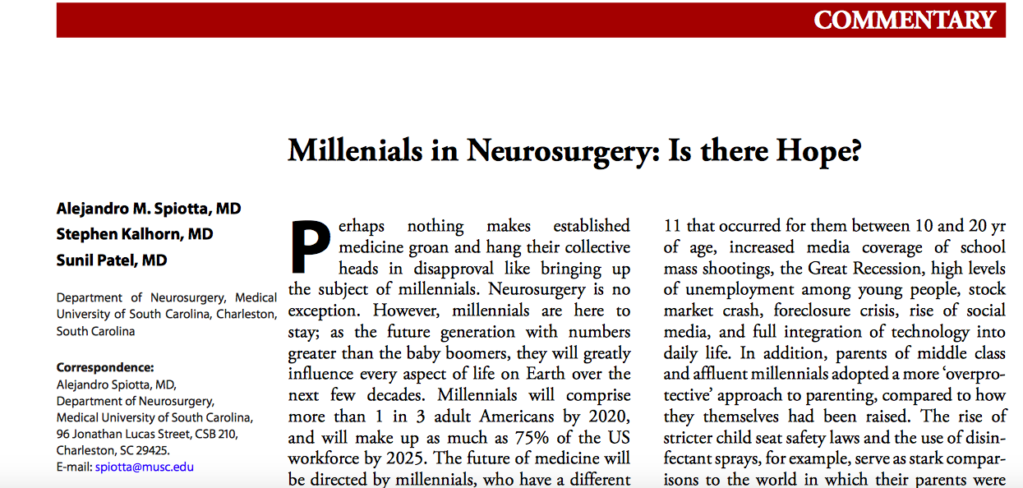

Slide 67
There is Hope…

Slide 68
There is Hope… (with our help)

Slide 69
Tech, Tech, Tech

Slide 70
What must be done?
Millennial: Destiny = Tech Advancements
All of Us: Duty = Mentorship / Inspiration

Slide 71
Shape their World View

Slide 72
These do not Inspire
RVUs
CAUTI
HCAPS
CPTs Bundling
EMR
etc etc

Slide 74
Professionalism Doctoring Patient Ownership

Slide 75
There is no Greater Joy, than working hard at work worth Doing.

Slide 76
There is no Greater Joy, than working hard at work worth Doing.
We just need to minimize the ’other stuff’

Slide 77
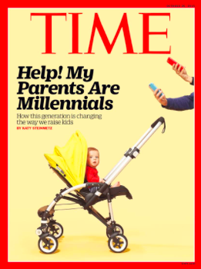

Slide 78
Thank you

